Slide 1
Assessing Vital Statistics
These materials have been developed by the National Center for Health Statistics, International Statistics Program, Hyattsville, Md., as part of the CDC Global Program for Civil Registration and Vital Statistics Improvement.
Notes:
A country’s vital statistics system should be periodically evaluated to see whether the needs of the system are being adequately met. Two major aspects should be examined: the quality of the resulting vital statistics and an evaluation of the overall CRVS system. We’ll look at different models that have been proposed for evaluation. As well, we’ll discuss the importance of evaluating the adequacy of government provisions for the CRVS system and the importance of system flexibility.

Slide 2
Outline
Adequacy of vital statistics
Quality of vital statistics
  Accuracy
  Timeliness
  Comparability
  Relevance
  Accessibility
ANACoD: a tool for Analyzing Mortality Levels & Cause of Death Data
SOURCES: NCHS, Unit 18.
Notes:
Notes:
A country’s vital statistics system should be periodically evaluated to see whether the needs of the system are being adequately met. Two major aspects should be examined: the quality of the resulting vital statistics and an evaluation of the overall CRVS system. We’ll look at different models that have been proposed for evaluation. As well, we’ll discuss the importance of evaluating the adequacy of government provisions for the CRVS system and the importance of system flexibility. Lastly, we’ll look at ANACoD, a tool that can be used to assess mortality data.

Slide 3
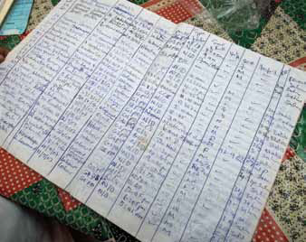
Adequacy of Vital Statistics
  Good statistical systems are:
  efficient, credible, objective
  Adequacy of statistics:
  Data content
  Tabulations
  Availability of population data for rate computation
  Quality of vital statistics data
Register of births. Panos/Jenny Matthews.
SOURCES: NCHS, Unit 18; Mahapatra.
Notes:
Notes:
Good statistical systems should meet the information needs of their users in an efficient, credible, and objective manner. The adequacy of statistics can be examined with respect to….
Data content: vital statistics should include all the information items necessary to meet all important needs of the users; one way to evaluate this aspects is to check against the UN recommendations.
Tabulations: Statistics need to be appropriately tabulated with sufficient details to meet the user needs; check against UN recommendations.
Population data: As reliable population data for current years are necessary requirements for computation of demographic rates, it is necessary to make such population estimates a part of a vital statistics system.
We will examine the components that assess the quality of vital statistics data in more detail.

Slide 4

Quality of Vital Statistics
  Quality of vital statistics data
  Accuracy
  Timeliness
  Comparability
  Relevance
  Accessibility
Data manager. WHO/Evelyn Hockstein.
SOURCES: NCHS, Unit 18; Mahapatra.
Notes:
Notes: These are the general criteria used to judge the quality of vital statistics data.

Slide 5
Mahapatra et al. (2007)
Assessment Framework
Timeliness
Production time
Regularity
Accuracy
Completeness / coverage
Missing data*
Use of ill-defined categories
Improbable classifications
Comparability
Over time
Across space
Relevance
Routine tabulations
Small area statistics
* other models also include erroneous data
Accessibility
Media
Metadata
User service
SOURCES: Mahapatra, Table 1 (slightly modified for better understanding and consistency with other sources).
Notes:
Notes:
Mahapatra et al. provide an assessment framework for vital statistics derived from civil registration systems that is consistent with quality dimensions for official statistics. This framework includes 5 evaluation components – accuracy, timeliness, comparability, relevance, and accessibility. (see Table 1 in Mahapatra reference for further description of each item).
Mahapatra et al. provide criteria for each component. In the following slides, we’ll look at some of these criteria, in addition to others.
[An element of Accuracy that is not included above but is included in Mahapatra’s Table includes “consistency between cause of death and general mortality, ” which is the % of cause-of-death data points deviating more than 2 (or 3) SDs from general mortality based predictions)].

Slide 6
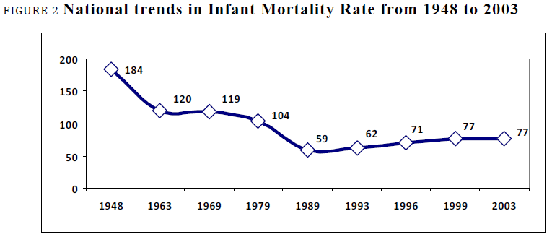
Accuracy of Vital Statistics
Coverage Error
Completeness / coverage
Content Error
Missing & erroneous data
Use of ill-defined categories
Improbable classifications
Evaluated by : analysis of trends & frequency distributions
Anomalies caused by reporting practices, i.e. digit preference
SOURCES: NCHS, Unit 15, 18; PRVSS2, Ch. V.
Notes:
Notes:
Accuracy of vital statistics is perhaps the most important element to evaluate when assessing the quality of data. The correctness or accuracy of registration means that all data items on the vital record have been accurately and completely filled in, i.e., there are no response errors and there are no missing items.
Here, we list again the four components of accuracy. We note that the first component, completeness & coverage, is an issue of coverage error, while the other three components are issues of content error.
Accuracy of statistics can often be evaluated by analysis of trends and frequency distributions. Each statistical series tends to exhibit certain clearly-defined temporal tendencies and certain recognizable distributions. Thus, any marked variation from these historical or distribution patterns might indicate the need for further inquiry.
It is known that certain anomalies of a series may be caused by reporting practices. For example, a distribution of deaths by age may reveal marked heapings at ages ending in 0 and 5 (also true for birthweights and gestational age). This uneven distribution is due to the well-known tendency to round and report ages incorrectly.

Slide 7
Accuracy of Vital Statistics
Completeness / coverage
Civil registration systems: every vital event that has occurred is registered in system
  Complete : ≥ 90% of events registered
  Incomplete: < 90% of events registered
Vital statistics: all registered events are forwarded to agency to compile & produce vital statistics
Coverage error (various measures)
Explore reasons for under-coverage
SOURCES: NCHS, Unit 15, 18; Mahapatra; PRVSS2, Ch. V, Glossary; WHO/HMN, Box 1.
Notes:
Notes:
We’ll first look at completeness & coverage aspects of vital statistics accuracy. These terms are often used interchangeably. In these slides, we’ve maintained use of terms according to the related reference. The important concepts to emphasize regarding completeness and coverage is that you are seeking 1) Complete registration and vital statistics reporting for all birth and death events and 2) full geographic coverage of registration.
Data are only as good as their source, so we’ll look at two aspects of completeness/coverage – for civil registration systems and for the vital statistics these systems produce.
You have a complete civil registration system when every vital event that has occurred to the members of the population of a particular country (or area), within a specified period, has been registered in the civil registration system, i.e. has a vital registration record. The registration system should strive for 100% completeness within a well-defined geographic area. It may well be that the system can be implemented fully for only a portion of the country, but complete coverage must be attained as soon as possible in order to produce useful vital statistics. From a practical point of view, a 100% coverage may not be feasible, but at least 90% coverage must be attained in each registration area to produce adequate vital statistics.
Vital statistics from civil registration data are complete when, in addition to the requirement of registration of each vital event (i.e. complete civil registration), a vital statistics report is forwarded to the agency responsible for the compilation and production of vital statistics.
A system in which every vital event that has occurred has been registered has attained 100 percent coverage. Any deviation from complete coverage is measured by coverage error. Coverage error can be due to variety of factors, which you want to explore in order to improve your system. We’ll look at completeness and coverage in more detail.

Slide 8
Completeness / Coverage
Coverage errors in civil registration systems
Geographic coverage
  % access level = # in districts with registration points X 100
          total population of the country
        Civil registration system coverage of deaths (WHO)
  % coverage = total deaths reported from system in year X 100
          total deaths estimated for year (by WHO)
        Coverage of medical certification of cause of death (COD)
  % covered by COD certification = # in districts with certification X 100
    total population of country
SOURCES: Mahapatra; PRVSS2, Ch. V, Glossary; WHO/UQ, Box 3.3; WHO/IMR; Freedman, p 24.
Notes:
Notes:
Coverage and coverage error can be measured in a variety of ways. When we look at a civil registration system, we’re first interested in the coverage or extent to which geographical or political units of the country have established these systems. We measure this by the % of the population with access to a functional civil registration system. Access encompasses a range of issues, including availability of registration points, distance, affordability, and cultural and social acceptability. To measure access level, we take the size of the population in districts that have at least one civil registration office or facility to register births or deaths, divide by the total population of the country for the same year, and multiply by 100.
WHO’s Indicator and Measurement Registry defines civil registration system coverage of deaths as the total deaths reported for a country from the civil registration system in a given year by the total deaths estimated by WHO for that year for the national population, multiplied by 100. WHO estimated coverages may be higher than 100% for a variety of reasons: a country may record all deaths occurring in the country, not just those to residents; deaths of nationals dying abroad may be included; or the UN-estimated population may be lower than the vital registration population. WHO’s Indicator and Measurement Registry also includes civil registration system coverage of births, but estimates are yielded from the UN demographic yearbook and UNICEF’s State of the World’s Children survey.
For cause of death specifically, coverage refers to the percent of the population living in areas where medical certification of cause of death (COD) has been legally mandated. We can look at the % of the population covered by medical certification of cause of death, where you take the size of the population living in districts with certification and divide by the total population for the same year, then multiply by 100 to get a percentage figure.

Slide 9
Completeness / Coverage
Coverage errors in civil reg. systems (cont’d):
Approximations of completeness by comparison with corresponding statistics
Estimated birth registration completeness (%)
= _ Actual # registered births X 100
(Crude birth rate per 1,000* x total population size/1,000)
Estimated death registration completeness (%)
= _ Actual # registered deaths X 100
(Crude death rate per 1,000* x total population size/1,000)
* As estimated by the United Nations or other sources
SOURCES: PRVSS2, p 88; WHO/HMN, Box 1.
Notes:
Notes:
We can obtain approximations of completeness by making comparisons of vital statistics data with corresponding statistics. To estimate birth or death registration completeness, divide the actual number of registered births (or deaths) in the country by the total estimated number of births (or deaths) in the country for the same period, and multiply by 100. A simple way to measure completeness in this way is to use an independent estimate of the number of births (or deaths) in the country. If no reliable national estimate is available, then an international estimate can be used.
It is important to note that these formulae provide only rough estimates, as they are based on survey estimates made at the national level. The estimates are subject to the same limitations as the survey data, and reliability is lost when national estimates are applied at lower (i.e. provincial) levels.
[Refer to handout: Kenya Country Profile_Registration Coverage_2009]. Comparisons of estimated completeness across geographic areas can be used as an indicator of the quality of the estimation method for a given area. For example, registration coverage rates in Kenya vary from 2.09% coverage for births in Ruiru District (not including two districts that reported 0 births) to 186.64% coverage in Kiambu East District. For deaths, rates varied from 1.15% coverage in Wajir South District (not including 1 district that reported 0 deaths) to 981.54% coverage in Ruiru District (perhaps a data entry error?). The wide variation seen in rates across Kenyan districts brings to question the quality of this estimation method for this area.

Slide 10
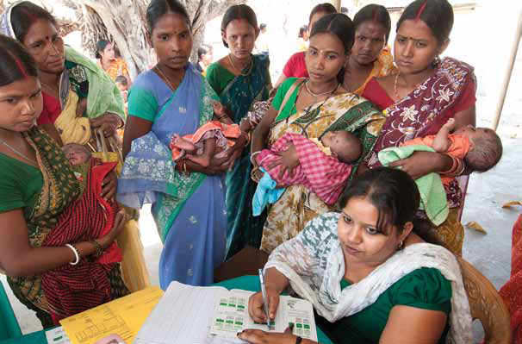
Completeness / Coverage
Coverage errors in civil reg. systems (cont’d):
Checking entries against independent sources
  Using death register to verify birth registration
  Administrative & social records
  Matching to census &
  survey records
  Dual record system
SOURCES: NCHS, Unit 18.
Panos/Heldur Netocny. Medical workers register women and babies.
Notes:
Notes:
Completeness can also be evaluated by checking the individual entries of the vital statistics against corresponding records from an independent source in order to detect any omissions. This method requires record linkage, which requires considerable expenses and careful planning. One available source of records is civil registration records – including matching infant death records with birth records. Other lists, such as school enrollments, hospital records, and baptism and burial records can be used to detect under-reporting. Lists of births or deaths from population census or survey data can be used to estimate registration completeness. Lastly, we have the dual records system.

Slide 11
Completeness / Coverage
“Dual record system”
  Retrospective survey of vital events (quarterly/annually)
  Census enumeration
Classify matched events:
  Events recorded in both register and other system
  Events recorded in register but not other system
  Events reported in other system but not register
  Estimate unknown number of events omitted from both systems*
* Chandra Sekar, C. and Deming, W. Edwards. “On a Method of Estimating Birth and Death Rates and the Extent of Registration.” Journal of the American Statistical Association. 44(245):101-115, March, 1949.
SOURCES: NCHS, 18; PRVSS2, p 86-87, 93-44.
Notes:
Notes:
The direct matching of individual vital events with other independent sets of records is generally known as the dual record system. Matching can be done based on the register and a retrospective survey of vital events or the register and census enumeration. The basic logic involved in this method is to classify the matched events into the following three categories… Based on that information, a fourth category, unknown number of events omitted from both systems, can be estimated statistically. We will not discuss the specific methods for this estimation in this course, but here is a reference for anyone that would like more information.
This procedure has several advantages, including minimizing recall biases and improving coverage through the retrospective surveys; providing reliable estimates of fertility and mortality, and using independent sources that provide both the numerator and denominator for estimating vital rates.
However, a major constraint in developing a dual record system is the cost and maintenance of truly independent data sources. As well, the matching process can be challenging in settings with poor data quality and common names (i.e. Maria or Mohammad) that can easily be confused. Finally, care must be taken to ensure that the denominator is correct – the population of the sample areas. This calls for periodic censuses of the sample areas to account for both natural population change and migration into or out of the sample areas.

Slide 12
Completeness / Coverage
Example: birth registration coverage
SOURCES: Elis S. Marks, William Seltzer and Karol J. Krotki. Population Growth Estimation: A Handbook of Vital Statistics Measurement. New York: The Population Control, 1974; NCHS 18.
Births
registered
during 3
month
period
Census enumeration
of infants
Notes:
Notes:
The direct matching method is usually done on a sample area of events that occurred during a short period of time. Let’s look at an example. Here we have a study of coverage of birth registration in a country done by matching the census enumeration of infants to births registered during a three-month period prior to the census.

Slide 13
Completeness / Coverage
Example: birth registration coverage
SOURCES: Elis S. Marks, William Seltzer and Karol J. Krotki. Population Growth Estimation: A Handbook of Vital Statistics Measurement. New York: The Population Control, 1974; NCHS, 18.
Births
registered
during 3
month
period
Census enumeration
of infants
Recorded in register & census
Notes:
Notes:
When you match the records, you will find the events that are recorded in both the register and the census data.

Slide 14
Completeness / Coverage
Example: birth registration coverage
SOURCES: Elis S. Marks, William Seltzer and Karol J. Krotki. Population Growth Estimation: A Handbook of Vital Statistics Measurement. New York: The Population Control, 1974; NCHS 18.
Recorded in register only
Births
registered
during 3
month
period
Census enumeration
of infants
Recorded in register & census
Notes:
Notes:
-events recorded in the register but omitted from the census data.

Slide 15
Completeness / Coverage
Example: birth registration coverage
SOURCES: Elis S. Marks, William Seltzer and Karol J. Krotki. Population Growth Estimation: A Handbook of Vital Statistics Measurement. New York: The Population Control, 1974; NCHS 18.
Recorded in register only
Recorded in census only
Births
registered
during 3
month
period
Census enumeration
of infants
Recorded in register & census
Notes:
Notes:
-and events recorded in the census data but omitted from the register.

Slide 16
Completeness / Coverage
Example: birth registration coverage
SOURCES: Elis S. Marks, William Seltzer and Karol J. Krotki. Population Growth Estimation: A Handbook of Vital Statistics Measurement. New York: The Population Control, 1974; NCHS, 18.
Recorded in register only
Recorded in census only
Births
registered
during 3
month
period
Census enumeration
of infants
Events not recorded in either system
Recorded in register & census
Notes:
Notes:
And then you can estimate the unknown number of events omitted from both systems (assuming the matching is done correctly).
Such a direct matching may not be necessary on a routine basis.
It is important to note that while the dual records technique has been widely used (i.e. in India), the method is debated and remains controversial due to concerns regarding lack of independence between data sources and problems with accurate matching (and the costs associated with each of these factors).

Slide 17

Completeness / Coverage
Coverage errors in vital statistics
Direct Assessment
– Monitoring registrar returns
Reports received on time
Every registration area has reported
Frequencies of events reported similar to expected values
– % of deaths with medically-certified cause of death
Health Metrics Network
SOURCES: NCHS, Unit 15, 18; Mahapatra; PRVSS2, Ch. V.
Notes:
Notes:
Coverage errors in vital statistics arise from under- or over-reporting of registration information. Errors can be introduced while transferring or transcribing data, by duplicate reports, or by under-reporting of events that were registered. Assessing coverage error in vital statistics can be done directly, by regularly querying and monitoring statistical returns from local registrars to ensure that statistical reports from the registration areas are received on time, that every registration area has reported their data, and that the frequencies of each type of vital event received are close to the expected values for the same time period. You can also look at the percentage of deaths with a medically-certified cause of death.

Slide 18
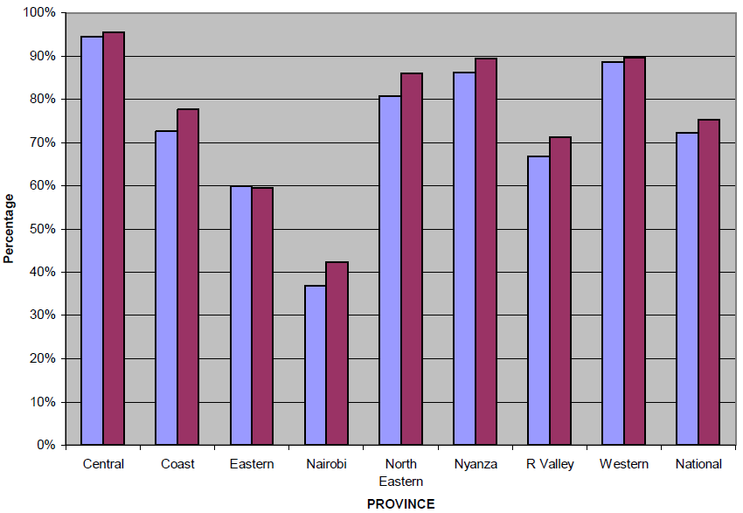

Completeness / Coverage
Coverage errors in vital statistics (cont’d)
    Indirect Assessment
    Comparison of trends
    Delayed registration
    Incomplete data methods
    Comparison w/ rates
      observed in similar
      populations or previous
      periods
SOURCES: NCHS, Unit 15, 18; Mahapatra; PRVSS2, Ch. V.
Notes:
Notes:
Coverage error in vital statistics can also be assessed indirectly, by comparing the total number of vital events registered and reported to the statistical agency for a given period with the number registered and reported in a previous, similar time period. Monitoring delayed registration, or the interval between the date of event occurrence and the date of registration of the event and the proportion of total registrations that are delayed provides a rough estimate of under-reporting. We won’t discuss this concept in depth, but indirect techniques for estimating basic demographic measures from incomplete data have been developed and can be used to compare estimates with rates obtained from civil registration data, to assess demographic relationships, and to estimate the level of under-registration of vital events. Lastly, birth and death rates can be compared with rates from similar populations or previous time periods known to have good registration coverage.

Slide 19
Completeness / Coverage
Coverage errors in vital statistics (cont’d)
Comparisons
    VS (# of events registered) in a given period with corresponding VS in previous years
    VS in a given period with population census or other estimates
    Proportion of delayed registrations as estimate of under-reporting in previous years
    Portions of VS with corresponding data collected through other means (i.e. fertility surveys)
    Vital rates with corresponding rates for similar countries
    Sex ratio at birth (under certain circumstances)
SOURCES: NCHS, 18; PRVSS2, p 84; Freedman, p 27-28.
Notes:
Notes:
Listed here are some comparisons:
Compare vital statistics in a given period with the corresponding statistics in previous years. Marked fluctuations would suggest a need for further investigation, though this technique may be problematic if the population is undergoing rapid change in size or characteristics resulting from events such as migration, war, epidemics, etc. Because vital events have a seasonal pattern, the comparison time period should have similar seasonality.
Compare vital statistics in a given period with the population census or estimates of certain categories which reasonably correspond with the vital events. For example, the number of births (minus the number of infant deaths) in a given year should be consistent with the population of age under one year. This is only a rough estimate since the difference may be due to either under-registration or errors in the census. The problems of infant under-enumeration and age misstatement in censuses are of particular concern in developing countries.
The proportion of total registrations that are delayed provides an estimate of under-reporting in previous years. Monitoring the extent of delayed registrations over time will provide a rough estimate of whether the registration system is improving or deteriorating.
Compare certain portions of vital statistics with corresponding data collected through other means, such as sample fertility surveys in a certain area.
Compare vital rates with corresponding rates for neighboring countries of similar characteristics.
For large population groups, an examination of sex ratios at birth may be used to assess the completeness of birth registration, but only if sex selection during pregnancy is not practiced in the country. A sex ratio of about 105 male births per 100 female births indicates either a reasonable level of registration, or a problem that is not sex-specific. A lower sex ratio may be an indication of the under-registration of male infants who died shortly after birth. A higher sex ratio may be an indication of preferential registration of male births. But a higher sex ratio can also be an indication of selective abortion of female fetuses, as in the very high sex ratios observed in some Asian countries. Note also that the sex ratio varies by race and ethnicity, so it is important to determine the appropriate country-specific ratio.

Slide 20
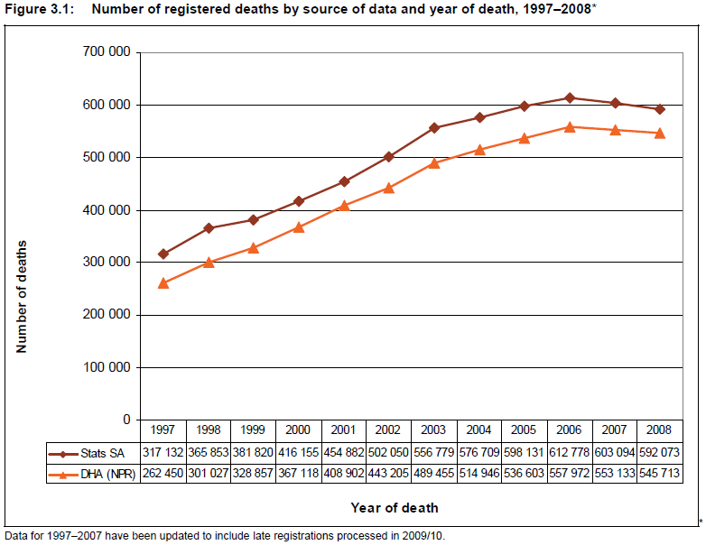
Number of registered deaths by source of data and year of death, 1997-2008*
SOURCES: Statistics South Africa, 2009.
Notes:
Notes:
This figure demonstrates how indirect assessment can be used. Registered deaths for the current year (2008) are compared against data for the 11 previous years. Also, data from Statistics South Africa are compared to data from the National Population Register (NPR). The decreased number of deaths observed by Statistics South Africa since 2006 is given credibility by the similarly decreasing trend observed by NPR.

Slide 21
Completeness/Coverage
Reasons for under-coverage
  Geographic: lack of access to the system
  Late registration
  Health infrastructure
  Under-registration: most crucial aspect of evaluation
    Poor legislation
    Failure of informant to comply with law
    Lack of proficiency of registrars
SOURCES: NCHS, Unit 15, 18; Mahapatra; PRVSS2, Ch. V; HMN/UQ, Subcomponent B3; Freedman p 25.
Notes:
Notes:
It does no good to measure the completeness of a system if you don’t consider reasons for any under-coverage that is detected. Under-coverage may be due to geographic reasons, where a portion of the population lacks access to a functioning registration system. It is useful to consider what sub-populations are most likely to be undercounted. The civil registration system may function differentially in different parts of the country. This may be due to lack of resources in certain local registration districts; to the remoteness of the region, requiring families to travel great distances to register a birth or death; or to local customs that don’t value the legal imperatives to register events or don’t perceive the need for a registration document etc.
Late registration only becomes a problem where year of occurrence and registration differ. Nonetheless, the extent of late registration should be tracked and monitored to ensure that it is decreasing and not increasing. If registration does not occur within a “reasonable” time period the record will not be included in the vital statistics file. When a large percentage of a certain type of event is registered late, it will affect a country’s statistics. An example is provided by violent, unexplained, sudden, and maternal deaths, which may be initially investigated by the police, who prepare reports, request postmortem examinations, and refer the cases to coroners. The entire process can take months/years, keeping the information from being included in the annual vital statistics reports. Thus, national vital statistics may suffer from serious under-reporting of selected types of deaths, including homicides, suicides, accidents, and maternal deaths. This may be addressed by including a provisional cause of death so that complete cause of death statistics can be compiled. The cause can be amended if the coroner’s inquest identifies a different cause of death.
Births and deaths that take place outside of health facilities are less likely to be reported. As well, a coverage barrier is introduced when a connection between health facilities and civil registration points is lacking.
Under-coverage may also be due to under-registration, which is the most crucial aspect of vital statistics evaluation. It is an accepted fact that vital registers are deficient in coverage to some degree in every country of the world. Factors contributing in various degrees to deficiencies include a lack of supportive legislation requiring registration or certification, or, alternatively, prohibitive legislation, such as fees for registration. Informants may fail to comply with the law due to a lack of incentive to register (i.e. beneficial services not connected with the need for a certificate), because of a lack of awareness about the need to or how to register, or due to cultural barriers or social stigma of illegitimate children. As well, a lack of proficiency of registrars may introduce interruptions in the system that lead to under-registration.

Slide 22
Improving
Completeness/Coverage
Reduce barriers to registration
Hire part-time & adjunct registration officials
Track pregnant women
Educational campaign to improve registration of infant deaths & stillbirths
Improve relationships between local registrars and coroners & police
Review classification of maternal deaths
Statistical adjustment for under-coverage
SOURCES: Freedman, p 28-31.
Notes:
Notes:
Many of the techniques used to improve coverage are those more generally needed to improve the system as a whole (discussed later). Specific suggestions also include:
Reducing barriers to registration, including a burdensome process (distance needed to travel, hours of operation, charging of fees for properly-registered events (supporting documents, but not fees, may be required for delayed registrations)).
Registration coverage may be improved by expanding the pool of officials who perform components of the civil registration function. Examples include: opening a satellite office in a remote area staffed by a part time official that performs a limited number of functions; using religious or health workers to perform registration functions.
Registering and tracking pregnant women to determine birth outcome and to ensure proper registration of births, early infant deaths, and fetal deaths.
It may be appropriate to undertake an educational campaign to address under-registration of infant deaths and stillbirths, either in the hospital or in the community. The campaign should emphasize the importance of these data for setting national public health priorities and encourage the complete reporting of these events.
Local registrars should develop relationships with coroners and police to expedite case reporting of unnatural deaths.
It may be helpful to routinely examine deaths to women of reproductive age to determine if maternal deaths are being classified to other causes. This may be done by matching these death certificates with birth and fetal death records to determine if the woman was pregnant during the period immediately preceding her death. Several countries have added a question to the death certificate to obtain information about pregnancy-related deaths.
Methods can be employed to reduce the bias from data that are derived from only selected areas or groups of populations (that are not representative). Methods include statistical adjustment for under-reporting or the use of data from sample areas or field surveys to complement the registration data. (The Pan American Health Organization has published procedures to adjust for under-registration of vital events).

Slide 23
Improving
Completeness/Coverage
Completeness & coverage
  Coverage as a measure of completeness
  Comparisons with corresponding statistics
  Checking with independent sources (dual record system)
  Coverage errors in vital statistics
  Reasons for under-coverage
  Improving completeness/coverage

Slide 24
Methods for Completeness/
Coverage in [COUNTRY]
List the methods that are used for measuring completeness in [country]. Consider methods for measuring completeness in the civil registration system and methods for measuring completeness in the country’s vital statistics.

Slide 25
Discuss
Discuss what geographic areas and population groups exist in your country. Do any of these groups present reporting or data-collection problems for civil registration?
What is the best way to make it easy for the public to participate but still collect complete information for either births or deaths?
Notes:
Notes:
[Country specific].
On public participation: consider registration certificates being required for social services to improve registration coverage and support timely registration; consider incorporating birth registration into other public health activities (i.e. delivery, post-natal care visits, or immunizations); how can certificates be used (e.g. registration for school, driver’s license, marriage license, etc.)?

Slide 26
Accuracy of Vital Statistics
Missing & Erroneous Data
Missing data
  % of key variables with no response
  % of COD reports with missing age/sex
Erroneous data
  Response error:
    Matching sample of reports with independent records
    % responses classified as “unknown”
    Internal consistency of data
  Coding error: double coding
SOURCES: NCHS, Unit 15, 18; Mahapatra; PRVSS2, Ch. V; Freedman, p 32.
Notes:
Notes:
In addition to errors introduced through the transmission of statistical reports, several other potential sources of error can affect the accuracy of vital statistics data. The processing functions of a civil registration and vital statistics system are critical to assessing and maintaining a quality data file. These include the control of records, editing, querying, coding and verification, and quality control. These issues were discussed when we learned about civil registration systems.
Errors in the process might result in missing and erroneous data.
Missing data can be due to refusal to respond or a skipped question. Missing data can be evaluated by the % of key variables with response not stated and the % of COD reports for which age/sex data are missing.
Errors can also be due to erroneous data, through faulty memory, misunderstanding of a question, or incorrect recording of the response. Also, errors in editing, coding, and data processing can affect accuracy. Response error can be evaluated directly by matching a sample of vital statistical reports with an independent set of records, like census records, autopsy reports, medical records, or re-interviews- and evaluating the agreement between the two data sources. Another rough indicator of possible response error is the proportion of answers classified as “unknown.” A large proportion of “unknowns” in any frequency distribution indicates that the distribution should not be considered reliable. For example, a high proportion of deaths of unknown age would make the accuracy of frequencies in every other age group questionable. Lastly, an indirect qualitative technique for assessing response error is to look at the internal consistency of the data- for example, comparing the number of early infant deaths with the number of late fetal deaths may indicate a misunderstanding of the definition of a live birth. You can also look at the sex ratio of births, which should be approximately equal. As well, reported ages can be analyzed for age heaping- or preferences for ages ending in 0 or 5 or even digits.
Coding errors can be detected by having two different groups of coders code the same set of statistical reports and discrepancies addressed (i.e. double coding).

Slide 27
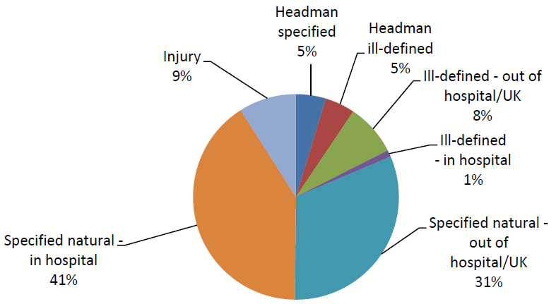
Accuracy of Vital Statistics
Use of ill-defined categories
  % of deaths classified as miscellaneous/ill-defined
  Should be < 25% unknown
Improbable classifications
  # deaths assigned improbable age/sex per 100,000 coded deaths
SOURCES: NCHS, Unit 15, 18; Mahapatra; PRVSS2, Ch. V.
Notes:
Notes:
The most problematic information item on death certificates is often cause of death – if a large majority of deaths appear as “unknown” or “ill-defined cause”, it is likely that the frequencies for the known causes of death are understated. The UN has used 25% of “unknown” or “ill-defined” cause of death as the upper limit for including mortality information by cause of death for a given country in the annual Demographic Yearbook.
[[Note: Physicians in the audience will likely be able to comment on their frustration in identifying a cause of death for an elderly person who has multiple complications or seems to have died of “old age.” It is important to communicate to them that the ICD system is intended to prevent premature deaths, which is not as applicable to the elderly population.]]
Lastly, improbable classifications include deaths that are assigned improbable age or sex categories– for example, a prostate cancer death in a female. Improbable classifications are measured by the number of deaths assigned to improbable age or sex categories per 100,000 coded deaths. Note: This does not apply to adult deaths due to causes considered as causes of infant death, as long as the “infant” cause is the disease that began the chain of events leading to death (i.e. congenital malformation). In other words, it would be incorrect to have an infant dying of Alzheimer’s disease, but you could have an adult dying of congenital malformation.
The amount of under-registration is measured by the percentage of events which occur in the area of responsibility which fail to get counted in the proper space and time.

Slide 28
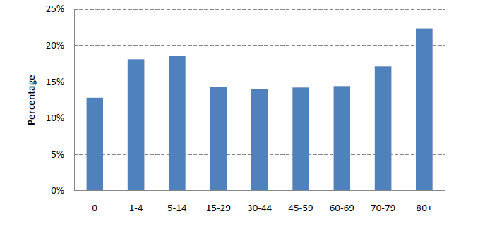
Proportion of natural deaths due to ill defined natural causes by age group – South Africa, 2007
Source: Statistics, South Africa
SOURCES: Bradshaw D, et al. Cause of death statistics for South Africa: Challenges and possibilities for improvement. Medical Research Council, South Africa. November 2010.
Notes:
Here’s an example from South Africa looking at the proportion of natural deaths due to ill defined causes by age group. All age groups are less than the goal of 25%. As expected, the highest percentage of ill-defined causes was in the 80+ age group, which is likely a result of multiple conditions associated with old age making it difficult to diagnose the underlying cause of death, or the death occurring out of hospital more frequently.
As an example of how this type of information is used – a higher than expected percentage for a give age group can prompt further investigation.

Slide 29
What to do with Imperfect Data
When you’re not confident on the certification of cause of death:
combine causes into broader groups
When you have ill-defined causes of death:
you can allocate deaths across other causes using advanced techniques
(see National Burden of Disease Studies: A Practical Guide. Edition 2.0)
Notes:
Suggested resources:
WHO. National Burden of Disease Studies: A Practical Guide. Edition 2.0. Global Program on Evidence for Health Policy. WHO: Geneva. October 2001. Section 6. Estimating Causes of Death.
D Bradshaw, P Groenewald, R Laubscher, N Nannan, B Nojilana, R Norman, D Pieterse and M Schneider. Initial Burden of Disease Estimates for South Africa, 2000. Medical Research Council. Burden of Disease Research Unit. March 2003. Section 2. Methods.

Slide 30
Accuracy of Vital Statistics in [COUNTRY]
List the following for the country, if known (use the most recent data year available):
Missing data
  % of key variables with no response
  % of COD reports with missing age/sex
Erroneous data
  Response error:
    Methods used for matching sample of reports with independent records?
    % responses classified as “unknown”
  Coding error: is double coding conducted?

Slide 31
Accuracy of Vital Statistics in [COUNTRY] (cont.)
List the following for the country, if known (use the most recent data year available):
Use of ill-defined categories
  % of deaths classified as miscellaneous/ill-defined
  Is this < 25% unknown (ideal)?
Improbable classifications
  # deaths assigned improbable age/sex per 100,000 coded deaths

Slide 32
Review:
Accuracy of Vital Statistics
Completeness & coverage
Missing & erroneous data
Use of ill-defined categories
Improbable classifications

Slide 33

Timeliness of Vital Statistics
Factors influencing timeliness:
  (1) Promptness of event registration
  (2) Transmission of data
  (3) Promptness of data production & dissemination
Health Metrics Network
Enforcing laws can be challenging
Know magnitude & effect of delayed registration
SOURCES: NCHS, Unit 15, 18; PRVSS2, p 82; Freedman, p 40-44.
Notes:
Notes:
Timeliness in registration implies that every event that has occurred has been reported for registration within the legally stipulated time. Timeliness is influenced by three factors: (1) the promptness of registration, (2) the relationship between the subnational and national offices and whether there are delays in the transmission of data between these groups; and (3) the promptness of data production and dissemination. Since vital statistics are based on all events that occur in a population, timeliness is dependent on assuring that all reporting areas are prompt; the system is as good as the weakest junction.
Prompt registration is essential for both prompt production of statistics and in securing accurate information from the informant. To attain this goal there should be time limits for registering vital events; some kind of legal backup is necessary to enforce the statutory time limits. Most countries require that births be registered within a month of the event, and deaths within three days of occurrence. While registration laws may impose a reasonable time limit for reporting, enforcing the law can be challenging due to topography, climate, communications, and culture.
The magnitude of delayed registration and its potential effect on the utility of vital statistics must be considered.
A good index of timeliness of vital statistics is the proportion of the vital events used for the annual tabulations which actually occurred in previous years (if these tabulations are based on year of registration). The timeliness of production and dissemination can be examined by comparing the reference year of statistics with the date of publication. A good goal is to strive for the release of a complete and accurate national data file within 12 months of the end of the data year.

Slide 34
Timeliness of Vital Statistics
    Indices of timeliness:
    % of events that occurred in previous years
    Production time: mean time from end of reference period to publication
    Regularity: SD of production time
SOURCES: NCHS, Unit 15, 18; Mahapatra.
Notes:
Notes:
A good index of timeliness is the proportion of the vital events used for the annual tabulation which actually occurred in previous years (if tabulations are based on year of registration).
The timeliness of production and dissemination can be examined by comparing the reference year of statistics with the date of publication.
Timeliness can also be measured by the regularity in the publication of statistics by taking the standard deviation of the productions time.

Slide 35
Timeliness of Vital Statistics
Delayed reporting of certain types of events
  Delay release of national file
  Publish without delayed records
  Use surrogate statistics (e.g. 9/11 World Trade Center attacks in United States)
SOURCES: Freedman, p 43.
Notes:
Notes:
If reporting of specific types of events (e.g. violent deaths) is delayed, the national office can decide to 1) delay release of the national file until records are received, 2) publish without the delayed records, or 3) use surrogate statistics to estimate the effect of the delayed records.
The third option is useful when the delay will be long and there is a known effect on the statistical file of not including the records. For example, in the United States, while most death records for victims of the 9/11 tragedies were reported within the allotted time to be included in the 2001 file, some were not, including death certificates for the terrorists on the airplanes which crashed. Since is uncertain when (or if) the remaining death certificates will be filed, and since information about the numbers of victims and terrorists is available from other sources, the 2001 final mortality report includes a special table detailing the total number of deaths from terrorism on September 11, 2001. The victims are classified as homicide deaths; the terrorists as suicides.

Slide 36
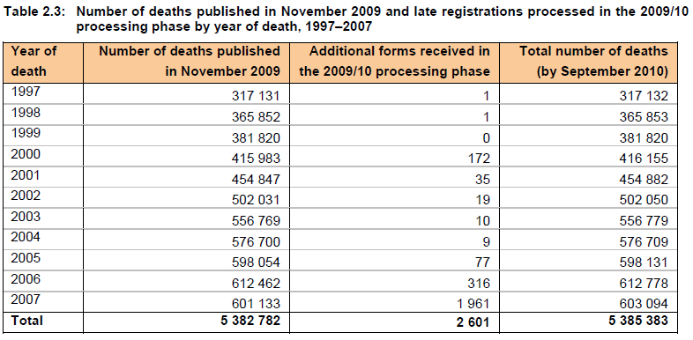
Timeliness of Vital Statistics
SOURCES: Statistics South Africa, 2009
Notes:
Notes:
This table from Statistics South Africa demonstrates how data can be used to evaluate timeliness. The number of additional forms received in the 2009/10 processing phase indicates the number of late registrations. A total of 2,601 additional death notification forms for 1997-2007 that were processed in 2009/10 is contrasted against a total of 23,245 late registrations that were processed in the previous period (2008/09), indicating significant improvement in the timeliness of reporting and registration. This improvement was attributed to a joint operation between Statistics South Africa and the Department of Homeland Affairs (DHA) that was undertaken to collect all forms that had reached the national DHA office.

Slide 37
Timeliness of Vital Statistics
Data in [COUNTRY]
    List the following for COUNTRY, if known (use the most recent year for which data are avialable):
    % of events that occurred in previous years
    Production time: mean time from end of reference period to publication
    Regularity: SD of production time
    Was there a delay in the release of the national file? If yes, for how long?
    Were reports published without delayed records?

Slide 38
Discuss
What factors can affect the timeliness of vital statistics?
Notes:
1) Promptness of event registration: population not knowing they need to register, or where or how to register; delay in registration agent collecting and compiling data; others?
2) Transmission of data: non-electronic processing of data; lack of oversight from national agency in data submission process; delay in registration agent submitting data; others?
3) Promptness of data production & dissemination: poor data quality, lack of knowledge in data processing, analysis, reporting; few resources; others?

Slide 39
Comparability
Need to accommodate necessary changes
  Proper procedures
  Implemented so users can employ new statistics
Comparability
  Across space: within country & between countries
    Uniformity of definitions across areas
    ICD to certify & code deaths; version used; code level used
  Over time:
    Stability of key definitions for VS
    Consistency of cause specific mortality proportions
SOURCES: NCHS, Unit 15, 18; Mahapatra.
Notes:
Notes:
Annual vital statistics are normally prepared year after year continuously, but comparability of statistics may be threatened if definitions and format of tabulations are drastically changed without proper procedures being followed to ensure comparability. Some required changes in the reporting system may result in various changes in vital statistics, but such changes must be implemented in an orderly manner so that users may employ the new statistics properly.
It is also important to ensure reasonable comparability of vital statistics from one area to another within a country as well as on an international basis. In comparisons across space, we’re looking for uniformity of definitions and consistency in how the ICD system is used. It is important to consider that countries may state that they conform to standard definitions, though they may not actually conform. Also, while a country may conform to standard definitions at the national level, local jurisdictions or health agencies may not.
We also look at comparability over time – looking at the stability of key definitions used to define vital statistics and the consistency of cause specific mortality proportions over consecutive years. As well, changes in the layout or content of forms used to collect information on vital events (i.e. birth and death certificates) can affect comparability of vital statistics. (Example: The United States recommended a new version of the birth certificate form in 2003. As of 2012, not all states have switched to the new recommended form. Thus, comparability of data must be carefully considered within states that have switched forms and between states, as not all states are using the same form).

Slide 40
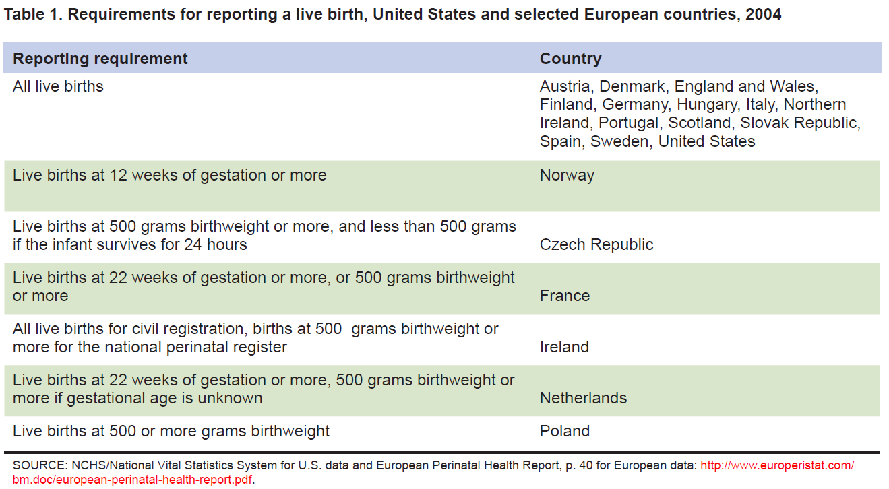
Comparability: Differences in
Reporting Requirements: “Live Birth”
SOURCES: MacDorman, MF and Mathews TJ. Behind International Rankings of Infant Mortality: How the United States Compares with Europe. NCHS Data Brief No. 23. Nov. 2009 (see references).
Notes:
See also: Healy, B. Behind the Baby Count. US News & World Report. 2 Oct 2006. (see references)
This is a review from a table shown in the “Analysis of Vital Statistics” slide set. This shows various definitions of “live birth” used in the US and different European countries. To compare data across countries, these differences in definitions would need to be taken into consideration.

Slide 41
Comparability:
International Comparisons
Data Quality
Consistency
Methodology
Coverage
Time period
Presentation & Interpretation
Presentation
Explanation
Underlying differentials
Context
Choice of Countries
Comparability
SOURCES: Australian Institute of Health and Welfare 2012. A working guide to international comparisons of health. Cat. No. PHE 159. Canberra: AIHW.
Notes:
Notes:
This is a review slide from the slide set on “Data Uses and Dissemination” to remind us of the characteristics which we can use to evaluate the quality of the comparison.

Slide 42
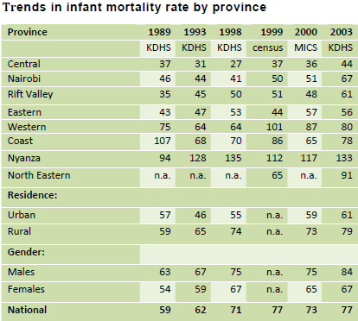
Relevance
Routine tabulations: by sex & specified age groups
Small area statistics: # of tabulation areas per million population
SOURCES: Mahapatra; WHOSIS.
Notes:
Notes:
Relevance is the degree to which cross-tabulations for priority characteristics (from a demographic and public-health perspective) are provided by the data source.
We look at the routine tabulations – by sex and by useful age groups. For general vital statistics, these include 5-year age groups, based on place of usual residence. For deaths in children under 5 years, we look for tabulations by 0 and 1-4 years age groups.
For cause-of-death statistics, we look for tabulations by sex and at least by eight broad age groups: 0, 1-4, 5-14, 15-29, 30-44, 45-59, 60-69, and 70+. If possible, it is desirable to use 10-year age groups as follows: 0, 1-4, 5-14, 15-24,…65-74, 75+ . These are the standard age groups used by many countries and in the WHO World Standard Population (notes: categories continue by 10-year age groups until 100+ in the WHO World Standard Population).
We also look for the presence of small area statistics, which is measured by the number of tabulations areas per million population for a given statistic.

Slide 43

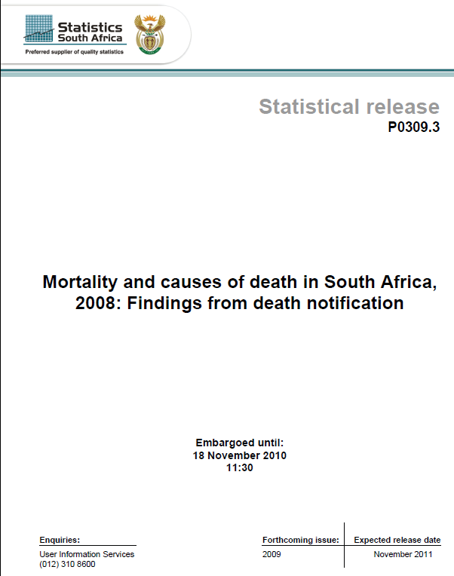
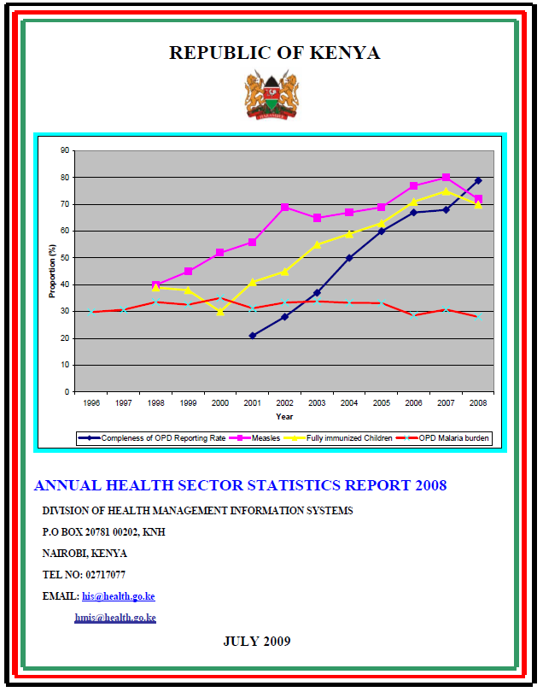
Accessibility
Media: # of formats in which data are released
Metadata: availability & quality of documentation
User service: availability & responsiveness of user service
SOURCES: Mahapatra.
Notes:
Notes:
Accessibility or availability refers to the ease with which users can access and make sense of the data. We look at three dimensions of accessibility in relation to quality of vital statistics.
Media refers to the dissemination of data in several formats – including print, electronic, and internet. A measure of media accessibility is the number of formats in which the data are released.
Metadata refers to information about the data, such as documentation of data elements, their definition, method of collection, manner of presentation, potential for errors, etc. Its purpose is to enhance the usability of data for public health analysis. As a measure of VS quality, we look at metadata availability and quality of documentation.
Finally, user service refers to dedicated institutional mechanisms for distribution of data products, clarification of user queries, productive engagement with data producers, and data accessibility. As a measure of VS quality, we look at the availability and responsiveness of the various user services provided by the CRVS system.

Slide 44
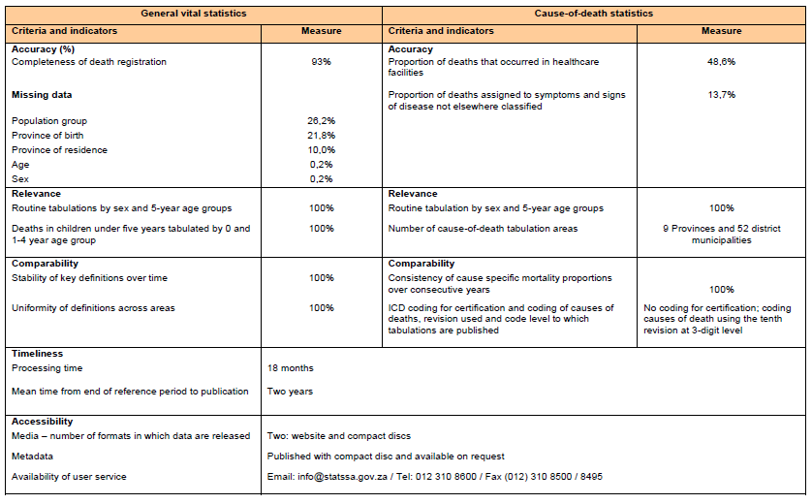
Example of Mahapatra Framework:
South Africa Death Notification Data, 2009
SOURCES: Statistics South Africa. Mortality and causes of death in South Africa, 2009: Findings from death notification. Statistical release P0309.3. (p16)
Notes:
[Available as handout for students: see Mahapatra Framework Example_South Africa_2009_Deaths; included in student notes]
Bringing the Mahapatra framework all together, this table shows an example of how the framework was used by South Africa in an analysis of their 2009 mortality data from death notification.

Slide 45
  Review:
  Quality of Vital Statistics Data
Accuracy
  Vital Statistics
  Civil Registration
Timeliness
Comparability
Relevance
Accessibility

Slide 46
Assessing the Quality of
Mortality Data: 10 step process
Prepare basic tabulations of deaths by age, sex and cause of death
Review crude death rates
Review age and sex-specific death rates
Review the age distribution of deaths
Review child mortality rates
Review the distribution of major causes of death
Review age patterns of major causes of death
Review leading causes of death
Review ratio of noncommunicable to communicable disease deaths
Review ill-defined causes of death
SOURCES:
World Health Organization (2011). Analysing mortality levels and causes of death (ANACoD) Electronic Tool. Department of Health Statistics and Information Systems. Geneva, World Health Organization. Available from healthstat@who.int (ANACoD)
AbouZahr C, Mikkelsen L, Rampatige R, and Lopez A. Mortality statistics: a tool to improve understanding and quality. Health Information Systems Knowledge Hub, University of Queensland. Working Paper Series 13. November 2010. http://www.uq.edu.au/hishub/wp13 (UQ Working Paper 13)
Notes:
Notes:
Steps for assessing the quality of mortality data are outlined in a 10 step process in a publication entitled “Mortality statistics: a tool to improve understanding and quality” from the Health Information Systems Knowledge Hub at the University of Queensland. The process may be applied to any mortality data. Common sources of mortality data include: national civil registration and vital statistics systems, censuses, longitudinal demographic surveillance, and routine health information systems. The purpose of assessing the quality of mortality data is to identify weaknesses and opportunities for improvement in the data. The assessment process, followed by corrective action, should be conducted on an ongoing basis and integrated into routine activities of health information systems.
The subsequent slides will review each of these steps. An Excel tool developed by the World Health Organization (ANACoD) can be used to automate the data quality assessment process described in these 10 steps.
Before continuing, it might be helpfult to do a brainstorming session with the class to see what they know of general patterns of mortality in different kinds of countries. We will see how these patterns are used to assess the quality of a country’s mortality data. (potential prompt: In what age groups do we expect to see the greatest number of deaths? – 0-4 years and >65 years).

Slide 47
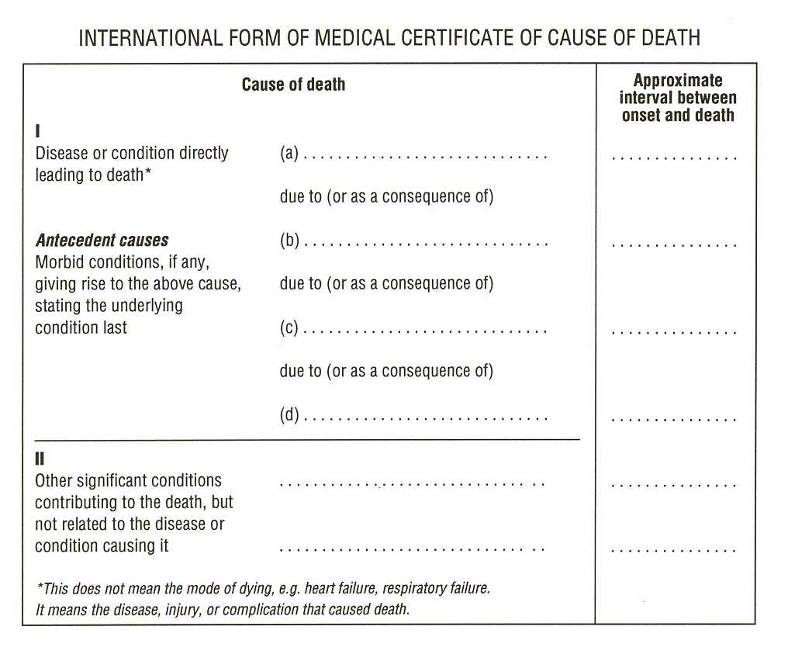
WHO recommends the use of the International Form of Medical Certification of Cause of Death to document the underlying cause of death
Traumatic shock
Internal injuries
Pedestrian hit by car
AIDS
Notes:
Let’s take a minute to review where medically certified cause of death information comes from. Countries that follow WHO’s international standards for medical certification of cause of death use the international form of medical certificate of cause of death– shown on this slide. The form is separated into two parts. Events directly leading to the death are listed in part one. Other significant conditions contributing to the death but that are not directly related it are listed in part two.
Part one contains 4 lines for recording conditions, each with a line to record the approximate time interval between the onset of the listed condition and death.
The disease or condition directly leading to the death should be listed in line a. Conditions giving rise to the condition directly leading to the death should be listed in subsequent lines, such that the underlying condition giving rise to all other events directly leading to the death is listed on the lowest line (blue circle).
For public health purposes, this is the condition in which we are most interested– the underlying cause of death. It is this condition that is captured in the public health statistics for a country– that that which we will use to assess the quality of a country’s mortality data.
For a complete review of medical certification of cause of death and the ICD system, see Slide Set 4 on Death Records.

Slide 48
International Statistical Classification of Diseases and Related Health Problems: 10th Revision (ICD-10) includes natural causes & external causes of death
Chapter Blocks Title
I A00-B99 Certain infectious and parasitic diseases
II C00-D48 Neoplasms
III D50-D89 Diseases of the blood and blood-forming organs…
IV E00-E90 Endocrine, nutritional and metabolic diseases
V F00-F99 Mental and behavioral disorders
VI G00-G99 Diseases of the nervous system
VII H00-H59 Diseases of the eye and adnexa
VIII H60-H95 Diseases of the ear and mastoid process
IX I00-I99 Diseases of the circulatory system
X J00-J99 Diseases of the respiratory system
XI K00-K93 Diseases of the digestive system
XII L00-L99 Diseases of the skin and subcutaneous tissue
XIII M00-M99 Diseases of the musculoskeletal system and connective tissue
XIV N00-N99 Diseases of the genitourinary system
XV O00-O99 Pregnancy, childbirth and the puerperium
XVI P00-P96 Certain conditions originating in the perinatal period
XVII Q00-Q99 Congenital malformations, deformations and chromosomal abnormalities
XVIII R00-R99 Symptoms, signs and abnormal clinical and laboratory findings…
XIX S00-T98 Injury, poisoning and certain other consequences of external causes
XX V01-Y98 External causes of morbidity and mortality
XXI Z00-Z99 Factors influencing health status and contact with health services
IU00-U99 Codes for special purposes
Notes:
Once a medical certificate of cause of death is completed, the listed conditions are reviewed and coded using the International Classification of Diseases (ICD) system (currently in 10th revision). This slide lists the contents of the ICD-10 system-- conditions are broken down into 21 chapters, coded by 3 or 4 character “blocks.” These blocks are used to tabulate the vital statistics from a country’s mortality data– to make them useable for public health purposes.

Slide 49

ANACoD:
Analysing mortality levels & cause-of-death data
An electronic tool to automate the 10 step process
Step-by-step tool for analysis of data on mortality levels and cause of death
Developed by:
  WHO
  The University of Queensland Health Info. Systems Knowledge Hub
  Health Metrics Network (financial support)
SOURCES FOR ANACoD SLIDES:
(ANACoD) World Health Organization (2011). Analysing mortality levels and causes of death (ANACoD) Electronic Tool. Department of Health Statistics and Information Systems. Geneva, World Health Organization. Available from healthstat@who.int.;
(UQWP13) AbouZahr C, Mikkelsen L, Rampatige R, and Lopez A. Mortality statistics: a tool to improve understanding and quality. Health Information Systems Knowledge Hub, University of Queensland. Working Paper Series 13. November 2010. (http://www.uq.edu.au/hishub/wp13)
Notes:
Notes:
A copy of the ANACoD Excel file is available with the curriculum package; contact EKNichols@cdc.gov. It is recommended that course participants use the ANACoD Excel program during the lecture. It is also recommended that prior to this section, participants read guidance on using this tool provided in handout “ANACoD version 1.0 Guidance.” This document can also be accessed by clicking on the “Guidance” button at the top, right of the screen for any sheet in the ANACoD program. This guidance is also referenced in the Working Paper on the 10 step process: AbouZahr C, Mikkelsen L, Rampatige R, and Lopez A. Mortality statistics: a tool to improve understanding and quality. Health Information Systems Knowledge Hub, University of Queensland. Working Paper Series 13. November 2010. (http://www.uq.edu.au/hishub/wp13). For some topics, the Working Paper 13 offers additional guidance– references are included in relevant slides.
The “Analysing mortality levels and causes of death” (ANACoD) electronic tool provides a step-by-step approach to enable users to quickly conduct a comprehensive analysis of data on mortality levels and causes of death. The tool automatically reviews the data for errors, tabulates the information, presents the results in the form of easy to use tables and charts, and provides the opportunity to compare the findings with those from other groups of countries.
With the growing demand for more results, faster, ANACoD provides an easy to use, free software solution.

Slide 50
Notes:
Activity: Distribute “ANACoD_Activity Guide” handout. The first two pages of the handout are the standard instructions for starting ANACoD. Notes for course participants have been added to the instructions in italics. Participants should read the first two pages of the handout and open the ANACoD program (ANACoD version 1.1 2013Feb_activity.xls) to the menu sheet.
Notes:
The ANACoD tool is an Excel-based application. Only knowledge of basic Excel commands and a basic understanding of ICD-10 is needed. All analyses are automated. Each step operates from a separate worksheet in Excel. The “Menu” worksheet is shown above.

Slide 51
CAUSES OF DEATH ANALYSIS
INPUT DATA
MORTALITY
LEVELS
ANALYSIS
Notes:
The tool has 3 parts: I. Input data (Steps 0-1); II. Mortality Levels analysis (Steps 2-5); and III. Causes of deaths analysis (Steps 6-10).

Slide 52
Getting Started
Open Excel file: ANACoD version 1.1 2013Feb_blank.xls
Enable macros
Go to sheet “step0-Input data”
Enter information at top of page:
  Country: Colombia
  Year: 2009
  Source of data: Civil registration
  ICD level used: ICD-10, 4-character codes
Input data from Excel file: Country Data_Anacod.xlsx
  Copy “Population” data; paste into ANACoD tool, starting in E14
  Copy “Deaths: data; paste into ANACoD tool, starting in C20
Notes:
Activity: Participants should review through Step 0 (p 1-4) in the ANACoD version 1.0 Guidance” document.
Course participants should follow the instructions on pages 1-3 of the “ANACoD_Activity Guide” to open the ANACoD tool and enter country data from the ‘Country Data_Anacod’ Excel file in the ‘step0-Input data’ sheet. Participants and instructors should refer to the ‘ANACoD version 1.0 Guidance’ document, Step 0, for additional information about the aggregation and tabulation of mortality data.

Slide 53
ANACoD - PART I: INPUT DATA
Step 0 - Input data: raw mortality data by age and sex and ICD 3 or 4 character codes; population data by sex and age
Notes:
Activity: Participants should confirm the numbers in their ANACoD tool sheet for Step0 match those on the slide.
The next several slides review the content of the ANACoD software.
Step 0: Input data: raw mortality data by age and sex and ICD 3 or 4 character (cause of death; see next slide) codes; population data by sex and age

Slide 54
ANACoD - PART I: INPUT DATA
Step 1 - Basic check of input data
Population: The entered data automatically generate a table and population pyramid (discussed further in Step 2).
Notes:
Activity: For each step, it is suggest that the participant first click the ”Guidance” button at the top right of the Excel worksheet for each step (also available in the “ANACoD version 1.0 Guidance” handout). Starting on Page 3, the handout ‘ANACoD_Activity Guide_participant’ provides additional guidance to participants on how to interpret the tables and figures in Steps 1-10. It is recommended that the instructor discuss and highlight important points for interpretation from each table and figure that is produced throughout the program. See the instructor guide (‘ANACoD_Activity Guide_instructor’) for points to emphasize. The instructor guide includes guidance on all tables and figures generated in the ANACoD program. Select tables and figures are additionally described in the following slides.
The ANACoD guidance is also referenced in the Working Paper on the 10 step process: AbouZahr C, Mikkelsen L, Rampatige R, and Lopez A. Mortality statistics: a tool to improve understanding and quality. Health Information Systems Knowledge Hub, University of Queensland. Working Paper Series 13. November 2010. (http://www.uq.edu.au/hishub/wp13). For some topics, the Working Paper 13 offers additional guidance– references are included in relevant slides.
Step 1: Note that for the purposes of this exercise, no corrections will be made to the original data.
Notes:
Step1: Basic check of input data – When the user clicks on sheet ‘step1-check first’, various tables and figures will automatically be generated. These tables and figures can be used to flag basic errors in the data.
ANACoD automatically generates a summary of the population information enetered in table and pyramid form.

Slide 55
ANACoD - PART I: INPUT DATA
Step 1 - Basic check of input data
Any non-zero numbers indicate age groups for which country data are not consistent.
 | sex | all ages | 0 | 1-4 | 5-9 | 10-14 | 15-19 | 20-24 | …
No deaths in "AAA": all causes
 | m | 113327 | 5333 | 1121 | 629 | 848 | 3604 | 5622 | …
 | f | 83354 | 4225 | 931 | 469 | 523 | 1042 | 1255 | …
Sum of deaths in all other codes
 | m | 113327 | 5333 | 1121 | 629 | 848 | 3604 | 5622 | …
 | f | 83354 | 4225 | 931 | 469 | 523 | 1042 | 1255 | …
Difference: should be zero
 | m | 0 | 0 | 0 | 0 | 0 | 0 | 0 | …
 | f | 0 | 0 | 0 | 0 | 0 | 0 | 0 | …
An attempt should be made to query and correct the specific death certificate.
See cite slide 54.
Notes:
Step 1: Note that for the purposes of this exercise, no corrections will be made to the original data.
Notes:
Step1: Basic check of input data – When the user clicks on sheet ‘step1-check first’, various tables and figures will automatically be generated. These tables and figures can be used to flag basic errors in the data.
Table 2.1 is checking to see if the total number of deaths reported from “all causes” from a country (AAA, first row) equals the sum of all the deaths that were reported by the individual ICD 10 codes (second row). All numbers in the third row of Table 2.1 should sum to “0”. If something does not equal “0”, Table 2.1 will give an indication of in which age group the country data are not consistent.
Are the number of deaths from “all causes” consistent with the sum of all deaths reported by individual ICD 10 codes for this country? Yes.
Table 2.2: The number of deaths for “all ages” in Table 2.2 should equal the number of deaths for “all ages” listed in Table 2.1. However, the deaths for which age is missing or unknown (MUN column in Table 2.1) are distributed proportionally across all age categories in Table 2.2. Thus, the age-specific number of deaths in Table 2.2 may vary slightly from those in Table 2.1.
The age distribution of reported deaths figure is another way of presenting the “Percentage of total deaths” column in Table 2.2. The distribution of total death is further explored in Step 4.
If potential errors are detected, go back to Step 0 and correct data as needed. (for this exercise, no corrections will be made to the original data)

Slide 56
ANACoD - PART I: INPUT DATA
Step 1 - Basic check of input data
Look for expected patterns:
Deviations may indicate errors in age or sex information.
MALES > Females
Males < FEMALES
Higher percentages in the 0 and 65+ age groups
Higher percentages for males compared to females in the 15-64 age groups, due to a higher number of deaths from external causes
Higher percentages for females compared to males in the oldest age groups
Notes:
Step 1: Note that for the purposes of this exercise, no corrections will be made to the original data.
Notes:
Step1: Basic check of input data – When the user clicks on sheet ‘step1-check first’, various tables and figures will automatically be generated. These tables and figures can be used to flag basic errors in the data.
Table 2.1 is checking to see if the total number of deaths reported from “all causes” from a country (AAA, first row) equals the sum of all the deaths that were reported by the individual ICD 10 codes (second row). All numbers in the third row of Table 2.1 should sum to “0”. If something does not equal “0”, Table 2.1 will give an indication of in which age group the country data are not consistent.
Are the number of deaths from “all causes” consistent with the sum of all deaths reported by individual ICD 10 codes for this country? Yes.
Table 2.2: The number of deaths for “all ages” in Table 2.2 should equal the number of deaths for “all ages” listed in Table 2.1. However, the deaths for which age is missing or unknown (MUN column in Table 2.1) are distributed proportionally across all age categories in Table 2.2. Thus, the age-specific number of deaths in Table 2.2 may vary slightly from those in Table 2.1.
The age distribution of reported deaths figure is another way of presenting the “Percentage of total deaths” column in Table 2.2. The distribution of total death is further explored in Step 4.
If potential errors are detected, go back to Step 0 and correct data as needed. (for this exercise, no corrections will be made to the original data)

Slide 57
ANACoD - PART I: INPUT DATA
Step 1 - Basic check of input data
Check for standard patterns:
Generally higher rates of male versus female mortality.
Smooth, increasing lines after age 35 years.
Notes:
Notes:
Step1: Basic check of input data – When the user clicks on sheet ‘step1-check first’, various tables and figures will automatically be generated. These tables and figures can be used to flag basic errors in the data.
This table and figure are calculated from data entered in Step 0 and population data for the country. The age- and sex- distribution of deaths are further explored in Steps 3 & 4.
A graph of the log mortality rates facilitates a quick visual test for abnormalities across age groups. Standard patterns observed in a graph of log mortality rates include:
Generally higher rates of male mortality compared to female mortality across all ages;
Lines that increase smoothly and linearly with age after about age 35.
Do the data in Table/Figure 2.3 follow expected patterns? Yes.

Slide 58
ANACoD - PART I: INPUT DATA
Step 1 - Basic check of input data
Checking for invalid ICD codes -- All cells should contain a “0” or “0%.”
…
…
…
Click to see a list of valid ICD codes for underlying cause of death or to see where non valid codes are flagged.
Notes:
Notes:
Step1: Basic check of input data – When the user clicks on sheet ‘step1-check first’, various tables and figures will automatically be generated. These tables and figures can be used to flag basic errors in the data.
If data are entered correctly, all cells should contain a “0” or “0%,” indicating that there are no deaths with ICD10 codes that should not be used for causes of deaths or that all codes used exist in ICD10.
Are there any cells without a “0” or “0%”. No. Participants can click the “ICD10” button or the “ICD 10 list” sheet to see a list of valid ICD codes for underlying causes of death. They can also click the button “Go” to see column AB in sheet ‘step0-Input data,’ where non valid codes are (or would be) flagged. If errors were detected, they should be corrected in Step 0.

Slide 59
ANACoD - PART I: INPUT DATA
Step 1 - Basic check of input data
Sex specific codes. Pink: female only, blue: male only
ICD | Disease | No of deaths
O00-O99 | Pregnancy, child birth and the puerperium - male | 0
C53 | Cervix uteri cancer - male | 0
C54-C55 | Corpus uteri cancer - male | 0
C56 | Ovary cancer - male | 0
C61 | Prostate cancer - female | 0
N40 | Benign prostatic hypertrophy - female | 0
Pls check if sum is not equal to zero ---> |  | 0
An attempt should be made to query and correct the death certificate for any deaths listed in these columns that indicate unlikely disease/sex combinations or unlikely causes of death.
Notes:
Notes:
Step1: Basic check of input data – When the user clicks on sheet ‘step1-check first’, various tables and figures will automatically be generated. These tables and figures can be used to flag basic errors in the data.
Are any deaths indicated in the upper left table, cells F111-117? Deaths in this column would indicate clearly incorrect causes of death, based on implausible sex/cause of death combinations. No. If there were deaths listed in this column, an attempt should be made to query and correct the specific death certificate. (for this exercise, no corrections will be made to the original data)
Are any deaths indicated in the lower left table, cells F122-132? Deaths in this column would indicate likely incorrect causes of death, based on diseases unlikely to cause death. Yes- 8 deaths. An attempt should be made to query and correct the specific death certificates. (for this exercise, no corrections will be made to the original data)

Slide 60
ANACoD - PART I: INPUT DATA
Step 1 - Basic check of input data
An attempt should be made to query and correct the death certificate for any deaths listed in this column that indicates an unlikely disease/age combination.
Notes:
Notes:
Step1: Basic check of input data – When the user clicks on sheet ‘step1-check first’, various tables and figures will automatically be generated. These tables and figures can be used to flag basic errors in the data.
Are any deaths indicated in the table to the right, cells O110-139? Deaths in this column would indicate likely incorrect causes of death, based on implausible disease/age combinations. Yes. An attempt should be made to query and correct the specific death certificates. (for this exercise, no corrections will be made to the original data)

Slide 61
ANACoD - PART II:
MORTALITY LEVELS ANALYSIS
  Steps 2-5
  Focus on simple steps to assess the plausibility of the mortality levels.
  The tool compiles and formats the raw data to enable the calculation of:
  crude death rates
  age-specific mortality rates
  life expectancy at birth
  child mortality

Slide 62
ANACoD - PART II: MORTALITY LEVELS ANALYSIS
Step 2: Crude death rates (CDR)
Enables users to:
Calculate the CDR and use the country’s population pyramid to helps in the interpretation of the CDR
Crude death rate = Number of deaths in resident population in given year X 1000
Size of the midyear resident population in that year
Use the CDR as an approximate indicator of completeness of death registration
Compare the CDR to the expected CRD based on life expectancy and population growth rates
Notes:
Activity: Participants and instructors should review the ‘ANACoD version 1.0 Guidance’ document, Step 2, for additional information about the use of crude death rates.
Notes:
Recall that the Crude Death Rate (CDR) is a measure of the number of deaths in a population, relative to the size of that population over a given period of time.

Slide 63
ANACoD - PART II: MORTALITY LEVELS ANALYSIS
Step 2: Crude death rates
Population data to aid in interpretation of crude death rates:
 | Age-group (yrs) | No of deaths |  | Population |  | Proportion of
 |  | male | female | male | female
 | All ages | 113 327 | 83 354 | 22 464 882 | 23 189 162
 | 0 | 5 368 | 4 234 | 466 526 | 446 815
 | 1-4 | 1 128 | 933 | 1 828 674 | 1 753 044
 | 5-9 | 633 | 470 | 2 250 657 | 2 160 252
 | 10-14 | 854 | 524 | 2 240 827 | 2 155 587
 | 15-19 | 3 628 | 1 044 | 2 201 572 | 2 130 962
 | 20-24 | 5 659 | 1 258 | 2 050 933 | 2 019 554
 | 25-29 | 6 112 | 1 289 | 1 894 170 | 1 912 832
 | 30-34 | 4 863 | 1 361 | 1 707 701 | 1 774 594
 | 35-39 | 4 197 | 1 582 | 1 510 151 | 1 612 906
 | 40-44 | 4 187 | 2 117 | 1 479 874 | 1 603 908
 | 45-49 | 4 646 | 2 791 | 1 275 551 | 1 399 558
 | 50-54 | 5 129 | 3 525 | 1 040 753 | 1 158 799
 | 55-59 | 6 046 | 4 132 | 833 936 | 945 156
 | 60-64 | 6 808 | 4 863 | 600 560 | 697 959
 | 65-69 | 8 366 | 6 323 | 408 106 | 492 649
 | 70-74 | 9 990 | 8 396 | 289 037 | 366 559
 | 75-79 | 11 431 | 10 206 | 193 494 | 261 311
 | 80+ | 24 281 | 28 307 | 192 360 | 296 717
 | Completeness of civil registration data is estimated by dividing the reported deaths by the UN estimates* => |  |  |  |  |  |  |  |  | 78%
CDR as approximate indicator of completeness of death registration: ≥ 90% is defined as “good” by UN standards.
Notes:
Notes:
The table and population pyramid presented at the top of Step 2 review information presented in Step 1. The population pyramid aids in understanding the population’s age-sex structure, and thus helps in the interpretation of the CDR. Populations that have a high proportion of the population in age groups where mortality rates are highest (i.e., below 4 years and 60+ years) can be expected to have a higher CDR.
The population pyramid for this country shows the highest proportion of the population in the 0-4 age group, where mortality rates are highest– thus we expect this country to have a higher crude death rate (see next slide). If it does not, it could be an indication of under-reporting.
Step 2 also presents the estimated completeness of civil registration data, based on dividing the reported deaths by UN estimates. We’ll look for consistency between the estimated completeness of registration data and conclusions drawn from the crude death rate. In this case, the estimated completion of 78% is lower than the UN standard goal of 90% completion for “good completion.” We will expect that the CDR is also low.

Slide 64
ANACoD - PART II: MORTALITY LEVELS ANALYSIS
Step 2: Crude deaths rates
CDRs < 5.0 are suspiciously low and indicate under-reporting.
Observed
Crude death rate per 1000 population |  |  | Both sexes |  |  | 4.3 | Life expectancy at birth (years) |  |  | Both sexes |  | 77.2
 |  |  | Males |  |  | 5.0 |  |  |  | Males |  | 73.6
 |  |  | Females |  |  | 3.6 |  |  |  | Females |  | 80.8
% Annual rate of population growth (UN*) |  |  | Both sexes |  |  | 1.46
 |  |  | Males |  |  | 1.43
 |  |  | Females |  |  | 1.48
*UN source: United Nations, World Population Prospects the 2010 revision
Expected crude death rates at different levels of life expectancy and population growth (based on Coale-Demeny West model)
Male |  | Annual rate of population growth (percent)
 | 10 | 5 | 3 | 2.5 |  | 2 | 1.5 | 1 | 0.5 | 0 | -0.5 | -1
Life expectancy at birth (years) | 40 | 26.7 | 23.6 | 23.2 |  | 23.1 | 23.1 | 23.4 | 24.1 | 25.0 | 26.3 | 27.9
 | 45 | 20.8 | 19.0 | 18.9 |  | 19.1 | 19.4 | 20.1 | 21.0 | 22.2 | 23.8 | 25.7
 | 50 | 16.0 | 15.2 | 15.4 |  | 15.8 | 16.4 | 17.3 | 18.5 | 20.0 | 21.8 | 24.0
 | 55 | 12.0 | 12.1 | 12.5 |  | 13.1 | 14.0 | 15.1 | 16.5 | 18.2 | 20.2 | 22.6
 | 60 | 8.7 | 9.5 | 10.1 |  | 10.9 | 11.9 | 13.2 | 14.8 | 16.7 | 18.9 | 21.4
 | 65 | 5.9 | 7.3 | 8.0 |  | 9.0 | 10.2 | 11.6 | 13.3 | 15.4 | 17.7 | 20.4
 | 70 | 3.8 | 5.6 | 6.4 |  | 7.4 | 8.7 | 10.2 | 12.1 | 14.3 | 16.8 | 19.6
 | 75 | 2.3 | 4.2 | 5.1 |  | 6.2 | 7.6 | 9.2 | 11.1 | 13.3 | 15.9 | 18.8
 | 85
Female |  | Annual rate of population growth (percent)
 | 10 | 5 | 3 | 2.5 |  | 2 | 1.5 | 1 | 0.5 | 0 | -0.5 | -1
Life expectancy at birth (years) | 40 | 27.4 | 24.1 | 23.6 |  | 23.4 | 23.6 | 24.1 | 24.1 | 25.0 | 26.2 | 27.8
 | 45 | 21.6 | 19.5 | 19.3 |  | 19.4 | 19.6 | 20.2 | 21.1 | 22.2 | 23.7 | 25.6
 | 50 | 16.8 | 15.7 | 15.8 |  | 16.1 | 16.7 | 17.5 | 18.6 | 20.0 | 21.8 | 23.9
 | 55 | 12.7 | 12.5 | 12.9 |  | 13.4 | 14.2 | 15.2 | 16.5 | 18.2 | 20.2 | 22.5
 | 60 | 9.4 | 9.9 | 10.4 |  | 11.1 | 12.1 | 13.3 | 14.8 | 16.7 | 18.8 | 21.3
 | 65 | 6.6 | 7.7 | 8.4 |  | 9.2 | 10.3 | 11.7 | 13.4 | 14.8 | 16.7 | 19.5
 | 70 | 4.3 | 5.8 | 6.6 |  | 7.6 | 8.8 | 10.4 | 12.2 | 14.3 | 16.7 | 19.5
 | 75 | 2.6 | 4.4 | 5.2 |  | 6.3 | 7.6 | 9.2 | 11.1 | 13.3 | 15.9 | 18.8
 | 80 | 1.5 | 3.4 | 4.2 |  | 5.3 | 6.7 | 8.3 | 10.2 | 12.5 | 15.1 | 18.1
Compare the observed CDR to the expected CRD based on life expectancy and population growth rates
Notes:
Activity: Participants and instructors should review the ‘ANACoD version 1.0 Guidance’ document, Step 2, for a useful explanation on the lower limits of CDRs.
Notes:
The lower limit for the CDR in any country is around 5 per 1000; CDRs below 5 per 1000 should be considered suspicious. If the age distribution shown in the population pyramid suggests that a country should have a higher CDR (as is the case in this country), and the observed CDR based on a country’s mortality data is suspiciously low, under-reporting of deaths and incomplete civil registration are expected. In this example, the country’s CDR for females (3.6) is suspiciously low. This observation is further confirmed by the estimates the completeness of civil registration data (78% as shown on previous slide).
Estimates of life expectancy and population growth rates can also be used to determine what a plausible CDR should be for a country. Step 2 lists these indicators with a table of the expected CDRs at different levels of life expectancy and population growth. The CDRs provided in the table for the appropriate indicators for a give country can be used to approximate by how much the country’s CDR (based on the entered mortality data) is under- or over-estimated. For this country, the expected crude death rate is 10.2 versus the observed 5.0 for males and 8.3 versus 3.6 for females– further confirmation that deaths are likely under-reported.
See the UQ Working Paper 13 for an additional explanation about trends in crude death rates.

Slide 65
ANACoD - PART II: MORTALITY LEVELS ANALYSIS
Step 3. Age and sex-specific death rates
Enables users to:
Calculate the mortality rate specific to a population age group (usually a five-year grouping), known as the age-specific mortality rate (ASMR)
deaths in a specific age group in a ASMR = population during a specified time period × 100 000 total mid-year population in the same age group, population and time period
Compare relative age patterns in ASMR for country to expected global patterns to identify potential under registration at certain ages
Compare patterns in male:female ASMR ratio to countries with various infant mortality rates to identify issues with completeness of registration
Look for deviations in expected patterns of the log ASMR to indicate under-reporting at certain ages or mis-reporting of correct age of death
Notes:
Activity: Participants and instructors should review the ‘ANACoD version 1.0 Guidance’ document, Step 3, for additional information about the use of crude death rates.
Notes: Since mortality rates are generally higher among males than females, and mortality risks vary across age groups, age- and sex-specific mortality rates can be used to identify possible age misreporting of deaths.
See the UQ Working Paper 13 for an additional explanation about dealing with fluctuations in the ASMR due to small population numbers.

Slide 66
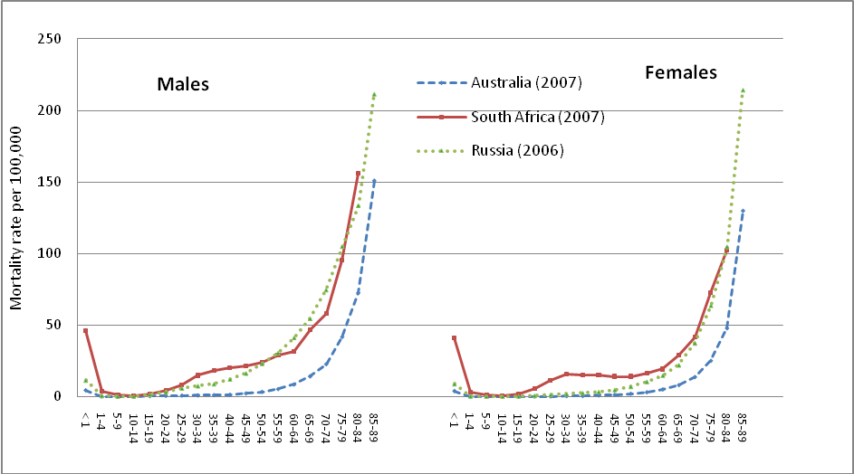
ANACoD - PART II: MORTALITY LEVELS ANALYSIS
Step 3. Age and sex-specific death rates
Compare relative age patterns to expected patterns in ASMR: Deviations may indicate under-registration in certain age groups and/or missing age or sex information.
Figure 3: ASMR for Australia, Russia and South Africa, males and females, 2000 (ANACoD)
Notes:
Notes:
A comparison of patterns in the ASMR data with an independent source (e.g. the census or data from a similar country/setting) can be used to assess plausibility of the observed data. In the absence of data for comparison, observed patterns in the data can be judged against expected patterns in ASMR, including:
Mortality rates should be highest during infancy and early childhood and lowest between 5 and 14 years (note, South Africa has particularly high infant mortality rates);
Mortality rates should increase exponentially beyond about 35 years;
A “bump” in mortality during reproductive years may indicate premature mortality due to HIV/AIDS or high maternal mortality (South Africa).
Deviations from these patterns may indicate under-registration of deaths in certain age groups and/or missing age or sex information for registered deaths. Note: it is the relative ASMR age pattern across age groups, not the level of mortality, that is of importance in this comparison. This highlights the importance of checking the plausibility of age-patterns of mortality, and to test for underreporting of deaths in certain age groups by plotting the graph of ln(m_{x}) versus age (x), as described in Step 3.

Slide 67
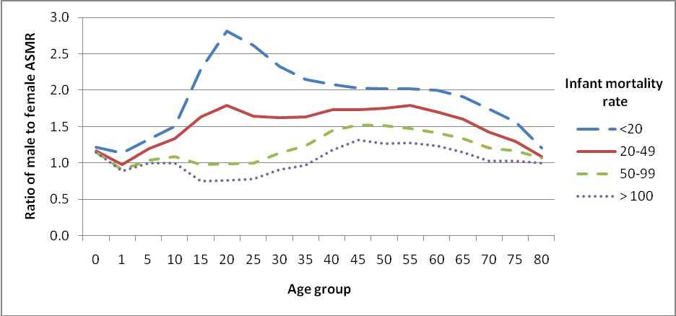
ANACoD - PART II: MORTALITY LEVELS ANALYSIS
Step 3. Age and sex-specific death rates
Compare patterns in ratio of male:female ASMR: Deviations may indicate country abnormalities or under-registration.
Figure 5: Ratio of male to female age-specific mortality rates at different levels of infant mortality (expected patterns)
IMR* = 16.0 per 1 000 live births
(WHO Global Health Observatory; 2010)
* From a source independent of the value from the data being assessed.
Notes:
Activity: The instructor should explain the implications of the various infant mortality rates and how they are indicative of a country’s socioeconomic status.
Notes:
Calculating the ratio of male to female ASMR can display male-female differences to see if observed patterns are consistent with expected patterns. Male death rates are higher than female death rates across all age categories in almost all societies, except those with very poor female status. Thus, a ratio > 1.0 for all ages is expected. However variation in the magnitude of the ratio can be seen across different infant mortality rates (a proxy for different standards of living and health). Figure 5 from the ‘ANACoD version 1.0 Guidance’ document shows the expected patterns in male:female ASMR ratio across age groups for various infant mortality rates. Expected patterns include:
A bump between 15 and 29 years, indicating higher death rates among males
A secondary peak in male:female ratio around ages 55-64, due to the tendency for males to die at higher rates from chronic disease compared to females, from increased risk factors for tobacco use, poor diet, and overweight and obesity
Comparing the examples presented: Like in Figure 5, the country (green line) has a bump between ages 10-14 and 45-49, indicating an increase in deaths among males, likely due to accidents and other violent deaths. However, the magnitude of the bump is greater in the country, compared to Figure 5, which indicates that there may be an abnormally high number of male deaths in these age categories for this country. For ages > 49, the ratio for the country is a little lower than the figure, but the general pattern observed is as expected.

Slide 68
ANACoD - PART II: MORTALITY LEVELS ANALYSIS
Step 3. Age and sex-specific deaths rates
Look for deviations in the expected patterns of the log ASMR: Deviations may indicate systematic underreporting at a given age.
Notes:
Notes:
Since death rates increase exponentially after about 35 years of age, using a logarithmic scale to graph mortality rates should yield a straight line as age increases. Graphing ASMR on a log scale enables the user to examine the data for irregular or implausible changes across age groups. General patterns that are expected in countries with complete registration data include the following:
The ASMR is expected to sharply decline between 0-4 years and 5-9 age groups, since the 0-4 year age category experiences the highest mortality rates.
In countries with high maternal or injury mortality in young adults (especially males), death rates will rise steeply around age 15 years, peak around 25 years, and decline at about 35 years. A similar bump is expected in countries with high AIDS-related mortality.
The ASMR will rise linearly with age, starting at about 35 years of age.
By comparing the log graph for your population with similar countries with good quality mortality data, it is possible to assess the extent to which deaths are being systematically underreported at all ages.

Slide 69
ANACoD - PART II: MORTALITY LEVELS ANALYSIS
Step 4: Review the age distribution of deaths
Enables users to:
Examine the age distribution of reported deaths
Compare the calculated distribution of deaths to expected distributions corresponding to:
  Country income group (ANACoD guidance)
  Country infant mortality rate (UQ Working Paper 13)
Notes:
Activity: Participants and instructors should review the ‘ANACoD version 1.0 Guidance’ document, Step 4, for additional information about the age distribution of deaths.
See the UQ Working Paper 13 for an additional explanation about comparing age distribution of deaths to countries with similar infant mortality rates.

Slide 70
Step 4: Review the age distribution of deaths
Look for expected patterns in age-specific mortality:
Deviations may indicate selective bias in age-specific death reporting.
MALE > female mortality, except in oldest age groups
    In countries with low income/high infant mortality, female rates may be comparable to male rates.
Peak in overall mortality in:
  0-4 years (less so in countries with high income/low infant mortality)
  Oldest age groups (less so in countries with low income/high infant mortality)
Peak in male mortality between 15-44 years due to external causes
Notes:
Step 4 facilitates a comparison of the age distribution of reported deaths for the country of interest to that of other countries in the same income group (the University of Queensland Working Paper 13 discusses comparisons to countries with similar levels of infant mortality).
Standard patterns observed in age-specific mortality rates include:
Generally higher rates of male mortality compared to female mortality across all ages; for low income countries and countries with high infant mortality rates, female rates may be more comparable to male rates;
A peak in both male and female mortality in the 0-4 age group and the oldest age groups; the peak in the 0-4 age group is generally less pronounced in high income countries and countries with low infant mortality rates; and the peak in the oldest age groups is less pronounced in low income countries and countries with high infant mortality rates;
A peak in male mortality between the ages of 15 and 44, accounting for an increase in external causes.
Significant departures from these model age-distributions of deaths suggest that the reporting of deaths by age may be selectively biased. One reason for such bias may be the way age at death is reported. For example, people tend to have a strong preference to report age at death as a number ending in 0 or 5 (e.g. 45, 50, 55). This is commonly known as digit preference or age-heaping. In other instances, the age of the deceased person may be misreported; it is common for families to report that the deceased person was older than was actually the case. This highlights the importance of checking the plausibility of age-patterns of mortality, and to test for underreporting of deaths in certain age groups by plotting the graph of ln(m_{x}) versus age (x), as described in Step 3.

Slide 71
ANACoD - PART II: MORTALITY LEVELS ANALYSIS
Step 4: Review the age distribution of deaths
Compare the calculated distribution of deaths to expected distributions corresponding to: country income group
Notes:
Step 4 facilitates a comparison of the age distribution of reported deaths for the country of interest to that of other countries in the same income group (the University of Queensland Working Paper 13 discusses comparisons to countries with similar levels of infant mortality).
Do the figures show similar patterns? Generally, yes, though there is a more pronounced bump in male deaths between 15 and 34 years. This is consistent with previous observations indicating an abnormally high number of deaths from external causes among males in this age group in Colombia.

Slide 72
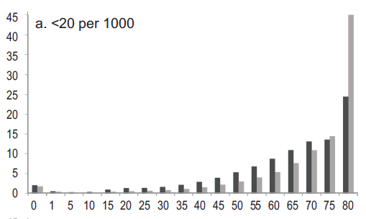
ANACoD - PART II: MORTALITY LEVELS ANALYSIS
Step 4: Review the age distribution of deaths
Compare the calculated distribution of deaths to expected distributions corresponding to: infant mortality group
Notes:
Observations are similar using countries with similar infant mortality rates for comparison.

Slide 73
ANACoD - PART II: MORTALITY LEVELS ANALYSIS
Step 5: Child mortality rates
Enables users to:
Calculate & interpret indicators of under-five mortality
  Infant mortality rate (ANACoD, UQWP13)
  Probability (per 1,000 live births) of a child born in a specified year dying before reaching the age of 1 if subject to current ASMRs
  Under 5 mortality rate (ANACoD, UQWP13)
  Probability (1,000 live births) of a child born in a specified year dying before reaching the age of 5 if subject to current ASMRs
  Neonatal mortality rate (UQWP13)
  Post neonatal mortality rate (UQWP13)
Use under-five mortality indicators from various sources to analyze the quality of mortality data
Notes:
See slide set 5 on analysis of vital statistics for more information on how to calculate the indicators of under-five mortality.

Slide 74
ANACoD - PART II: MORTALITY LEVELS ANALYSIS
Step 5: Child mortality rates
Calculate indicators of
under-five mortality:
1. Child deaths by age and calculation of mortality indicators:
Data from Civil registration, 2009
 | x | n | Population | Deaths | _{n}m_{x} | _{n}q_{x}
 | 0 | 1 | 913341 | 9601.941 | 0.0105 | 0.0104
 | 1 | 4 | 3581718 | 2061.323 | 0.0006 | 0.0023
 | Infant mortality rate per 1000 live births |  |  |  | = 1000* ₁q₀ |  | ==> | 10.4
 | Under-5 mortality rate per 1000 live births |  |  |  | = 1000*[1-(1-₁q₀)(1-₄q₁)] ==> |  |  | 12.7
x = beginning of the age interval
n = number of years in the interval
Population = from entered data; sum of male and female population in Step 2.
Deaths = from entered data; sum of male and femal deaths in Step 2.
_{n}m_{x} = mortality rate (ASMR) for age x to age n; Deaths/Population.
_{n}q_{x} = probability of a child dying between age x and age n; automatically calculated (see ANACoD guidance for calculation details).
Notes:
The calculations used to determine infant and under-5 mortality rates are performed automatically using the entered data. See the ANACoD Guidance document for Step 5 for more details on how to calculate the probability of a child dying between age x and age n.

Slide 75
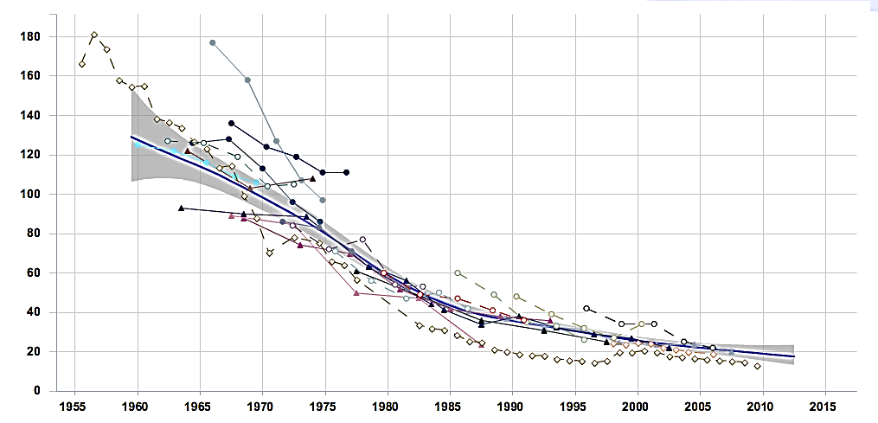
ANACoD - PART II: MORTALITY LEVELS ANALYSIS
Step 5: Child mortality rates
Use under-five mortality indicators from various sources to analyze the quality of mortality data: Deviations from “best fit” line indicate over- or under- reporting.
Under-Five Mortality Rate, Columbia
Child Mortality Estimates
www.childmortality.org
“Best fit”
Census data
Various surveys
Vital registration data
Notes:
Step 5 instructs users to www.childmortality.org. If internet is not available, the instructor may complete this step ahead of time to generate the relevant graph for reference, or the class may interpret the graph presented on the slide.
To interpret the Under-Fiver Mortality Rate, Step 5 refers users to www.childmortality.org to generate a graph comparing the country’s Under-Five Mortality Rate, as measured by various data sources, including the census, surveys, and vital registration data. Large differences between the levels of under-five mortality rates calculated from the reported data and other sources, such as censuses, household surveys or estimates developed by UN international agencies are likely to be due to underreporting of child deaths in the country.
There are particular reasons why deaths occurring in young children are less likely to be registered than deaths in adulthood. In settings where civil registration is not universal, deaths are generally only registered when there are some benefits attached to doing so, for example to claim land ownership and inheritance or to claim compensation by the dependants. Registering the death of a child is not usually linked to such a benefit and as a result many such deaths remain unregistered. In such settings, data on infant and child mortality estimated from censuses and surveys tend to be more reliable.
For additional information on ways to measure incompleteness of death reporting, see Step 5 in the ANACoD guidance document and UQWP13.

Slide 76
ANACoD - PART III:
CAUSES OF DEATH ANALYSIS
  Steps 6-10
  Focus on simple steps to assess the plausibility of data on causes of death
The objectives of steps 6-10 are to enable users to:
  Calculate broad patterns of causes of death
  Critically analyse and interpret cause of death data
  Assess the plausibility of the cause of death patterns emerging from the data

Slide 77
ANACoD - PART III: CAUSES OF DEATH ANALYSIS
Step 6: Distribution of death according to the Global Burden of Disease list
Enables users to:
Calculate the percentage distribution of deaths by broad disease groups
Compare distribution to what would be expected for the population (based on level of life expectancy)
Identify potential problems in quality of data based on deviations from expected patterns
Notes:
Activity: Participants and instructors should review the ‘ANACoD version 1.0 Guidance’ document, Step 6 for additional information about the distribution of death according to the Global Burden of Disease list.

Slide 78
ANACoD - PART III: CAUSES OF DEATH ANALYSIS
Step 6: Distribution of death according to the Global Burden of Disease list
Global Burden of Disease cause list:
Group I: Communicable diseases, e.g.:
TB, pneumonia, diarrhoea, malaria, measles
Maternal and perinatal causes (e.g. maternal haemorrhage, birth trauma)
Nutritional conditions (e.g. protein-energy malnutrition)
Group II: Non-communicable diseases, e.g.:
Cancer, diabetes, heart disease, stroke
Group III: External causes of mortality , e.g.:
Accidents, homicide, suicide
Notes:
A first step in any quality assessment of cause of death data is to calculate the percentage distribution of deaths by broad disease groups and compare the results with what would be expected given the level of life expectancy for the population. ANACoD uses the broad disease group of the Global Burden of Disease.

Slide 79
ANACoD - PART III: CAUSES OF DEATH ANALYSIS
Step 6: Distribution of death according to the Global Burden of Disease list
Compare distribution to what would be expected for the population (based on life expectancy): Deviations suggest potential problems with the certification and/or coding of causes of deaths.
Calculating proportions of groups 1, 2 and 3 after redistribution of deaths from unknown sex and ill-defined diseases
…
Proportions to total deaths
grp1 | 0.11
grp2 | 0.71
grp3 | 0.18
 | 1.00
New totals after all the above adjustments | 196681
Colombia life expectancy, 2011: 78 years
(WHO Global Health Observatory)
Table 2: Expected distribution of causes of death according to life expectancy by broad groups
Life Expectancy | 55 years | 60 years | 65 years | 70 years
Group I causes of death (communicable) | 22% | 16% | 13% | 11%
Group II causes of death (non-communicable) | 65% | 70% | 74% | 78%
Group III causes of death (external) | 13% | 14% | 13% | 11%
Notes:
Step 6 requires an estimate of life expectancy (independent of the civil registration system). If internet is available, participants may get estimates from WHO’s Global Health Observatory: http://apps.who.int/gho/data/node.main.3?lang=en. If internet is not available, the instructor may complete this step ahead of time and provide the information to the participants.
In Step 6, from the data entered in Step 0, ANACoD shows the number of deaths assigned to the various ICD codes by sex and by age. A second table starting in row 173 shows the redistribution of deaths from 1) unknown age (despite incorrect title indicating redistribution of deaths from unknown sex), and 2) ill-defined diseases. In rows 184-186, this table shows the proportion of total deaths distributed to Groups 1, 2, and 3 after redistribution for both unknown age and ill-defined diseases. (Note that the UQWP13 suggests that ill-defined causes should be excluded from the calculation of percentage of death assigned to groups 1, 2, and 3).
The expected percentage distribution of causes of death into these three broad groups varies in different countries according to where they stand in relation to the so called “health transition” – an interrelated set of changes in demographic structures, patterns of disease and risk factors. A simple but effective way of checking the plausibility of mortality data is to compare the observed patterns of causes of death with what would be expected given the local levels of life expectancy (at birth). As a general rule, countries with low life expectancy are characterised by high levels of mortality due to infectious and parasitic diseases especially in childhood, along with high maternal mortality (i.e. Group I causes). As life expectancy rises, the pattern of mortality changes, with more deaths occurring in older age groups due to non-communicable conditions such as cardiovascular diseases and cancers (i.e. Group II causes).
In making this comparison, it is important to use an independent source of life expectancy data (e.g. WHO, or the United Nations, or from your census), not the life expectancy calculated from the civil registration data, as this may be unreliable if the system is incomplete. Estimates from WHO’s Global Health Observatory: http://apps.who.int/gho/data/node.main.3?lang=en; for Colombia in 2011 – 78 for both sexes.
Significant departures from these patterns suggest potential problems with the certification and/or coding of causes of deaths.

Slide 80
ANACoD - PART III: CAUSES OF DEATH ANALYSIS
Step 7: Age pattern of broad groups of causes of death (Distribution of major causes of death)
Enables users to:
Observe age-pattern of deaths from broad causes
Check if pattern is consistent with expected patterns of countries from same income level
Identify potential problems associated with:
  Poor medical certification of cause of death
  Poor coding practices
  Age-misreporting of deaths
  Bias in reporting certain infectious diseases
Notes:
Activity: Participants and instructors should review the ‘ANACoD version 1.0 Guidance’ document, Step 7, for additional information about the use of age patterns of broad groups of causes of death.
Demographers and epidemiologists have used many years of data and observations on patterns of causes of death in different settings to develop the expected age patterns for cause of death. Any significant deviation from the expected pattern that cannot be explained by some local, external factor should be viewed as a potential problem with the quality of the cause of death data.

Slide 81
ANACoD - PART III: CAUSES OF DEATH ANALYSIS
Step 7: Age pattern of broad groups of causes of death (Distribution of major causes of death)
Colombia, 2009 -- Observed
Upper middle income countries -- Expected
Group 1: Communicable
Group 2: Non-communicable
Group 3: External
Notes:
In Step 7, ANACoD automatically generates a figure with the distribution of the broad causes of death groups for both males and females. While the expected age-patterns do not change very much with increasing life expectancy, for comparison, ANACoD provides a unique distribution for each of four income levels.
While the pattern for communicable diseases among males in Colombia appear to follow the general expected pattern, being more common in the younger ages and again in the oldest ages, the distribution is lower than expected among 15-50 year olds. This may indicate a bias in reporting certain infectious diseases (e.g., HIV/AIDS). Non-communicable diseases from Group II also follow the same general pattern as expected, being most common in the older ages, with a slight peak between 5 and 15 years. However, they are a little lower than expected between about 15 and 55 years. This observation might be explained by corresponding deviations in external causes from Group III, which are higher than expected among males 15-55 years. This observation is consistent with findings from previous steps and may be an indication of real increases in deaths due to external causes among males in this age group.

Slide 82
ANACoD - PART III: CAUSES OF DEATH ANALYSIS
Step 7: Age pattern of broad groups of causes of death (Distribution of major causes of death)
Colombia, 2009 -- Observed
Upper middle income countries -- Expected
Group 1: Communicable
Group 2: Non-communicable
Group 3: External
Notes:
Comparing females, we see a similar issue as for males: the pattern for communicable diseases (Group I) appears to follow the general expected pattern for the youngest and oldest age groups, though the distribution is much lower than expected among 15-50 year olds; again, this may indicate a bias in reporting certain infectious diseases (e.g., HIV/AIDS). Non-communicable diseases from Group II follow the same general pattern as expected, though the proportions remain consistently higher than expected for those under 35 years, likely accounting for some of the possible under-reporting from Group 1. Finally, the observed data follow the general expected pattern for external causes from Group III, though again we see higher than expected proportions among females about 20 to 35 years of age, which, like males, may be an indication of real increases in deaths due to external causes in this age group.

Slide 83
ANACoD - PART III: CAUSES OF DEATH ANALYSIS
Step 8: Leading causes of death
Enables users to:
Determine the distribution of leading causes of death for the country
Compare observed distribution to distributions expected in other countries of similar income level
Identify deviations that would be indicative of potential biases in certification and coding practices
Notes:
Activity: Participants and instructors should review the ‘ANACoD version 1.0 Guidance’ document, Step 8, for additional information about leading causes of death.
An analysis of the leading causes of death can indicate certain biases in the certification and coding of causes of death thus indicating the degree of reliability of the cause of death data from the civil registration system. Significant departures from the average rankings of leading causes of death from countries with similar income levels are suggestive of problems with the quality of cause of death data.

Slide 84
ANACoD - PART III: CAUSES OF DEATH ANALYSIS
Step 8: Leading causes of death
Compare distribution of leading causes:
Deviations may indicate biases in certification or coding practices
20 leading causes of death, all ages
 | Both sexes | Nos | %total
1 | Ischaemic heart disease | 27,597 | 14.0
2 | Homicide | 19,680 | 10.0
3 | Cerebrovascular disease | 13,870 | 7.1
4 | Chronic obstructive pulmonary dis. | 10,265 | 5.2
5 | Other cardiovascular diseases | 8,674 | 4.4
6 | Other digestive diseases | 7,111 | 3.6
7 | Diabetes mellitus | 6,469 | 3.3
8 | Lower respiratory infections | 6,442 | 3.3
9 | Other malignant neoplasms | 6,441 | 3.3
10 | Road traffic accidents | 6,377 | 3.2
11 | Hypertensive disease | 5,664 | 2.9
12 | Stomach cancer | 4,450 | 2.3
13 | Ill-defined diseases (ICD10 R00-99) | 4,289 | 2.2
14 | Trachea, bronchus and lung cancers | 3,898 | 2.0
15 | Nephritis and nephrosis | 3,199 | 1.6
16 | Other respiratory diseases | 2,732 | 1.4
17 | Colon and rectum cancers | 2,575 | 1.3
18 | Prostate cancer | 2,419 | 1.2
19 | HIV | 2,340 | 1.2
20 | Self-inflicted injuries | 2,259 | 1.1
Upper middle income countries
 | Both sexes | Nos (000) | %total
1 | Ischaemic heart disease | 1,508 | 19.1
2 | Cerebrovascular disease | 1,035 | 13.1
3 | Other cardiovascular diseases | 419 | 5.3
4 | HIV | 377 | 4.8
5 | Lower respiratory infections | 295 | 3.7
6 | Diabetes mellitus | 248 | 3.2
7 | Hypertensive disease | 224 | 2.8
8 | Road traffic accidents | 196 | 2.5
9 | Chronic obstructive pulm. dis | 189 | 2.4
10 | Other malignant neoplasms | 189 | 2.4
11 | Other digestive diseases | 183 | 2.3
12 | Other unintentional injuries | 178 | 2.3
13 | Trachea, bronchus ,lung can. | 175 | 2.2
14 | Homicide | 171 | 2.2
15 | Cirrhosis of the liver | 146 | 1.8
16 | Stomach cancer | 122 | 1.5
17 | Other respiratory diseases | 117 | 1.5
18 | Colon and rectum cancers | 113 | 1.4
19 | Other infectious diseases | 108 | 1.4
20 | Inflammatory heart diseases | 104 | 1.3
Notes:
The percentage distribution of leading causes (by specific disease groups) globally, and in low-income, middle-income and high-income countries (using World Bank definitions) are shown in the spreadsheet. These charts can assist countries to ascertain divergences in their reported leading causes of death compared with leading causes of death estimated by WHO. These global estimates refer to the average experience of all countries in each of the country groups, and hence it is unlikely that the percentage distribution of deaths in any one country would exactly match them. However, significant departures from these average rankings of leading causes of death are suggestive of problems with the quality of cause of death data.
In this example, Colombia has a particularly high percentage of deaths from homicide (yellow), compared to other upper middle income countries; consistent with previous observations, this may be indicative of an epidemic level of homicides in Colombia. The percentage of HIV (blue) for Columbia is notably low; consistent with previous observations regarding infectious disease, this may be indicative of biased reporting practices.
Lastly, it is recommended practice that countries include ill-defined causes as a category in their rankings in order to see how frequently these causes are coded. In many cases, ill-defined causes may be in the top 3 or 4 leading causes of death. This suggests serious problems with certification and/or coding in the country. These ill-defined causes, while unfortunately commonly reported, are of absolutely NO value for informing public health policies and debates in countries. In this case, ill-defined causes are only 2.2% of deaths, which is not an alarming number. (note: ill-defined causes were not included as a category in the comparison tables).

Slide 85
ANACoD - PART III: CAUSES OF DEATH ANALYSIS
Step 9: Ratio of non-communicable to communicable causes of death
Enables users to:
Calculate the ratio of deaths from non-communicable diseases to communicable diseases for the country
Compare the country ratio to the world and 4 income groupings
Identify deviations that are suggestive of errors in cause of death data
Notes:
Activity: Participants and instructors should review the ‘ANACoD version 1.0 Guidance’ document, Step 9, for additional information about the use of the ratio of non-communicable to communicable diseases.

Slide 86
ANACoD - PART III: CAUSES OF DEATH ANALYSIS
Step 9: Ratio of non-communicable to communicable causes of death
Compare ratio for country to similar income group:
Deviations indicate potential errors in cause of death data
Notes:
As countries develop their health systems, communicable diseases such as diarrhoea and pneumonia, as well as maternal, perinatal and nutritional risks will be increasingly brought under control. As a result, more and more people will survive to adulthood where chronic diseases such as ischaemic heart disease, stroke, cancer and chronic obstructive pulmonary diseases, claim more and more lives. Hence, the simple ratio of Group II deaths/Group I deaths should progressively increase as a country moves through the epidemiological transition (i.e. as life expectancy increases).
Deviations from the ratios for countries in similar income levels indicate potential errors in the cause of death data.
For Colombia, an upper middle income country, the ratios are similar, though Colombia may slightly overestimate the number of non-communicable deaths. This observation is consistent with previous findings that suggest HIV and other communicable diseases may be under-reported.

Slide 87
ANACoD - PART III: CAUSES OF DEATH ANALYSIS
Step 10: Ill-defined causes of death
Enables users to:
Calculate the proportion of deaths attributed to ill-defined causes of death
Evaluate the proportion of ill-defined causes of death against recommended levels
Identify target areas for remedial action to reduce usage of ill-defined causes of death
Notes:
Activity: Participants and instructors should review the ‘ANACoD version 1.0 Guidance’ document, Step 10, for additional information about ill-defined causes of death.
When a death occurs and is medically certified, every effort should be made to correctly ascertain the underlying cause of death in order to be able to draw conclusions about the leading causes and about the need for priority public health interventions. Classification of deaths to ill-defined conditions does not generate information of public health value. Where a high proportion of all deaths is classified as being due to ill-defined causes, the cause-of-death distribution will be biased and unreliable.

Slide 88
Ill-defined causes are: ‘symptoms, signs and abnormal clinical and laboratory findings, not elsewhere classified.’ They arise from:
Deaths classified as ill-defined (Chapter XVIII of ICD-10)
Deaths classified to any one of the following vague or unspecific Dx:
A40-A41 Streptococcal and other septicaemia
C76, C80, C97 Ill-defined cancer sites
D65 Disseminated intravascular coagulation [defibrination syndrome]
E86 Volume depletion
I10 Essential (primary) hypertension
I269 Pulmonary embolism without mention of acute cor pulmonale
I46 Cardiac arrest
I472 Ventricular tachycardia
I490 Ventricular fibrillation and flutter
I50 Heart failure
I514 Myocarditis, unspecified
I515 Myocardial degeneration
I516 Cardiovascular disease, unspecified
I519 Heart disease, unspecified
I709 Generalized and unspecified atherosclerosis
I99 Other and unspecified disorders of circulatory system
J81 Pulmonary oedema
J96 Respiratory failure, not elsewhere classified
K72 Hepatic failure, not elsewhere classified
N17 Acute renal failure
N18 Chronic renal failure
N19 Unspecified renal failure
P285 Respiratory failure of newborn
Y10-Y34, Y872 External cause of death not specified as accidentally or purposely inflicted
Notes:
Ill-defined causes are vague diagnoses often described as ‘symptoms, signs and abnormal clinical and laboratory findings, not elsewhere classified’ that the ICD-10 advises should not be used as the underlying cause-of-death.

Slide 89
ANACoD - PART III: CAUSES OF DEATH ANALYSIS
Step 10: Ill-defined causes of death
% ill-defined should ideally be:
≤ 10% for deaths at ages 65 years and over
< 5% for deaths at ages below 65 years
 | Both |  | Male | Female | Male
 | All ages |  |  |  | 0 | 1-4 | 5-9 | …
All causes | 196681 | 113327 |  | 83354 | 5333 | 1121 | 629 | …
Ill-defined causes by ICD-10 chapter:
I. Infectious and parasitic diseases | 1024 | 502 |  | 522 | 56 | 16 | 5 | 5
II. Neoplasms | 1773 | 843 |  | 930 | 2 | 7 | 5 | 4
III. … | 74 | 37 |  | 37 | 13 | 4 | 1 | 1
Total of ill-defined | 18989 | 10395 |  | 8594 | 415 | 145 | 80 | 69
as % of All causes | 9.7% | 9.2% |  | 10.3% | 7.8% | 12.9% | 12.7% | …
Notes:
Activity: Participants and instructors should review the ‘ANACoD version 1.0 Guidance’ document, Step 10, for additional information about ill-defined causes of death.
The ANACoD guide suggests that the proportion of deaths assigned to ill-defined causes should ideally be <= 10% for deaths at ages 65 years and over and < 5% for deaths at ages below 65 years. However, from the data in our example, no age/sex category meets these recommendations for ages below 65 years. The level of <= 10% is more universally applied across age groups, as is indicated by the >10.0% criteria for highlighting in the ANACoD tool.
Specific attention should be focused on improving cause of death certification and coding for any age/sex group that exceeds 10% ill-defined.

Slide 90
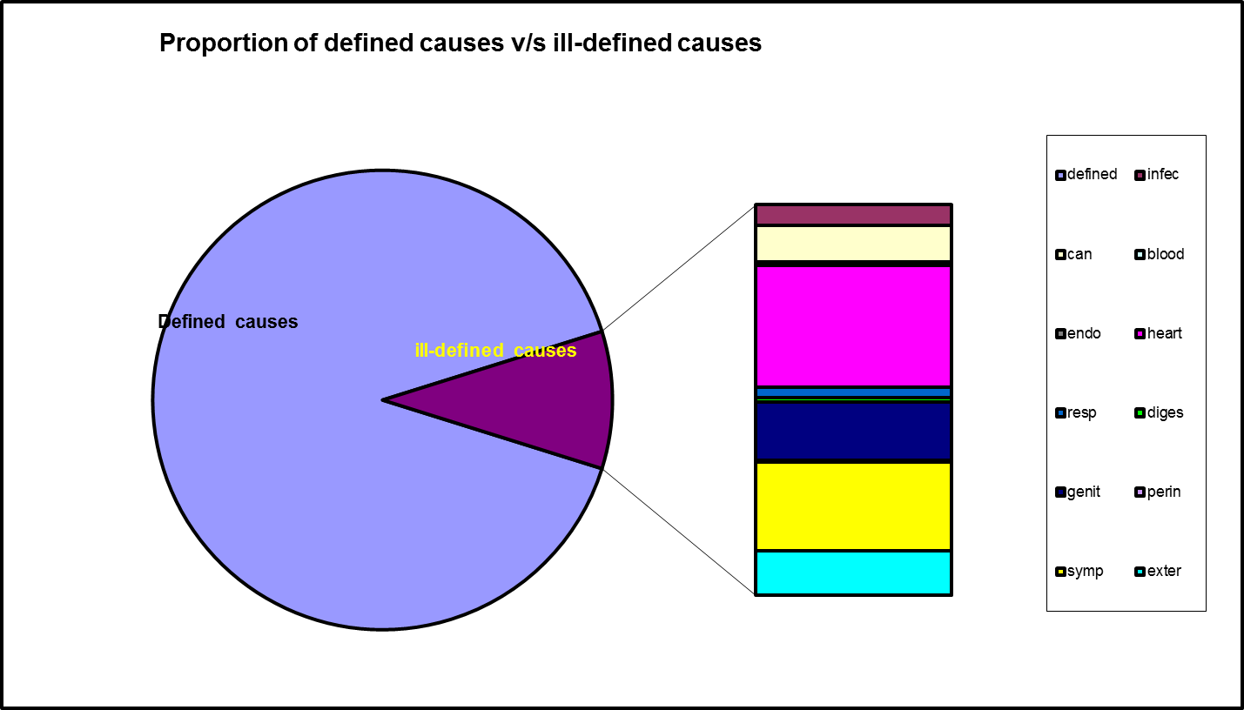
ANACoD - PART III: CAUSES OF DEATH ANALYSIS
Step 10: Ill-defined causes of death
Specific causes among ill-defined causes can be used to target improvement efforts.
Notes:
ANACoD also automatically generates a pie chart showing a break down of the specific causes for deaths assigned to ill-defined causes. This chart can be used to target improvement efforts and retraining for medical certification and coding of cause of death.

Slide 91
ANACoD Wrap up
The “Summary” sheet provides a summary report of findings
With ANACoD, the user is able to:
Derive the mortality profile of the country/area analysed
Develop a critical view on the quality of mortality data
Understand further cause-of-death statistics
Limitations of ANACoD include:
Partial data are not adjusted for incompleteness by the tool
The tool cannot improve the quality of poor data, but it can provide insights on medical certification or coding problems
Currently only data coded to ICD-10 three or four characters can be analysed

Slide 92
References
(Freedman) Freedman MA. Improving Civil Registration and Vital Statistics. The World Bank. 2003.
(Mahapatra) Mahapatra P, Shibuya K, Lopez AD, et al. Civil registration systems and vital statistics: successes and missed opportunities. Who Counts? 2. Lancet. 370:1653-63. 2007.
(NCHS) National Center for Health Statistics. Methods of Civil Registration: Modular Course of Instruction.
(PRVSS2) UN. Principles and Recommendations for a Vital Statistics System, Revision 2. New York. 2001.
Statistics South Africa. Mortality and causes of death in South Africa, 2009: Findings from death notification. Statistical release P0309.3. (p16)
Bradshaw D, et al. Cause of death statistics for South Africa: Challenges and possibilities for improvement. Medical Research Council, South Africa. November 2010.
(UQWP13) AbouZahr C, Mikkelsen L, Rampatige R, Lopez A. Mortality statistics: a tool to improve understanding and quality. Health Information Systems Knowledge Hub, University of Queensland. Working Paper 13. Nov 2010.
(ANACoD) World Health Organization (2013). Analysing mortality levels and causes-of-death (ANACoD) Electronic Tool, Version 1.1. Department of Health Statistics and Information Systems, WHO, Geneva, Switzerland.
(WHO/HMN) WHO, University of Queensland. Rapid assessment of national civil registration and vital statistics systems. WHO: Geneva. 2010.
(WHO/UQ) WHO, University of Queensland. Improving the quality and use of birth, death and cause-of-death information: guidance for a standards-based review of country practices. WHO: Geneva. May 2010.
(WHO/IMR) WHO. Indicator and Measurement Registry. Version 1.6.0. Civil registration coverage of deaths (%).
(WHOSIS) WHO Statistical Information Systems. Indicator definitions and metadata, 2008. Age-standardized mortality rates by cause.

Slide 93
Activity
Comparison of Vital Event Definitions:
In small groups, discuss the degree to which the vital event definitions used in your country match those used by WHO. If differences exist, discuss:
  Philosophies behind them
  Whether or not those differences affect the registration system or interpretation of vital statistics
Share with the class.
Notes:
This exercise can be conducted at a country or regional level (comparing definitions across countries in a region). The vital event definitions used in the country or region should be compiled and distributed to class. The WHO/ICD Definitions handout can be used as a reference for WHO recommendations (see Appendix A in Participant Notes).
If the information is available, also discuss with the class how closely definitions are followed by hospitals, registrars, sub-areas, and at the national level.

Slide 94
Activity
Data Quality Review:
In small groups, review and compare various reports for the aspects of data quality:
  Accuracy
  Timeliness
  Comparability
  Relevance
  Accessibility
Discuss observations with class.
Notes:
Note: This activity may be combined with the Vital Statistics Report Review Activity from Slide Set 6 on Data Uses and Dissemination.
Information for responding to the items in this activity will depend on the reports used for this exercise. Reports focusing on data quality or a review of mortality or natality measurement may provide more useful/relevant information.
Participants should review the slides in this lecture and look for relevant information in the reports (presented in report text, tables, and/or figures) on the various aspects of data quality. If necessary, the instructor can guide the students through the exercise by asking prompting questions to guide students to the relevant information (see comments/questions below). Alternatively, a list of prompts has been included in the Participant Notes (see Activity Materials section).
Accuracy: Information on accuracy is likely to be contained in the introductory chapters and in technical notes on methods.
-Coverage/Completeness: Look for comment on coverage and the various measures of coverage errors in civil registration systems. Are data available from all regions in the country? Are there extreme changes in the number of events reported over time? Look for the various items reported on Slide 19 (Comparisons, for coverage errors in vital statistics). What appear to be the reasons for any under-coverage observed?
-Missing & Erroneous Data: Are there missing or unknown items (e.g. missing sex or age). Are there zero cells in tables?
-Use of ill-defined categories: What % of deaths are classified as ill-defined/miscellaneous (for countries with medical certification of cause of death)? Is this less than 25% unknown?
-Improbable classifications: This information is likely corrected prior to publication. The technical notes may include comment on improbable classifications.
Timeliness: Review dates of data and date of publication. What is the average lag time? What is the shortest lag time? Is there information on the percentage of events that occurred in previous years?
Comparability: Are data comparable within the country? Do all registration areas use the same definitions? Are the data comparable to other countries? Does the country use ICD/WHO definitions?
Relevance: Are data available for sub-populations (e.g. race/ethnic, regions, urban/rural, age)? Are cross-tabulations provided for various sub-populations?
Accessibility: Are data available in any other format? Are user services available for questions or additional information requests? This information is likely contained in introductory sections or technical notes.
Recommended resource material (same materials from report review activities in Slide Set 6: Data Uses and Dissemination):
Latest volume of WHO’s World Health Statistics Annual
Several issues of latest Monthly Vital Statistics Reports of the US NCHS
Latest volumes of US Vital Statistics
Latest vital statistics reports of several countries/ your country

Slide 95
Overall Review
  Good statistical systems are efficient, credible, and (subjective / objective).
  The quality of vital statistics data is judged based on (reliability / accuracy), timeliness, comparability, relevance, & accessibility.
  (Direct / Indirect) assessment of coverage error includes comparing the total number of vital events registered and reported to the statistical agency for a given period with the number registered and reported in a previous, similar period.
  (Direct / Indirect) assessment of coverage error includes regularly querying and monitoring statistical returns from local registrars.
  Production time is the mean time from (beginning / end) of reference period to publication.
Notes:
Good statistical systems are efficient, credible, and (subjective/objective).
The quality of vital statistics data is judged based on (reliability / accuracy), timeliness, comparability, relevance, and accessibility.
(Direct / Indirect) assessment of coverage error includes comparing the total number of vital events registered and reported to the statistical agency for a given period with the number registered and reported in a previous, similar time period.
(Direct / Indirect) assessment of coverage error includes regularly querying and monitoring statistical returns from local registrars.
Production time is the mean time from (beginning / end) of reference period to publication.

