Slide 1
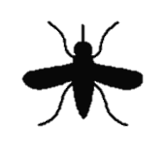
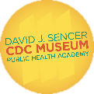
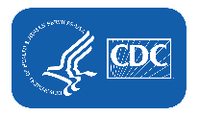
Trapping Mosquitoes
Notes:
Almost everyone in the world has been bitten by a mosquito. Although most species of mosquitoes are just a nuisance, some spread pathogens, like viruses or parasites, that cause infectious diseases. For most viruses spread by mosquitoes, no vaccines or specific medicines are available.
Note: These slides are made possible by the David J. Sencer CDC Museum Public Health Academy. https://www.cdc.gov/museum/education/lessons/

Slide 2
Terms to Know
 | people who help collect data for research projects conducted by professional scientists
 | an insect that transmits disease
 | a tiny, infectious particle that lives inside living organisms
 | any disease caused by a pathogen (germ) such as a virus, bacteria, parasite, or fungus
 | a sudden occurrence or increase of something
 | a small organism that gets its food and shelter from others
 | a scientist who studies how disease spreads and can be controlled
 | the science of protecting and improving the health of people and their communities
Word Bank
infectious disease
public health
vector
outbreak
parasite
citizen scientist
virus
epidemiologist
Notes:
Terms to know:
Citizen scientists: people — young or old — who help collect data for research projects conducted by professional scientists
Vector: an insect that transmits disease
Virus: a tiny, infectious particle that lives inside living organisms
Infectious disease: any disease caused by a pathogen (germ) such as a virus, bacteria, parasite, or fungus
Outbreak: a sudden occurrence or increase of something
Parasite: a small organism that gets its food and shelter from others
Epidemiologist: a scientist who studies how disease spreads and can be controlled
Public health: the science of protecting and improving the health of people and their communities

Slide 3
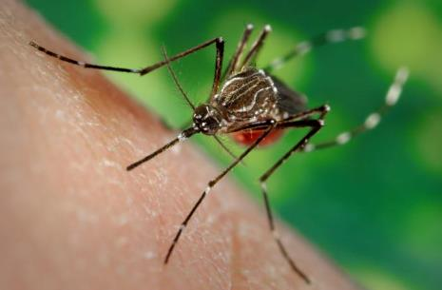
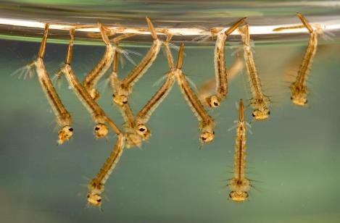
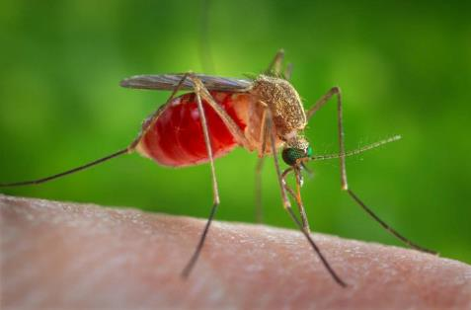
Understanding Mosquitoes
Bite: day and night
Live: indoors and outdoors
Prefer warm temperatures
In case of cold: hibernate in enclosed spaces
Sheds
Garages
Inside or under homes
Notes:
Mosquitoes bite during the day and night, live indoors and outdoors, and search for warm places as temperatures begin to drop. To survive cold temperatures, some mosquitoes hibernate in enclosed spaces, like garages, sheds, and under (or inside) homes. Except for the southernmost states in North America, mosquito season starts in the summer and continues into fall.

Slide 4
Think About It
What attracts mosquitoes?
At what times of day have you seen mosquitoes?
Where do you see mosquitoes most in your community?

Slide 5
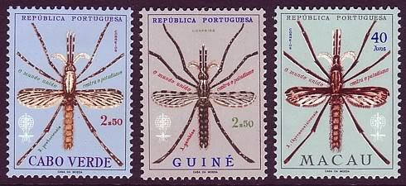
Mosquitoes and malaria
Malaria:
Infectious disease
Caused by Plasmodium (parasite)
Mosquitoes = vectors
Mosquitoes transfer parasite to humans through mosquito bites
Notes:
Mosquitoes bite during the day and night, live indoors and outdoors, and search for warm places as temperatures begin to drop. To survive cold temperatures, some mosquitoes hibernate in enclosed spaces, like garages, sheds, and under (or inside) homes. Except for the southernmost states in North America, mosquito season starts in the summer and continues into fall.
Malaria is an infectious disease caused by the Plasmodium parasite. The parasite is carried by mosquitoes, which act as vectors by transferring the parasite to humans through mosquito bites. Malaria enters a person’s bloodstream and causes the person to experience flu-like symptoms, including fevers and chills. Untreated, people with the disease can experience more severe symptoms and die.

Slide 6
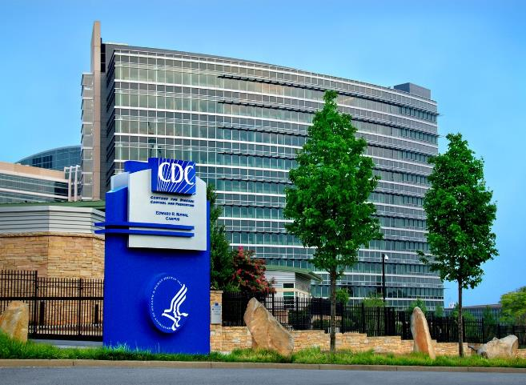
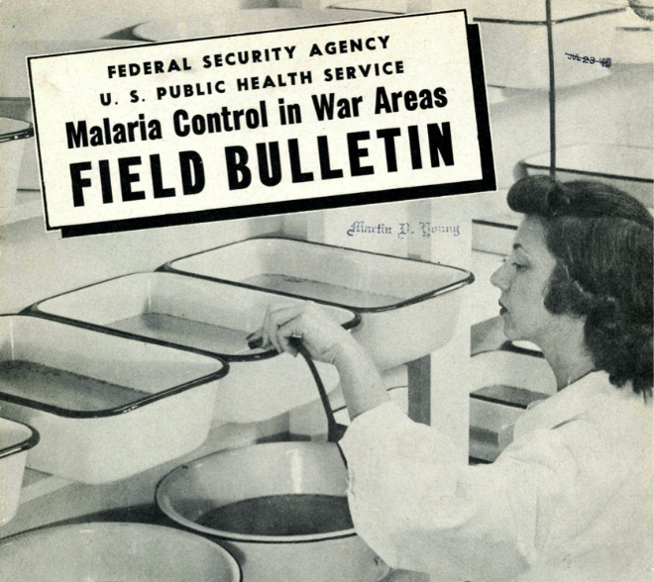
Malaria and CDC
1940s: WWII
Outbreak of malaria in southern U.S.
Malaria Control in War Areas (MCWA) unit created
Dr. Joseph Mountin
Rid southern United States of disease-causing mosquitoes
Beginnings of CDC
Notes:
CDC has been on the frontlines of mosquito population control for over 75 years. In fact, it was the need to protect the public from the mosquitoes that carry malaria that gave CDC its start.
Back in the 1940’s, states in the southern United States were experiencing a significant outbreak of malaria. The timing could not have been worse; the United States was in the middle of World War II, and soldiers from the United States trained in the southern states where the disease was spreading. Previous research had shown that the disease was carried by mosquitoes, so the federal government was desperate for a way to control these insects.
Dr. Joseph Mountin of the Public Health Services Bureau of State Services (now known as the United States Public Health Service), was given the job of creating a task force to battle the mosquito populations. He chose Atlanta as a base since it had been hit hard by the disease and served as a transportation hub for the country. The department, the Malaria Control in War Areas (MCWA) unit, was extremely effective in ridding the southern states of the mosquitoes causing the disease.
Realizing there was a need to have a unit dedicated to researching and reducing the spread of infectious diseases like malaria, Dr. Mountin pushed to continue and expand the program, and from his efforts, CDC was born! Today, CDC continues to work with local, state and national health officials to provide advisement, protocols and ground support for public health.

Slide 7
Think About It
What is the goal of the United States Public Health Service?
Why was it important that the MCWA be located in the southern United States?
How did controlling malaria change the way we handled public health issues?

Slide 8
From the Expert
https://youtu.be/xabI2Oxl6-k
Notes:
Listen to a breakdown of how mosquitoes are bred and used in tests to determine if they are becoming resistant to the insecticides used in nets and spray to prevent malaria. CDC’s malaria expertise and global partnerships have helped save millions of lives. https://youtu.be/xabI2Oxl6-k

Slide 9
Think About It
What location will you use for your trap?
How often will you need to check your trap?
How will you record the data from your trap?

Slide 10
Give it a Try
Call to Action!
Create + implement mosquito management plan
Build mosquito trap
Share your findings
Why do you think participation is important?
Notes:
Why Participate? A Message from CDC
Mosquito control and prevention will work best with public awareness and support. Because of this, CDC uses various ways to educate the public about the role mosquitoes play in transmitting disease, including this activity. It is important for each person to have a good understanding of mosquitoes, the benefits realized from their control and the role people have in preventing certain mosquito-borne diseases.
As a citizen scientist, you are now equipped with some of the knowledge CDC shares with the public. You can help further spread information about mosquitoes by sharing what you’ve learned with your peers, continuing your work to keep down mosquito populations, and leading your peers in their own investigations. Feel you need support to share CDC’s message? More information can be found at https://www.cdc.gov/mosquitoes/index.html.

Slide 11
Create a Mosquito Management Plan
Ask
Ask a question
Research
Do background research
Hypothesis
Construct hypothesis
Test
Test with an experiment
Analyze
Analyze data
Draw conclusions
Conclusions
Share
Communicate results
Notes:
The scientific method is a great tool to use to create a plan to address mosquito populations in your own yard. Within it you can track your investigation. Use the flow chart below to think out your plan. Record your answers in a composition notebook.

Slide 12
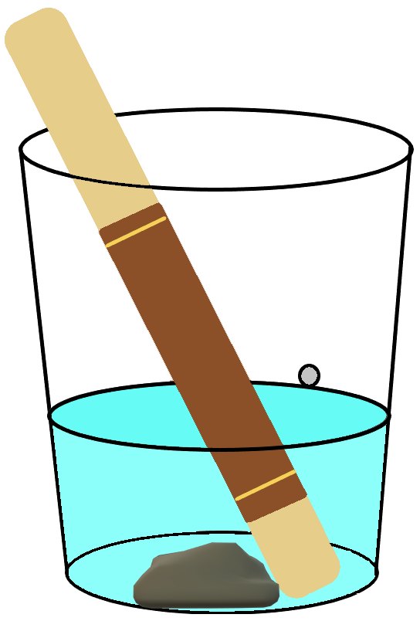
Give it a Try
1. Build a Mosquito Trap
Prepare the Oviposition Cup
Prepare the Ovipaddle
Place the Trap
Notes:
Tools of the Trade
In order to trap mosquitoes, you will need to design and build an ovitrap. The word ovitrap comes from two words - ovi (meaning egg) and trap (meaning, well, trap). You will need the following materials:
Cups: 16 oz party cups (your choice of color or clear)
Ovipaddle: 6” jumbo craft sticks
Ovipaper: 8” unbleached paper towel
Water: Ovitraps work best with dechlorinated water. To dechlorinate tap water, collect the tap water and allow it to air out for several days before the experiment.
Other Tools: power drill, ruler, stapler or rubber bands, permanent marker, insect repellant
Prepare the Cup
1. Using a ruler, measure the cup from bottom to top. Use a permanent marker to make a small line at the 3” mark.
2. Creating the trap requires the use of a power drill. You may need an adult’s help to drill or on top of the mark. Carefully drill a hole at the mark.
Prepare the Ovipaddle
3. Cut the paper towel to 6” in length.
4. Wrap the cut paper towel around the craft stick. Secure the paper towel to the stick using staples or rubber bands at the top and bottom of the stick.
5. Use the permanent marker to label the ovipaddle with your initials.
Place the Trap
Expert Tip: When setting your trap, be sure to protect yourself from mosquito bites. Wear long-sleeved shirts and long pants and use an EPA-registered insect repellent before beginning.
6. Find a space outside your home where your ovitrap won’t be disturbed. It should be a flat, shady spot that you can easily access. Tip: Add a rock to the bottom of your cup to prevent it from blowing over in strong winds.
7. Label the ovipaddle with the date. Fill the cup to the hole with water and place the ovipaddle in the cup.
8. Place the ovitrap in your selected spot. The cup will remain in this spot for a week.

Slide 13
Give it a Try
2. Implement a Mosquito Management Plan
Week 1 Data Collection
Mosquito Control Measures
Week 2 Data Collection
Notes:
Implement a Mosquito Management Plan
You will conduct data collection over two weeks. The first week, you will get a baseline- a measurement of how large the populations were before you implemented your plan. Then you will make some changes to the environment to see how they affect the number of mosquitoes captured in the second week.
Week 1 Data Collection
Check the ovitrap once a day to ensure the water level is the same. If the water is below the hole, refill the cup. If the cup has filled past the hole, carefully pour the excess out, being sure not to disturb the paddle.
At the end of week 1, remove the ovipaddle from the cup. Take photos of the ovipaddle and count the eggs on the ovipaddle. Print or draw the table below and record the information in the table.
Mosquito Control Measures
At the start of Week 2, you will implement your plan. Some ideas to reduce populations include:
Get rid of any standing water around your yard.
Spray outside your house with a safe pesticide- a chemical used to kill insects. You will need to choose wisely if you use this method, because you do not want to kill any beneficial insects.
Clear areas where mosquitoes make their nests.
Plant mosquito repelling plants, like lemongrass and marigold.
You will need to determine how often you need to take prevention steps. Be sure to take notes on what your plan includes, how often you do it, and where you do it. This way other citizen scientists can follow your steps.
Week 2 Data Collection
When you collect data for week 2, reset your ovitrap.
Create a second ovipaddle and mark it with the date.
Place the ovitrap back in the same flat, shady spot that you can easily access.
Check the ovitrap once a day to ensure the water level has not changed.
At the end of week 2, remove the ovipaddle from the cup. Take photos of your ovipaddle. Count the eggs on the ovipaddle and record the information in your data table. Feel free to continue the experiment for several weeks to gather more complete data. You might also choose to repeat the experiment again while changing variables such as cup color, amount of water, sun exposure, etc.

Slide 14
Give it a Try
3. Share Your Findings
The Citizen Science Invasive Mosquito Project
The GLOBE Observer: Mosquito Habitat Mapper
David J. Sencer CDC Museum (@CDCmuseum on Instagram)
Notes:
The most important part of this investigation is to share the data you collected. There are several ways you can share your data. Here are a couple of examples:
The Citizen Science Invasive Mosquito Project
(http://www.citizenscience.us/imp/index.php)
This project was designed to collect data from around the United States about mosquito populations.
To share your data, you will need to go to the “Collection Form” page and follow the steps to complete it.
The GLOBE Observer: Mosquito Habitat Mapper
(https://observer.globe.gov/do-globe-observer/mosquito-habitats)
This app allows you to upload your information to an international database, keep track of your observations, and review the measurements made by others. To share your data, create an account after downloading the app. The app will then provide step-by-step directions to upload your data.

Slide 15
Questions?

