Slide 1

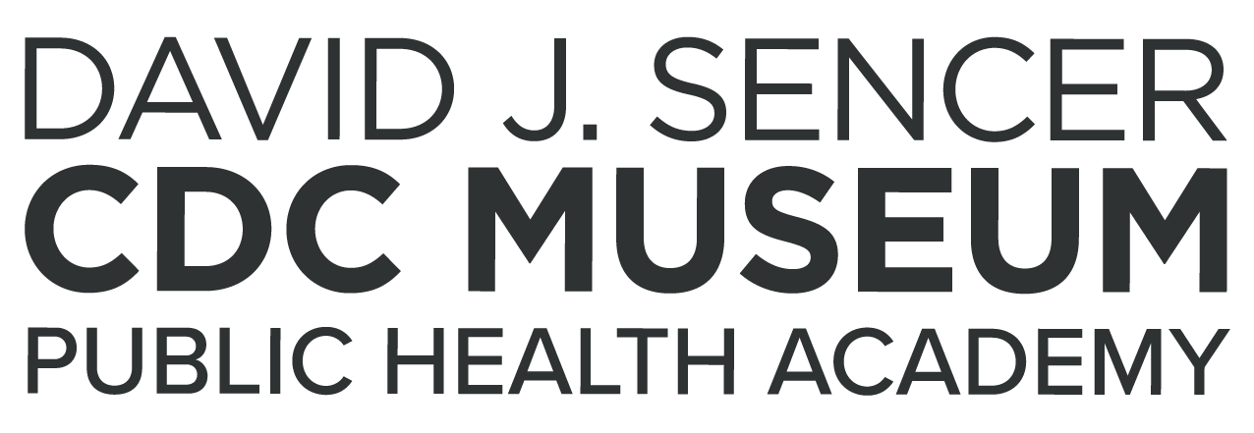
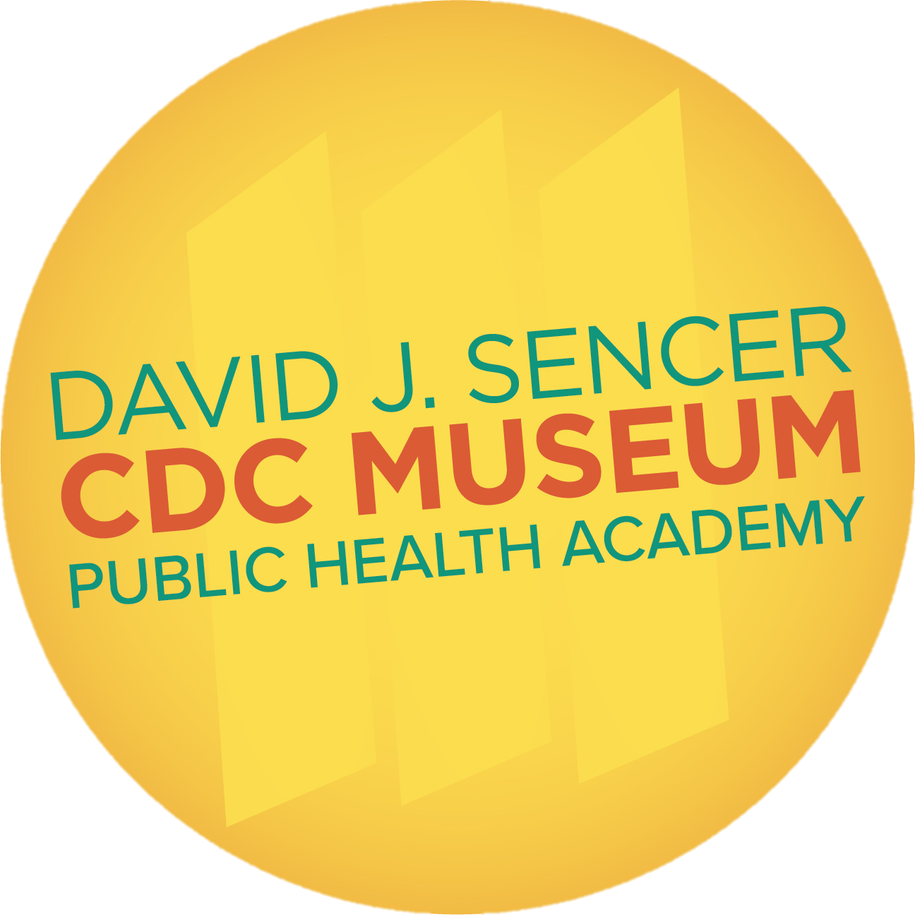
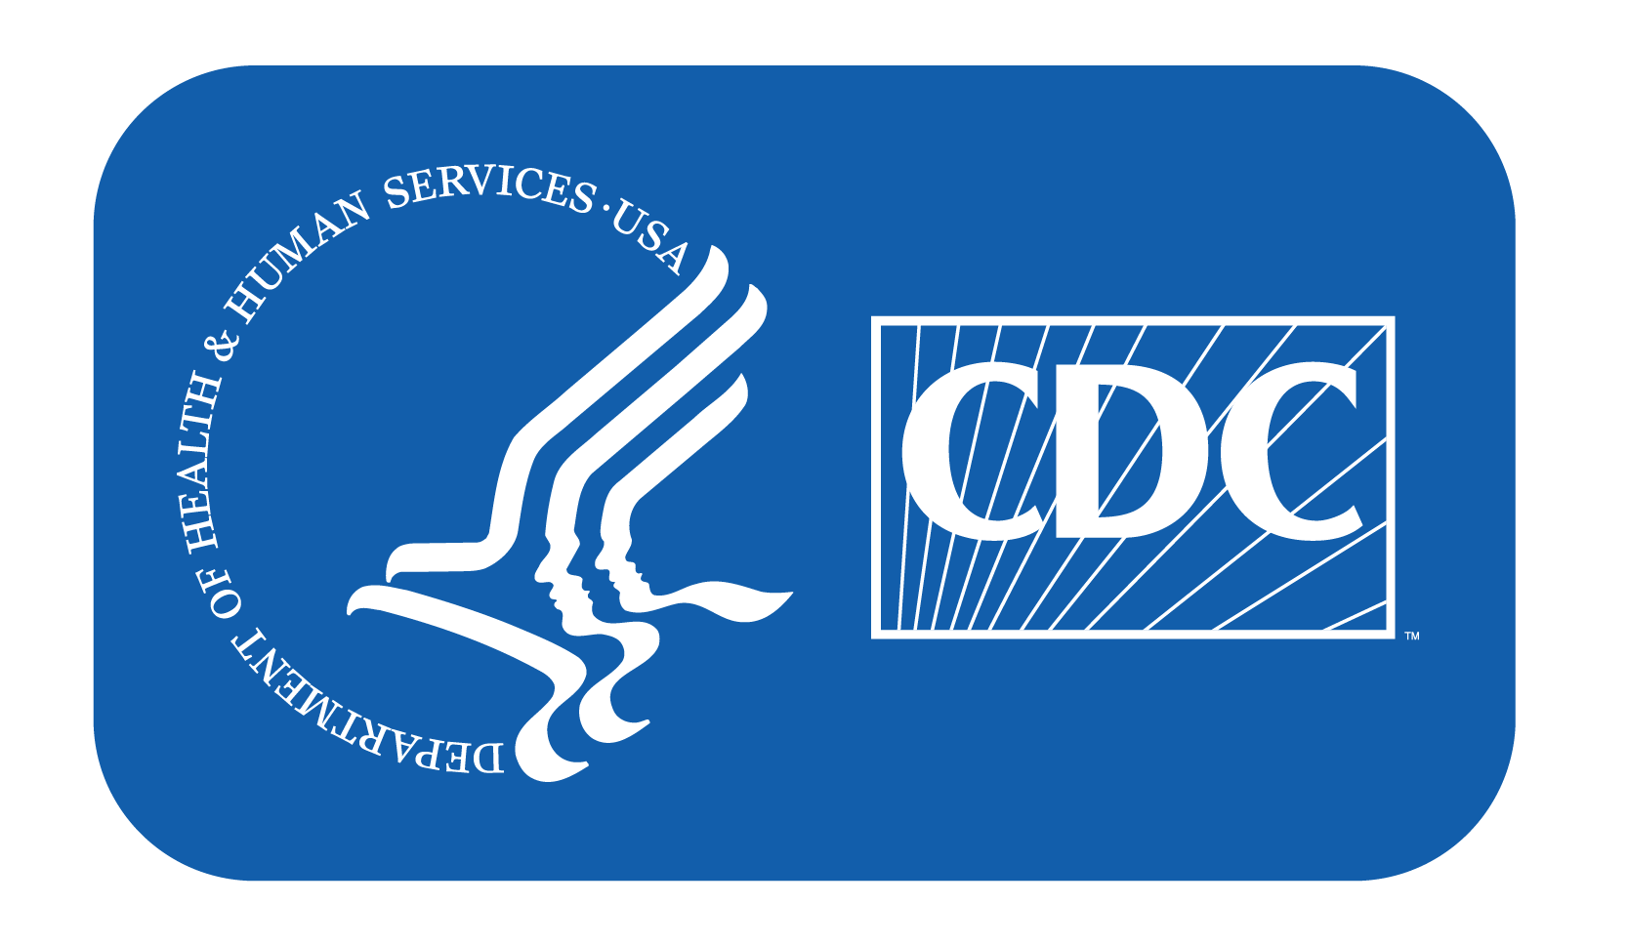
Making Water Safe
Notes:
Since 1990, 2 billion people have gained access to improved drinking water sources and 1.8 billion people have gained access to improved sanitation. However, worldwide, 780 million people still do not have access to improved water sources and an estimated 2.5 billion people — half of the developing world — lack access to adequate drinking water.
Note: These slides are made possible by the David J. Sencer CDC Museum Public Health Academy. https://www.cdc.gov/museum/education/lessons/

Slide 2
Terms to Know
 | people who help collect data for research projects conducted by professional scientists
 | the process of making or keeping things free from filth, infection, or other dangers
 | a system that removes impurities from water or air
 | to leave without protection, shelter, or care
 | able to be passed from one individual to another through contact
 | the science of protecting and improving the health of people and their communities
 | microscopic living organisms found everywhere; some good, some harmful
 | a program that protects communities from harmful water
Word Bank
exposure
sanitation
contagious
citizen scientist
public health
filtration system
bacteria
Global Water, Sanitation, and Hygiene (WASH) program
Notes:
Terms to know:
Citizen scientists: people — young or old — who help collect data for research projects conducted by professional scientists
Sanitation: the act or process of making or keeping things free from filth, infection, or other dangers to health
Filtration System: a system that removes impurities from water or air
Exposure: to leave without protection, shelter, or care; subject to a harmful condition
Contagious: able to be passed from one individual to another through contact
Public health: the science of protecting and improving the health of people and their communities
Bacteria: microscopic living organisms that can be found everywhere; some bacteria are good for your body, while other types can be very harmful
Global Water, Sanitation, and Hygiene (WASH) program: a program that protects communities from harmful water by creating solutions to produce clean water and educating the public about keeping water sources clean
Drinking Water: water that is or has been made safe to drink
Microorganism: living things that are too small to be seen with the naked eye

Slide 3
Understanding Drinking Water
Drinking Water sources:
  public water systems, private wells, bottled water
Public water systems remove harmful microorganisms and chemicals
Notes:
Drinking water comes from a variety of sources including public water systems, private wells, or bottled water. In countries like the United States, drinking water is made clean through public water systems. These systems clean water using a variety of processes that remove harmful microorganisms and chemicals. In other countries, public water systems are not available or not up to date. This threatens the health of their communities, since their water sources are not clean.

Slide 4

Think About It
What are some sources of drinking water?
Why is clean drinking water important?
Why do some communities not have access to clean drinking water?

Slide 5
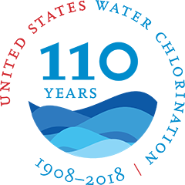
Safe Water and CDC
Public water systems:
  have existed thousands of years
  provide water for communities, take away waste
Before 1900:
  U.S. water contaminated by bacteria that cause cholera and typhoid
1908:
  first efforts to sanitize water in Jersey City, New Jersey
Notes:
Safe Water and the Centers for Disease Control and Prevention (CDC)
Public water systems have existed for thousands of years. These systems were designed not only to provide communities water, but also to take away wastes that contaminate water. However, efforts to sanitize water began much later. In the United States, the first efforts to sanitize occurred in 1908 in Jersey City, New Jersey. Over the next decade, thousands of cities and towns across the United States followed suit in routinely disinfecting their water, contributing to a dramatic decrease in disease across the country.
Before this, water in the United States had been contaminated with bacteria that carried several diseases, including cholera and typhoid. Both diseases caused severe stomach ailments that could lead to death. In 1900, 100 out of every 100,000 citizens would contract typhoid fever. By 1920, sanitation efforts across the country helped the number drop to less than 34 out of every 100,000 citizens. As of 2018, CDC estimates that this number dropped to 1.74 out of 100,000, meaning 5,700 people contract typhoid in the United States each year.

Slide 6
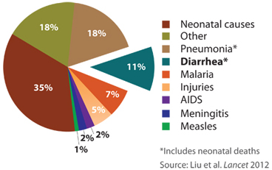
Safe Water and CDC
Over 2.5 billion people worldwide do not have access to effective sanitation
Over 780 million people do not have access to improved water sources
Global Water, Sanitation, and Hygiene (WASH) Program
  protects communities from contaminated water by promoting behavior change
  Provides affordable and sustainable solutions
  Used to be under Safe Water System
Global Leading Cause of Death Among Children Under Five
Notes:
Though sanitation efforts greatly improved water quality in the United States, many countries around the world still struggle to provide safe drinking water and waste removal for their communities. More than 2.5 billion people in the world still do not have access to effective sanitation, and more than 780 million people do not have access to improved water sources. Even more worrisome, nearly 88% of global deaths due to diarrhea illnesses have been attributed to unsafe water, inadequate sanitation, and poor hygiene.
Globally, diarrheal diseases (such as cholera) kill more children than AIDS, malaria, and measles combined, making it the second leading cause of death among children under five (excluding neonatal deaths).
As our world becomes more connected, global public health has had an increased importance in our everyday lives. The diseases carried in water in other countries can reach the United States. In 1998, CDC teamed up with the Pan American Health Organization to develop the Safe Water System (SWS). The program aimed to protect communities from contaminated water by promoting behavior change and providing affordable and sustainable solutions. It has since been changed to Global Water, Sanitation, and Hygiene (WASH) Program
WASH increases access to safe water by helping individuals treat and safely store water in homes, health facilities, and schools. By treating household water directly, providing safe water storage options, and communicating ways to improve hygiene, sanitation, and water and food handling practices, WASH hopes to create a global impact on millions of lives.

Slide 7
Think About It
Why was it important for cities to sanitize their public water sources?
How many people around the world struggle with access to clean water?
How does WASH address global water sanitation issues?

Slide 8
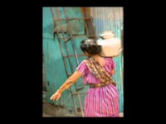
From the Expert
https://youtu.be/FjwPwq9UB2s
Notes:
Lack of access to safe water affects more than 1 billion people in the developing world. Annually, 2 to 3 million children under age 5 die of diarrheal diseases, often acquired through exposure to contaminated water. Listen to the experts explain CDC-supported programs helping to reduce these numbers. https://youtu.be/FjwPwq9UB2s

Slide 9
Think About It
What are the dangers associated with diarrheal diseases?
Explain the role communication plays in water safety.
How can your efforts support the efforts of CDC?

Slide 10
Give it a Try
Call to Action!
Design a safe water practice infographic
Engineer a water filter
Share your designs
Why do you think participation is important?
Notes:
Human health and well-being are strongly affected by the environment in which we live — the air we breathe, the water we drink, and the food and nutrients we eat. All these things can be affected by unsafe drinking water. Community water systems and water safety plans are important ways to ensure the health of the community. For most people who live in developed countries, these systems and plans provide safe drinking water that is as close as the nearest faucet. However, many people in developing countries are not so fortunate. They face many challenges in finding, hauling, treating, and storing water. CDC strives to increase access to safe drinking water and reduce the effects of poor sanitation on health and well-being. Through public support, these efforts can be sustained.
More information can be found about global water, sanitation, and hygiene practices.

Slide 11
Design a Water Filter and Safe Water Practice Infographic
Define
Define the problem
Research
Do background research
Specify
Specify requirements
Brainstorm
Choose and develop solutions
Build
Build a prototype
Test and redesign
Test
Share
Communicate results
Notes:
Design a Safe Water Practices Infographic and Water Filter
The engineering design process allows engineers to develop and test solutions to problems. You can use the process to help determine the best way to inform the public about ways to keep themselves safe from waterborne illness and to design your own water filter.

Slide 12
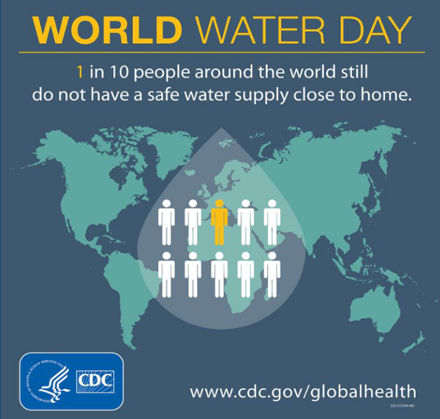
Give it a Try
1. Design a Safe Water Practices Infographic
Notes:
Design a Safe Water Practices Infographic
An infographic is a visual representation of information. Often, these images give people a better understanding of the information being shared. The information is organized in a way that gives visual meaning to data. CDC often uses infographics to share information with the public to make sure each person is able to understand the information being shared. Check out this infographic from CDC about World Water Day:
In this infographic, you can see that yellow is used to indicate important information. The “1” stands out for readers. Similarly, having one of the person icons colored yellow reminds the viewer of the one person in ten who don’t have safe water. Having a water droplet and a world map helps the viewers connect the topic of water and lets them know it’s a global issue.
Steps to Design
1. When you are making your design, you can use the following links for information:
Handwashing-https://www.cdc.gov/healthywater/hygiene/hand/handwashing.html
Sanitation-https://www.cdc.gov/healthywater/global/sanitation/index.html
Safe Water Handling- https://www.cdc.gov/healthywater/emergency/preparing-a-home- water-supply.html?CDC_AA_refVal=https%3A%2F%2Fwww.cdc.gov%2Fhealthywater%2 Femergency%2FEmergency-Water-Supply.html
2. Choose an image to go with each practice. Make sure the images help to explain each action a person should take.
3. Organize your design. Page 6 gives you examples of how you can organize your images.
4. Share your infographic with CDC on Facebook, Twitter and Instagram using @CDCgov!

Slide 13
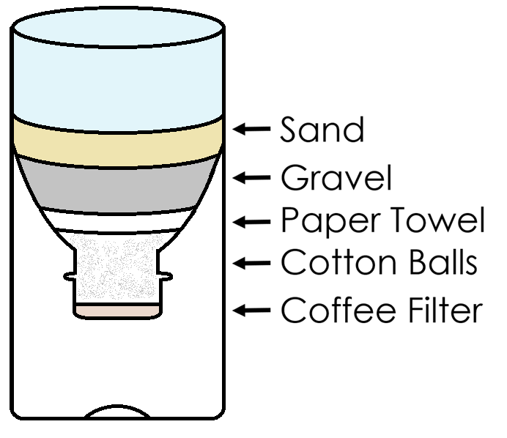
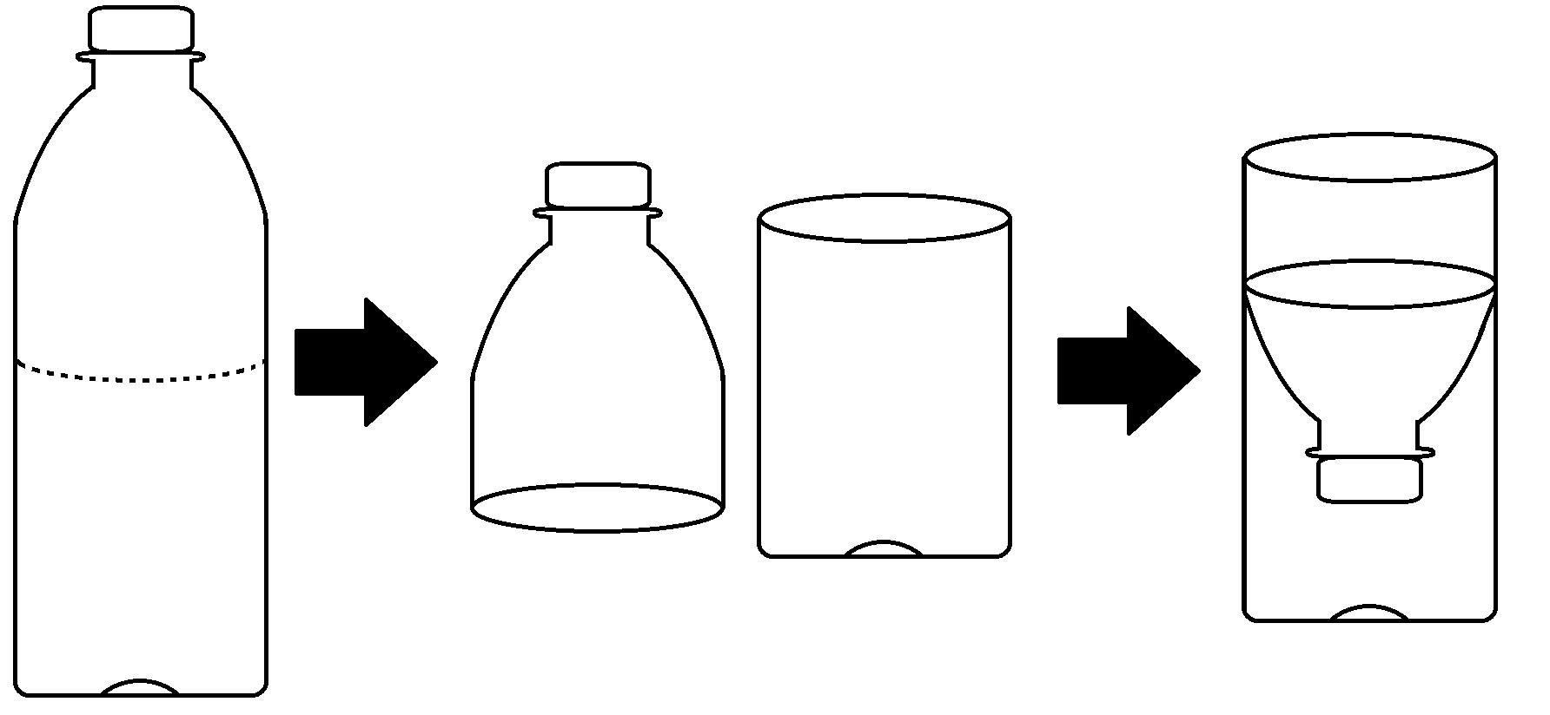
Give it a Try
2. Engineer a Water Filter
Prepare the water sample
Prepare the containers
Build the prototype
Notes:
To test whether your filter works, you will need a water sample that is not clean. For the water sample you will need:
1 quart of water
½ cup soil or dirt
¼ cup sand
2-quart pitcher
1 long-handled spoon
8 cups (8 oz size)
¼ cup measuring cup
½ cup measuring cup
1 permanent marker
Your filter will need to be housed inside a container. To test different ideas, it is recommended you get 3 of the containers you choose. You can use any container that has a neck. The following containers work well for design:
2-liter soda bottles
20-ounce water bottles
½ gallon milk containers
Since you are creating your filter using your own design, you can choose what materials you feel would be best to remove the soil/dirt and sand from your water sample. Recommended materials include:
cotton balls
tulle or netting
gauze or cloth bandages
paper towels or napkins
coffee filters
aquarium gravel
tissue
sand
cloth squares
Prepare the Water Sample
Pour the water into the pitcher.
Add the soil/dirt to the pitcher and stir with the spoon.
Carefully fill 4 cups with the mixture. Label one of the cups “A” with the permanent marker.
In a fifth cup, pour ½ cup of the mixture into the cup, then fill the rest of the cup with water.
Label this cup “B” with the marker.
In a sixth cup, pour ¼ cup of the mixture into a cup, then fill the rest of the cup with water.
Label this cup “C” with the marker.
Fill a seventh cup with clean water. Label this cup “D.” The last cup will be used later.
Prepare the Containers
Start with your first container. Take the cap off the container.
Cut the container in half, as shown in the image to the right. You may need an adult to help you.
Turn the top half of the container upside down and place the top half of the container into the bottom half of the container. The top half will hold your filter, while the bottom half collects the filtered water.
Repeat this process with each container.
Write out the steps you took for your procedure on a sheet of paper. Include drawings of your containers for each step.
Build the Prototype
Now that you have your container built, it is time to prototype your filter. Remember, this is your design, and it may or may not work well the first time. You will measure success by how much soil/dirt and sand you can remove from your three water samples, and how much water you are able to gather from the filter. After all, if your filter does not let water through, it is not really a filter. Once you have decided on the materials you will use to filter your water, you need to decide the order you want them to go inside the container.
Some tips:
Sand and aquarium gravel are excellent filters. In fact, one of the home filtration systems CDC has implemented in communities without access to adequate filtration systems is the slow sand filtration system.
However, neither sand nor aquarium gravel can be the bottom layer of the filter because they will fall right through it.
Tissue can be an excellent way to plug the neck so that water can come through the filter without the other filter materials falling through. However, water can weaken the tissue and cause it to break apart.
Coffee filters are, well, filters. However, water moves very slowly through a coffee filter.
Tulle and netting will let small debris like sand through them. However, they are both strong enough to hold all the other filter materials to keep them from falling through the filter.
Once you have determined your order, draw a diagram with each layer labeled in the container.

Slide 14
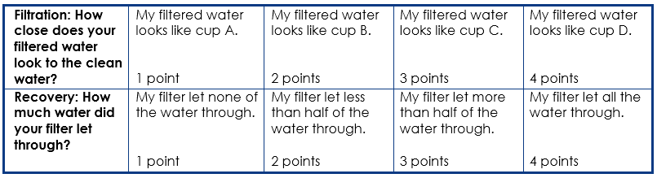
Give it a Try
2. Engineer a Water Filter
Test the prototype
Notes:
Test the Prototype
Construct your prototype based on your design. Once you have it constructed, test your filter by pouring the sample water into the prototype.
While your sample water works through your filter, line up cups A, B, C, and D. These will serve as comparison cups. You will compare your filtered water to the cups to test how well your filter works.
Once your water has finished filtering, pour the filtered water into the 8th cup. Hold your cup up to cups A-D to determine which cup matches your filtered water the best. The closer your filtered water looks to cup D, the better your water filter works.
Compare the amount of filtered water you recovered to the amount of water in cup D.
Record your results by circling them in the chart on your handout.
[Prototype 1: Data Table]
Add up the point values for your filtered water. A good filter will earn at least 5 points. A better filter will earn at least 6 points. A great filter will earn 7 or more points.
If your prototype scores a 4 or less, think about improvements that could be made. Run the engineering design process again, this time changing the layers you use to filter. This could involve changing the materials themselves, the order of the materials, or both.
If your prototype scores well, try to replicate the results by building a second prototype of the same kind. Again, repeat the engineering design process.
For your third prototype, focus either on recovery or filtration. Repeat the engineering design process.
Record your results for your second and third prototype by circling them in the tables below:
[Prototype 2: Data Table]
[Prototype 3: Data Table]

Slide 15
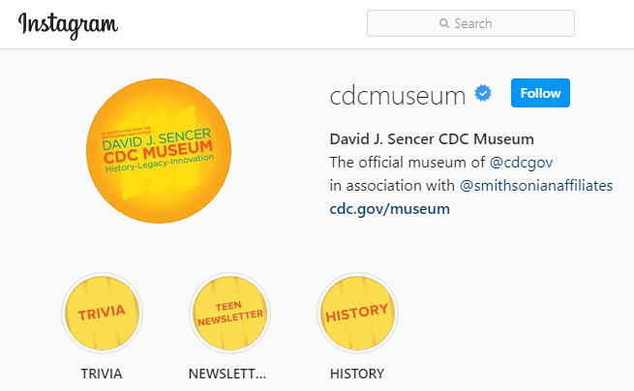
Give it a Try
3. Share Your Designs
Instagram @CDCmuseum
Notes:
Share Your Findings
The David J. Sencer CDC Museum uses award-winning exhibits and innovative programming to educate visitors about the value of public health and presents the rich heritage and vast accomplishments of CDC. Your demonstration could be a valuable contribution! Share your demonstration with the CDC Museum on Instagram using @CDCMuseum.

Slide 16

Questions?

