Slide 1




Exploring Polio
Notes:
Poliomyelitis, also known as polio, is a disabling and life-threatening disease caused by the poliovirus. The virus spreads from person to person and can infect a person’s brain and/or spinal cord, causing paralysis. A targeted vaccination program has dramatically reduced the cases worldwide.
Note: These slides are made possible by the David J. Sencer CDC Museum Public Health Academy. https://www.cdc.gov/museum/education/lessons/

Slide 2
Terms to Know
 | disabling and life-threatening disease caused by poliovirus infection
 | likely to be transmitted to people and organisms through the environment
 | a nerve that runs from the neck to the diaphragm and controls breathing
 | type of microbe that causes infectious diseases
 | loss of the ability to move (and sometimes to feel) part of the body
 | making or keeping things free from filth, infection, or other dangers to health
 | virus that infects people and causes poliomyelitis, polio for short
Word Bank
virus
polio
paralysis
infectious
sanitation
phrenic nerve
poliovirus
Notes:
Terms to Know
Virus: type of microbe (organisms too small to be visible to the naked eye) that causes infectious diseases; has a core of genetic material but no way to reproduce on its own; uses infected cells’ reproductive machinery
Infectious: likely to be transmitted to people and organisms through the environment
Poliovirus: virus that infects people and causes poliomyelitis, polio for short
Polio: disabling and potentially life-threatening disease caused by poliovirus infection
Sanitation: the act or process of making or keeping things free from filth, infection, or other dangers to health
Paralysis/Paralyzed: the loss of the ability to move (and sometimes to feel anything) part or most of the body; typically caused by illness, poison, or injury
Phrenic nerve: a nerve that runs from the neck to the diaphragm and controls breathing

Slide 3
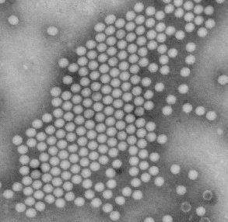
Understanding Polio
Polio (aka poliomyelitis) is:
  a disabling and life-threatening disease
  caused by the poliovirus
Polio can be spread through:
  Contact with the feces (poop) of an infected person
  Droplets from a sneeze or cough of an infected person
  People who are infected even without symptoms
Symptoms of Infection:
  1 out of 4: flu-like symptoms (sore throat, fever, etc)
  1 out of 25: meningitis infection of brain or spinal cord
  1 out of 200: paralysis/weakness in arms, legs, or both
Notes:
Polio is a crippling and potentially fatal infectious disease caused by the poliovirus. Poliovirus is very contagious and spreads through person-to-person contact. The virus enters the human body through the mouth and exits via the digestive system. For most, this virus passes through undetected but, for others the virus can cause nerve damage, resulting in paralysis. It enters the body through the mouth and spreads through contact with the feces (poop) of an infected person or droplets from a sneeze or cough of an infected person. Polio can contaminate food and water in unsanitary conditions where access to proper sanitation is unavailable.

Slide 4

Think About It
What microbe causes polio?
How is polio spread in a community?
Why do some communities lack access to clean water and sewage sanitation?

Slide 5
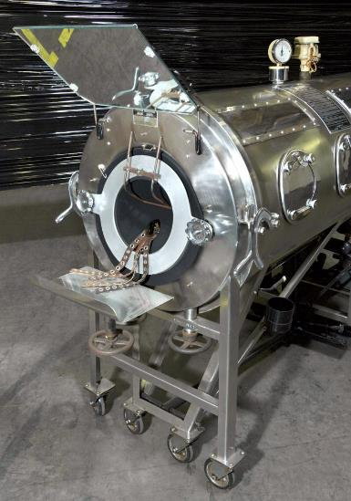
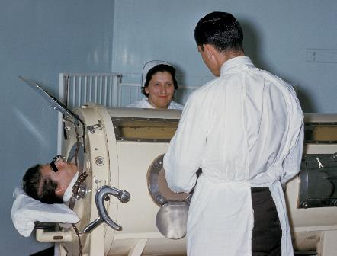
Polio and CDC
Polio usually infects children
Polio infection can cause paralysis in any area of body
Phrenic nerve paralysis affects diaphragm muscle and leads to an inability to breathe
Iron lungs provided artificial respiration for polio patients
Without iron lung, patients died
Today, portable respirators have replaced the need for iron lungs
Notes:
Polio and the Centers for Disease Control and Prevention (CDC)
Polio was the great equalizer as fear swept through the U.S. for the first half of the 20th century. Little was known about how the disease spread, leading to closed pools in summer and empty playgrounds as parents tried to protect their children from falling ill. Though most people will show no symptoms of poliovirus infection, 1 in 4 will experience a few days of flu-like symptoms (sore throat, fever, tiredness, nausea, headache, and stomach pain). Some of these infected people will experience tingling in the legs or infection of the spinal cord and/or brain. In about 1 of every 200 poliovirus infections, paralysis will occur and can be fatal. When paralytic infection occurs, the disorder is called poliomyelitis, or polio for short. Oftentimes this paralysis included the phrenic nerve, a nerve that runs from the neck to the diaphragm and controls breathing.
The iron lung was developed to help people with upper body paralysis. The machine gets the name iron lung because it is made of metal and helps people breathe. A patient lies on a roll-out bed tray and sticks their head outside the machine through an opening on one end of the bed. A small motor in the machine pumps a lever on the far end of the iron lung near the patient’s feet to change the air pressure inside the sealed machine. When the pressure decreases in the iron lung, the patient inhales. When the pressure increases in the iron lung, the patient exhales. There is a mirror angled over the headrest so the patient can interact with others. Because it was an expensive machine, a family often could not afford to have a machine at their house and had to send sick children to hospitals far away.
In 1955, Barton Hebert (pictured left) contracted polio in Covington, Louisiana when he was 15 years old. He recovered from the devastating virus but was left paralyzed from the waist up and confined to an iron lung. Nonetheless, Mr. Hebert returned to school to finish his high school degree. After a close friend told him, “Forget about physical conditions– work on your brain. The body is nothing but a life-support system for the brain,” Hebert went on to earn a degree in finance and to enjoy a successful career as a stockbroker and investment counselor. At work he used a portable respirator, but he was most comfortable breathing in his iron lung.

Slide 6
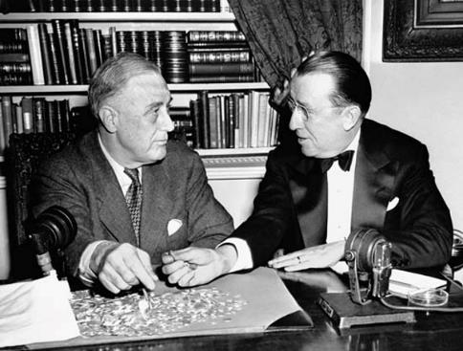
Polio and CDC
President Franklin D. Roosevelt
contracted polio and was partially
paralyzed
Roosevelt asked Basil O’Connor
to found National Foundation for
Infantile Paralysis to study polio,
which later became the March of Dimes
CDC and partners are working to globally eradicate polio through vaccination
Last case of endemic (naturally occurring) polio in U.S. was in 1979
Notes:
The widespread fear of polio prompted President Franklin D. Roosevelt, in 1938, to ask his counsel Basil O’Connor to form and oversee the National Foundation for Infantile Paralysis. Today, this organization is known as the March of Dimes. This organization collected money for polio research, which made possible funding for the first polio vaccine, developed by Jonas Salk in the early 1950s. CDC is working with other agencies across the world to eradicate, or completely remove, polio. Thanks to mass vaccination campaigns, the last case that originated in the United States was in 1979. Today, polio only occurs naturally in two countries- Pakistan and Afghanistan. Only a few hundred cases are reported yearly worldwide, down from approximately 350,000 when the Global Polio Eradication Initiative was launched in 1988.

Slide 7
Think About It
What symptom is required for a person to be considered to have polio?
What types of discrimination do people with physical disabilities experience?
What are the disadvantages of iron lung treatment?

Slide 8
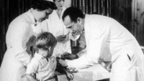
From the Expert
https://youtu.be/C6Weidit5Wo
Notes:
Watch this clip to hear Dr. Walter Orenstein, former director of CDC’s National Immunization Program and current Associate Director of the Emory Vaccine Center, discuss the dangers of polio for children in the 1950s. Find out more about the symptoms of the disease, how it spreads, and the specific ways in which the nervous system is affected, leading to paralysis.

Slide 9
Think About It
What are the dangers associated with polio?
Why is it important for everyone to understand the dangers of polio?
How can your efforts support the efforts of CDC?

Slide 10
Give it a Try
Call to Action!
Create a lung model.
Conduct a breathing demonstration.
Share your findings.
Why do you think participation is important?
Notes:
Call to Action
In order to understand how polio causes difficulty breathing, it is essential that people understand how the lungs function. You can help people by following these three steps:
Create a lung model. When we breathe, we use multiple parts of the body, including the lungs and the diaphragm. Building a model will give you a visual representation of how those parts work together to keep us breathing and how polio disrupts respiration.
Conduct a breathing demonstration. This will allow you to see the importance of the diaphragm and what it does. Some people with polio are paralyzed and they are not able to breathe on their own. The iron lung (today a respirator) works as their diaphragm.
Share your findings. One of the ways CDC communicates information is through social media. Your demonstrations can help CDC communicate the work they have done and are doing to improve access to polio vaccinations across the globe.
Why Participate? A Message from CDC
Successful vaccination efforts by CDC in the 1950s reduced polio cases in the U.S. from 15,000 annually to zero within 30 years. The Global Polio Eradication Initiative (GPEI) began in 1988 with the goal of eradicating polio worldwide and has dropped the infection rate by over 99.9%.
You can help support these efforts by raising awareness about the importance of routine vaccinations in your community. While endemic (naturally occurring) polio has been eradicated (eliminated) in much of the world, unvaccinated people are still vulnerable to infections that are brought in from other areas. It is important that people understand and follow the recommended CDC immunization schedule for their own health and that of their communities.

Slide 11
Use the Engineering Design Process
Define
Define the problem
Research
Do background research
Requirements
Specify requirements
Brainstorm
Develop solutions
Build
Build a prototype
Test and redesign
Test
Share
Communicate results
Notes:
The engineering design process allows engineers to develop and test solutions to problems. You can use the process to help determine the best way to inform the public about polio eradication efforts.

Slide 12
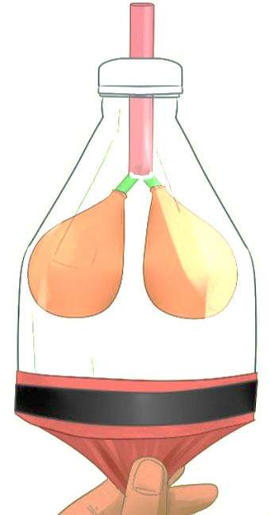
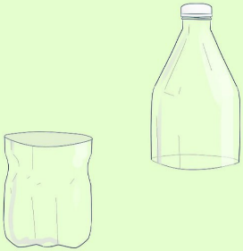
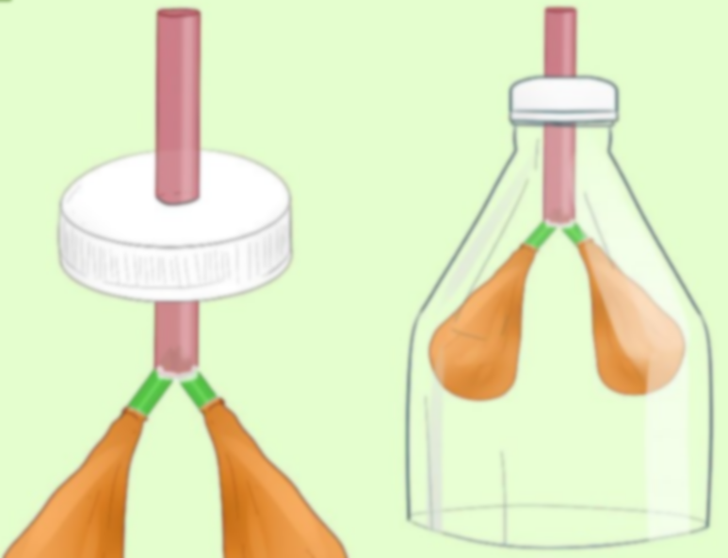
Give it a Try
1. Create a lung model.
Use a plastic bottle to make a chest cavity
Use straws and balloons to make the windpipe and lungs
Assemble and add the diaphragm muscle and phrenic nerve
Notes:
Create a Lung Model
Your model will give viewers an idea of how the respiratory system works. You will need these parts to construct your model:
plastic bottle (20oz or larger), 2 plastic straws, 3 balloons, tape, string or yarn (optional), scissors, utility knife, hot glue gun
Cut the bottle into two pieces horizontally with your scissors.
Use a utility knife to make a small cut in the side of your plastic bottle, 4–5 inches (10–13 cm) above the bottom. The incision should be horizontal. Insert one of the scissor blades into the incision that you made. Hold the bottle firmly and cut all the way around the side of the bottle with your scissors so that you end up with two halves—one half with the bottle cap and one half with the base. You can recycle the bottom half of the plastic bottle.
Use your utility knife to cut an opening in the bottle cap for the straw.
Hold the bottle cap in place and carefully puncture the top of the bottle cap with the tip of your utility knife. Carve a small circle into the cap by holding the knife at an 80-degree angle. Take a plastic straw and try to squeeze it through your bottle cap. If the straw fits and doesn’t fall out of the opening, your bottle is ready to go. It’s okay if the straw is a little snug inside the hole. A tighter fit is going to be easier to work with than a looser fit. Tip: You may also use a drill bit to puncture your hole if the bottle cap is too thick for a utility knife.
Cut a plastic straw into thirds with your scissors.
Cut the straw into even thirds. Cut at an angle that’s perpendicular to the straw so that the places where you cut are even and flat. Then use your scissors to cut one end of two of the straw sections at a 45-degree angle to make them pointy.
Slide the pointed edges of two pieces of straw into the bottom of a larger straw.
Squeeze the tip of each straw and slide each inside the same opening at the bottom of an uncut straw. The two smaller sections that you already cut will rely on the tension inside the opening to keep them in place. Make sure the sections of straw are at a 45º angle to one another and are symmetrical. Glue the junction where your three straws meet with a hot glue gun. This will ensure that no air escapes when you’re using your lung. Wait 2-3 minutes to let the hot glue dry.
Add hot glue to the inside lip of two balloons and put them on the straws.
Put a drop of hot glue inside each balloon near the top of each balloon’s opening. Slide them over each of the branching straws so that the longer length of straw is still open. Squeeze the section where you added hot glue against each straw for 15-30 seconds so that they’re sealed over the opening of each straw. Blow into the open end of your straw to test it. If the balloons expand, you’re ready to continue. If you hear air coming out, identify the leak and cover it with hot glue. You can also use tape to help with leaks.
Slide the open end of your straw through the bottle cap. You may need to pinch the opening of your straw to fit it through the hole as you slide it up through the bottle cap. Slide it until each balloon is inside the case of your bottle. Screw the bottle cap tight and seal the area where your length of straw and bottle cap meet with hot glue. Optional: Cut a 12” long piece of string or yarn. Fold it in half and dangle the 2 ends into the hole before inserting your straw. This represents the phrenic nerve, which starts in the neck and runs down to the diaphragm to control breathing.
Stretch another balloon over the bottom of the bottle.
Cut the balloon about 1.5 inches (3.8 cm) from the top near the section where the balloon’s neck begins to get wider. Slide the balloon that you cut over the bottom of your bottle. Stretch it evenly over the bottom of the bottle. It may take a couple attempts since the plastic and the balloon are both flexible. Use a rubber band or tape to tightly secure the balloon to the bottle by wrapping it around the area where they meet.

Slide 13
Give it a Try
2. Conduct a breathing demonstration.
Record a demonstration of your iron lungs
Pull down on the diaphragm to show how the lungs respond
Describe how paralysis of the phrenic nerve due to polio would change the lungs
Notes:
Conduct a Breathing Demonstration
The diaphragm is a muscle located beneath the lungs. As it expands and contracts, the pressure inside your lungs changes, causing respiration to occur. In the model you built, the balloon on the bottom of the bottle represents the diaphragm. Pull on the skin of the balloon at the bottom of the bottle to use your lung and observe the changes that occur.
Record your demonstration. Be sure to explain the importance of the diaphragm for respiration and how pressure changes the size of the lungs. Explain why people with polio who are paralyzed in this area of the body, need an iron lung to help them breathe.

Slide 14
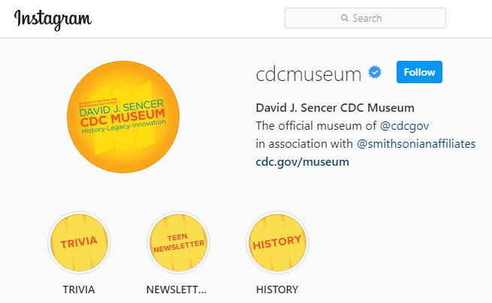
Give it a Try
3. Share Your Findings
Instagram @CDCmuseum
Notes:
Share Your Findings
The David J. Sencer CDC Museum uses award-winning exhibits and innovative programming to educate visitors about the value of public health and presents the rich heritage and vast accomplishments of CDC. Your demonstration could be a valuable contribution! Share your demonstration with the CDC Museum on Instagram using @CDCMuseum.
CDC plays a critical role in eradicating polio by providing scientific leadership and guidance at the global, regional and country level to implement evidence-based strategies. Since 1988, CDC, ministries of health, and Global Polio Eradication Initiative (GPEI) partners have worked together across these areas to reach every community and vaccinate every last child.
CDC’s Center for Global Health (CGH) works 24/7 around the globe to stop health threats at their source. As a citizen scientist, you can help CDC’s CGH by sharing your demonstration on their Twitter or Facebook pages to show the importance of polio vaccination using @CDCGlobal.

Slide 15
Questions?

