Slide 1

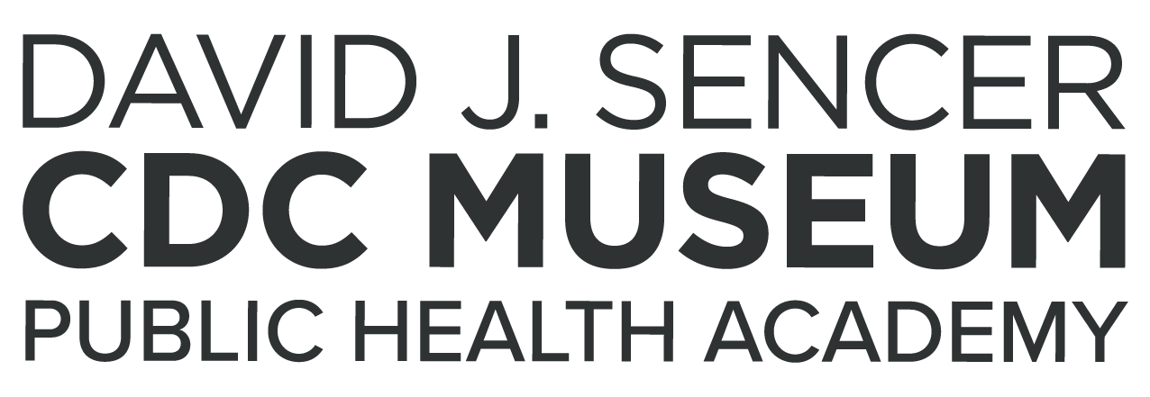
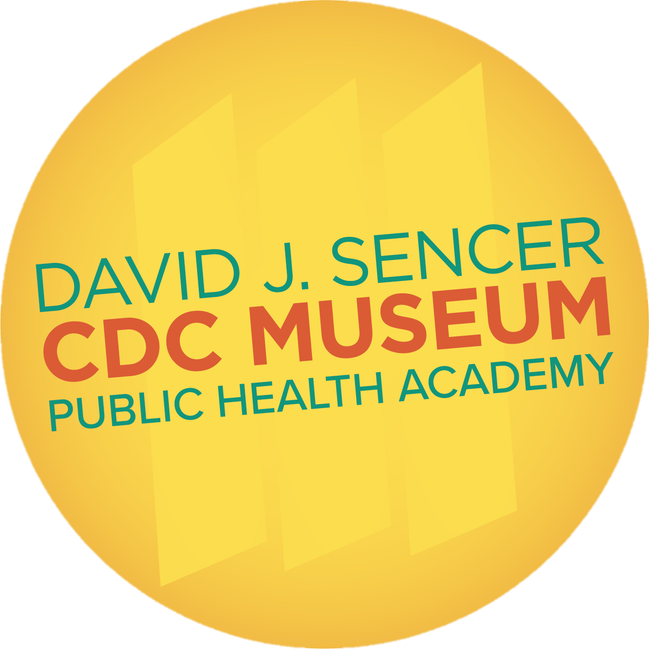
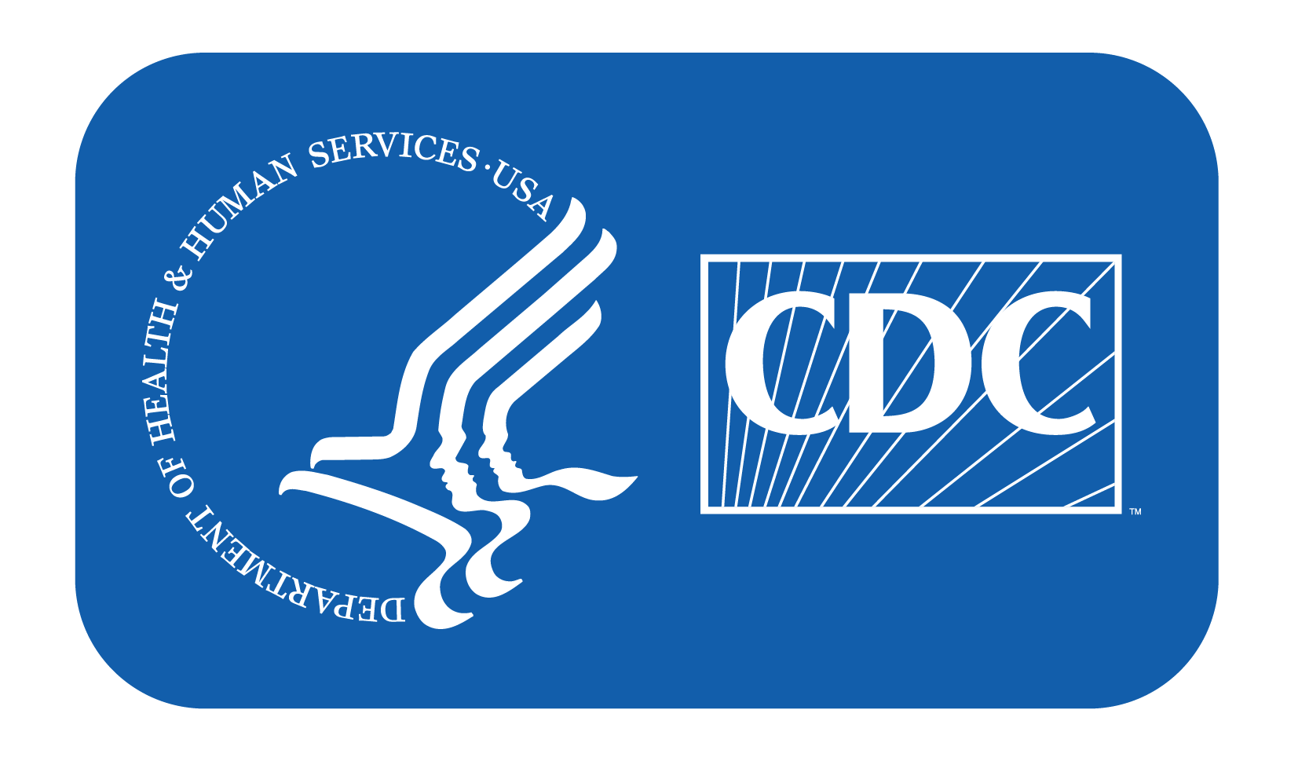
Hand Hygiene
Notes:
Hand hygiene is the process of cleaning one’s hands to prevent the spread of infectious diseases. Good hand hygiene means washing your hands with soap and water or using alcohol-based rubs (hand sanitizer) to keep them germ free. Since many diseases spread to others through dirty hands and contaminated surfaces, maintaining clean hands is an effective way to stay healthy.
Note: These slides are made possible by the David J. Sencer CDC Museum Public Health Academy. https://www.cdc.gov/museum/education/lessons/

Slide 2
Terms to Know
 | a condition characterized by episodes of frequent liquid stools (poop)
 | a way of cleaning one’s hands that substantially reduces potential pathogens
 | the science of protecting and improving the health of people and communities
 | occurs when bacteria can no longer be killed by antibiotics that were once effective
 | tiny microbes such as viruses and bacteria, which can cause disease
 | an infection of the lungs caused by viruses, bacteria, or fungi
 | a type of coronavirus that causes the respiratory disease COVID-19
 | a disinfectant/storage system that provided a clean water source
Word Bank
antibiotic resistance
diarrhea
germs
hand hygiene
pneumonia
public health
Safe Water System
SARS-CoV-2
Notes:
Terms to Know
Antibiotic resistance - occurs when bacteria can no longer be killed by antibiotics that were once effective against them; also known as drug resistance
Diarrhea - a condition characterized by episodes of frequent liquid stools (poop)
Germs - tiny microbes such as viruses and bacteria, which can cause disease
Hand hygiene - a way of cleaning one’s hands that substantially reduces potential pathogens; includes hand washing with soap and water and alcohol-base hand rubs
Pneumonia - an infection of the lungs caused by viruses, bacteria, or fungi; common causes include influenza, RSV, SARS-CoV-2, and Streptococcus pneumoniae
Public health - the science of protecting and improving the health of people and communities
Safe Water System (SWS) - a disinfectant/storage system that provides a clean water source for homes, health facilities, and schools in places where access to clean water is scarce
SARS-CoV-2 - a type of coronavirus that causes the respiratory disease COVID-19

Slide 3
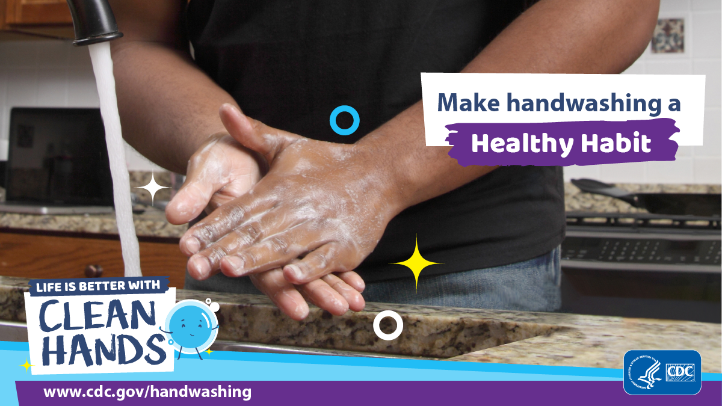
Understanding Hand Hygiene
Handwashing after contacting hazardous materials is an important habit to maintain your health
Feces (poop) from people or animals contains germs that can cause diarrheal or respiratory infections
Touching raw meats, contaminated objects, or people who are infected with a disease can make you sick
Notes:
Feces (poop) from people or animals is an important source of germs that cause diarrhea, like Salmonella, E. coli O157, and norovirus, and it can spread some respiratory infections like adenovirus and hand, foot, and mouth disease. These kinds of germs can get onto hands after people use the toilet or change a diaper, but also in less obvious ways, like after handling raw meats that have invisible amounts of animal poop on them. Germs can multiply in some types of foods or drinks, under certain conditions, and make people sick. Germs can also get onto hands if people touch an object that was touched by some other contaminated object or was coughed or sneezed on. When these germs get onto hands and are not washed off, they can be passed from person to person and make people sick.

Slide 4

Think About It
When do you generally wash your hands?
What barriers might people have that prevent them from washing their hands?
How has COVID-19 changed your hand hygiene behaviors?

Slide 5
Hand Hygiene and CDC
About 1.8 million children under age 5 die annually from diarrheal diseases and pneumonia
Handwashing could prevent in young children…
  1 out of 3 diarrheal diseases
  1 out of 5 respiratory infections
Estimated global handwashing after using the toilet is only 19%
Handwashing education and access to soap in schools can improve attendance and child development
If handwashing isn’t possible, alcohol-based hand sanitizers with at least 60% alcohol can be used to get rid of most germs
Notes:
Hand Hygiene and the Centers for Disease Control and Prevention (CDC)
About 1.8 million children under the age of 5 die each year from diarrheal diseases and pneumonia, the top two killers of young children around the world. Although people around the world clean their hands with water, very few use soap to wash their hands. Washing hands with soap removes germs much more effectively. Handwashing with soap could protect about 1 out of every 3 young children who get sick with diarrhea and almost 1 out of 5 young children with respiratory infections like pneumonia.
Estimated global rates of handwashing after using the toilet are only 19%. Proper handwashing education in a community has been shown to reduce cases of diarrhea by 23-40% and respiratory illnesses by 16-21%. Handwashing education and access to soap in schools can help improve attendance and child development in some settings.
Washing hands with soap and water is the best way to get rid of germs in most situations. If soap and water are not readily available, you can use an alcohol-based hand sanitizer that contains at least 60% alcohol instead. Sanitizers can quickly reduce the number of germs on hands in many situations; however, sanitizers do not get rid of all types of germs.

Slide 6
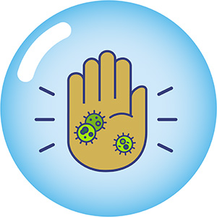
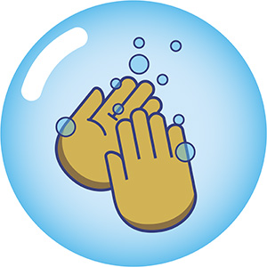
Hand Hygiene and CDC
When to Wash Your Hands
Before, during, and after preparing and eating food
Before and after caring for someone who is sick with vomiting or diarrhea
After using the toilet or cleaning up a child who has used the toilet or a diaper
Before and after treating a cut or wound
After blowing your nose, coughing, or sneezing
After touching an animal, animal feed, animal waste, or treats
After touching garbage
Before and after touching your eyes, nose,
mouth, or face mask due to COVID-19
After interacting with high-touch surfaces
like doors, tables, and checkouts due to COVID-19
Notes:
Handwashing is one of the best ways to protect yourself and your family from getting sick. Washing hands can keep you healthy and prevent the spread of respiratory and diarrheal infections from person to person. It is very important that everyone, including young children, washes their hands:
• Before, during, and after preparing and eating food
• Before and after caring for someone who is sick with vomiting or diarrhea
• After using the toilet or cleaning up a child who has used the toilet or a diaper
• Before and after treating a cut or wound
• After blowing your nose, coughing, or sneezing
• After touching an animal, animal feed, animal waste, or treats
• After touching garbage
• Before and after touching your eyes, nose, mouth, or face mask due to COVID-19
• After interacting with high-touch surfaces like doors, tables, and checkouts due to COVID-19

Slide 7
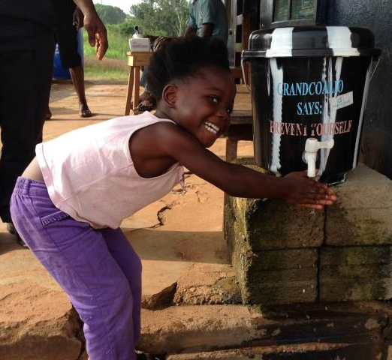
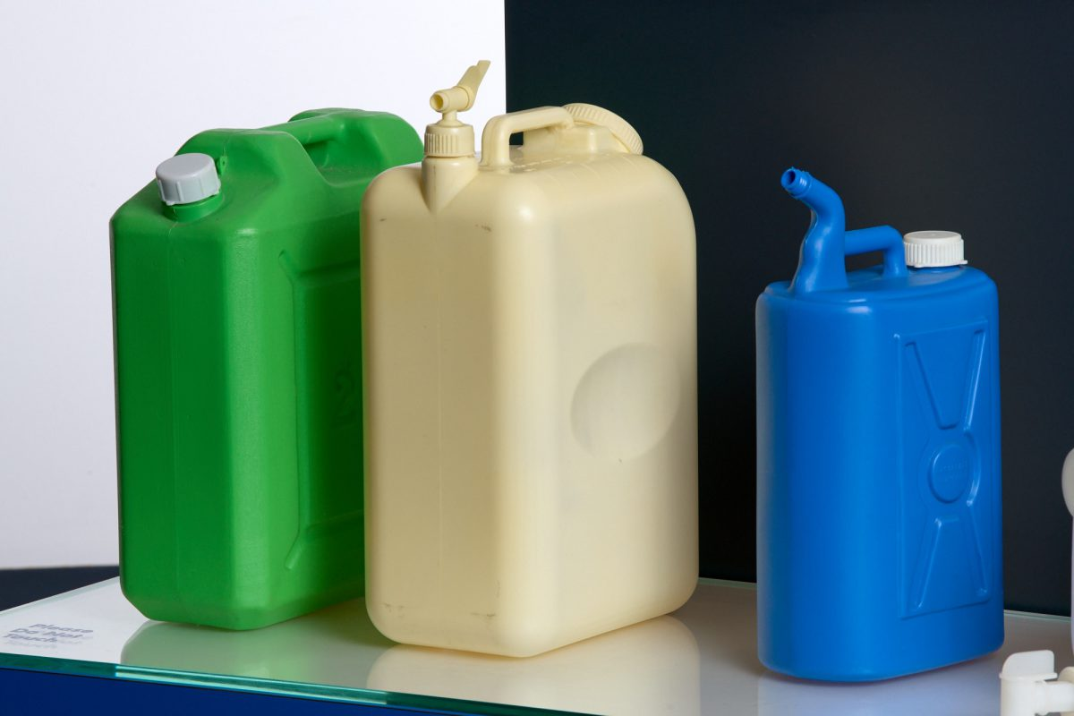
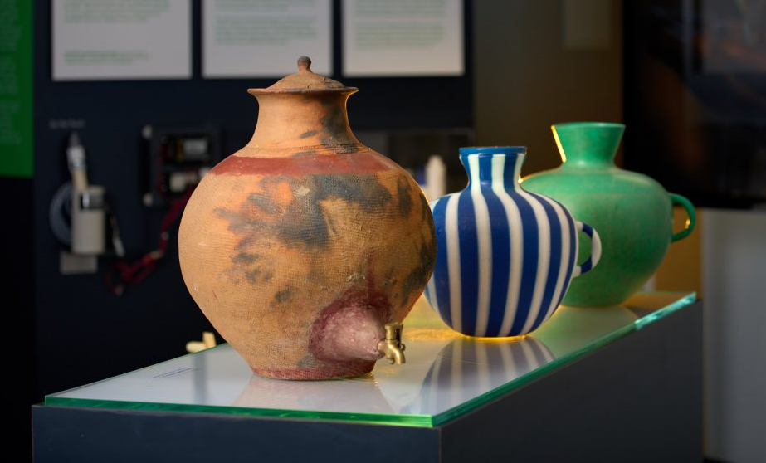
Hand Hygiene and CDC
CDC Safe Water System (SWS)
  Provided a source of clean water as well as storage
  Used for drinking and sanitation
  Distributed to places without access to clean water
  Used heavily during outbreaks, natural disasters, and other emergencies to improve sanitation and reduce disease
Notes:
CDC and its partners promote handwashing as a public health measure globally in response to epidemics and disasters. In places where clean water was not easily available, CDC Safe Water System (SWS) provided clean, accessible water to make proper handwashing practices possible. During the 2014-16 West African Ebola outbreaks, cleaning stations full of 0.05% chlorine water were set up around countries. Buckets and chlorination tablets also provided clean water sources for handwashing, cooking, and drinking after a major earthquake and cholera outbreak in Haiti in 2010. A 1994 cholera outbreak in Rwandan refugee camps in Zaire (now the Democratic Republic of the Congo) was stopped with better sanitation and access to handwashing stations. During the SARS-CoV-2 outbreak, handwashing and sanitation guidelines were implemented worldwide to stop COVID-19.
Today WASH is the new global program at CDC. https://www.cdc.gov/global-water-sanitation-hygiene/about/index.html

Slide 8
Think About It
What effects can proper hand hygiene have on the health of a community?
Why do you think handwashing is so important during food preparation?
How can education play a role in improving rates of childhood illness?

Slide 9
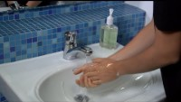
From the Expert
https://youtu.be/eZw4Ga3jg3E
Notes:
From the Expert:
Watch the video from Michele Hlavsa, a CDC epidemiologist, to learn more about how and why to wash your hands to remove germs and chemicals. https://youtu.be/eZw4Ga3jg3E
Remember to wet, lather, scrub, rinse, and dry your hands. Make sure you’re washing for at least 20 seconds to ensure that all germs are soaped up and rinsed away.

Slide 10
Think About It
CDC recommends you wash your hands for at least 20 seconds. How does this make a difference in its effectiveness?
Why is art an important part of public health? Can you think of any examples of art pieces or graphics you have seen that have public health messages?
How can antibiotic resistance that develops in one person ultimately end up affecting an entire community?

Slide 11
Give it a Try
Call to Action!
Develop an effective handwashing process.
Create hand hygiene art.
Share your findings.
Why do you think participation is important?
Notes:
Call to Action
In order to understand handwashing, it is essential that people understand why it is important. You can help people by following these three steps:
1. Develop an effective handwashing process. In this experiment, you will observe the efficiency of your current handwashing method and then try to create a more efficient method by generating a step-by-step guide.
2. Create hand hygiene art. The David J. Sencer CDC Museum curated the art exhibition Watching Hands: Artists Respond to Keeping Well to showcase the work of 6 artists and their interpretation of the act of handwashing and why it matters. Create your own piece of art that fits in with that overall theme.
3. Share your findings. One of the ways CDC communicates information is through social media. Your demonstrations can help CDC communicate the work they have done and are doing to improve knowledge about the practice and importance of hand hygiene.
Why Participate? A Message from CDC
Preventing sickness reduces the amount of antibiotics people use and therefore the likelihood that antibiotic resistance will develop. Handwashing can prevent about 30% of diarrhea-related sicknesses and about 20% of respiratory infections (e.g., colds). Antibiotics often are prescribed unnecessarily for these health issues. Reducing the number of these infections by washing hands frequently helps prevent the overuse of antibiotics—the single most important factor leading to antibiotic resistance around the world. Handwashing can also prevent people from getting sick with germs that are already resistant to antibiotics and that can be difficult to treat. Watch this video from the World Health Organization (WHO) for more info: https://youtu.be/kOKeFv5VvY4
Research shows that community education plays a huge role in hygiene and sanitation practices. Spreading the knowledge you gain through completing these tasks can positively impact your community and future generations.

Slide 12
Use the Engineering Design Process
Define
Define the problem
Research
Do background research
Requirements
Specify requirements
Brainstorm
Develop solutions
Build
Build a prototype
Test and redesign
Test
Share
Communicate results

Slide 13
Give it a Try
1. Develop an Effective Handwashing Process
Cover the area to protect from paint drips
Use paint on gloved hands with your eyes closed to simulate washing your hands
Examine your paint coverage to determine how effective your normal handwashing method is
Develop a more effective handwashing method that cleans your entire hands
Try the WHO handwashing method
Notes:
Develop an Effective Handwashing Process
Good handwashing habits are key to stopping the spread of many diseases. However, just because you wash your hands doesn’t mean you’re doing it well. How good do you think your handwashing technique is?
Tools of the Trade
Disposable gloves (3+ pairs)
Acrylic paint
Paint protection measures
Before you begin:
Cover the area around you in newspaper, plastic, cardboard, or another material that will stop any paint drips or splatters. Make sure you are wearing clothes that can get messy or wear an apron or other covering to protect them. Consider performing this experiment outside over grass or dirt.
Part 1: Examine the effectiveness of your hand washing method
Put on a pair of disposable gloves. Squeeze paint into the palm of one of your hands, making sure to use at least a tablespoon or two. Close your eyes. Pretend that the paint is soapy water and use it to “wash” your hands. Your goal here is to see how effective your normal handwashing routine is, so don’t worry about making it perfect. Just do what you would normally do. When you are finished washing, open your eyes. Any unpainted area of your glove represents an area where germs could still be hiding.
Consider: How effective was your washing method? If your hands were not 100% covered in paint, what areas needed more attention? How long did you spend washing your hands?
Part 2: Develop a more effective handwashing method
Put on a fresh pair of disposable gloves. Add more paint to the palm of one of your hands. Use the paint to visualize your germ removal. Develop a step-by-step procedure for proper handwashing that you could teach to others.
Part 3: Try the World Health Organization handwashing method
The World Health Organization (WHO) developed a handwashing routine for use in healthcare settings. This method provides a consistent routine that cleans all areas of the hands thoroughly and ensures enough time has passed to remove germs. Put on another clean pair of gloves, add some paint, and try this method to see how effective it is.
Video instructions are also available here: https://youtu.be/3PmVJQUCm4E

Slide 14
Give it a Try
2. Create Hand Hygiene Art
Review the art exhibition Watching Hands: Artists Respond to Keeping Well on the David J. Sencer CDC Museum website
Create your own piece of handwashing art in response to this question:
How can art communicate and interpret the practice of one of the most simple and effective disease prevention strategies – handwashing?
Notes:
Create Hand Hygiene Art
When Ignaz Semmelweis instituted mandatory handwashing in 1847 at Vienna General Hospital to help curb maternal deaths due to childbed fever, he was met with resistance from his colleagues. Twenty years later, Joseph Lister published “An Address on the Antiseptic System of Treatment in Surgery” in The Lancet, which proposed that surgeons should clean their hands and instruments before operating. This practice was adopted and led to a revolution in healthcare by dramatically increasing a patient’s likelihood of survival. Handwashing and tool cleaning were critical to stopping the spread of disease and infections from one patient to another.
How can art communicate and interpret the practice of one of the most simple and effective disease prevention strategies – handwashing?
In 2011, the David J. Sencer CDC Museum curated the art exhibition Watching Hands: Artists Respond to Keeping Well. Artists were asked how art can communicate and interpret the practice of one of the most simple and effective disease prevention strategies: handwashing. The six artists who participated created paintings, drawings, installations, and graphic communications that live on in an online exhibition. Look through the works, read more about the artists, and watch the videos to hear them talk about the artistic process and how It relates back to public health.
Read the introductory essay from curator Louise E. Shaw for insight into the exhibition and its message. https://www.cdc.gov/museum/online/watching-hands/essay.html
Watching Hands: Artists Respond to Keeping Well
https://www.cdc.gov/museum/online/watching-hands.html
When you have finished exploring the exhibition, create your own piece of art that centers around the act and importance of handwashing. It may seem small, but simple handwashing has saved countless lives during the last 150+ years. You have your choice of medium, including photography, sculpture, drawing, digital media, painting, needlecraft, or any other art form.

Slide 15
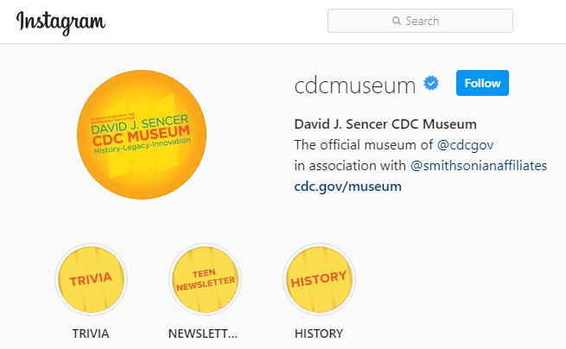
Give it a Try
3. Share Your Findings
Instagram @CDCmuseum
Notes:
Share Your Findings
The David J. Sencer CDC Museum uses award-winning exhibits and innovative programming to educate visitors about the value of public health and presents the rich heritage and vast accomplishments of CDC. Your demonstration could be a valuable contribution! Share your demonstration with the CDC Museum on Instagram using @CDCmuseum.

Slide 16
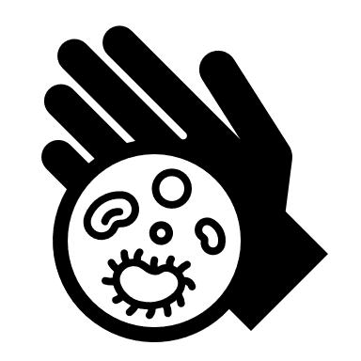
Questions?

