Slide 1




Cleaning the Air
Notes:
Outdoor air quality has improved since the 1990s, but many challenges remain in protecting Americans from air quality problems. Ground-level ozone, the main part of smog, and particle pollution are just two of the many threats to air quality and public health in the United States.
Note: These slides are made possible by the David J. Sencer CDC Museum Public Health Academy. https://www.cdc.gov/museum/education/lessons/

Slide 2
Terms to Know
 | people who help collect data for research projects conducted by professional scientists
 | a metal that is poisonous to humans that is used in a variety of products
 | a filter that removes particles and impurities from the air
 | to leave without protection, shelter, or care; subject to a harmful condition
 | something that has been released into the world, particularly the air
 | the science of protecting and improving the health of people and their communities
 | pollution caused by small bits of matter in the air
Word Bank
exposure
lead
emissions
citizen scientists
public health
air filter
particle pollution
Notes:
Terms to know:
Citizen scientists: people — young or old — who help collect data for research projects conducted by professional scientists
Lead: a metal that is poisonous to humans that is used in a variety of products
Air filter (filter): a filter that removes particles and impurities from the air
Exposure/expose: to leave without protection, shelter, or care; subject to a harmful condition
Emissions: something that has been released into the world, particularly the air
Public health: the science of protecting and improving the health of people and their communities
Particle pollution: pollution caused by small bits of matter in the air

Slide 3
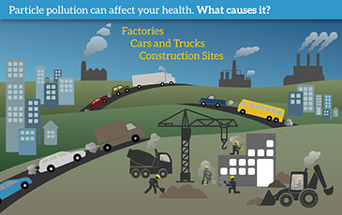
Understanding Particle Pollution
Particle pollution:
  also called particulate matter (PM)
Particles include:
  dust, dirt, soot, metals, smoke, drops of liquid
Some visible, others too small to see
Notes:
Particle pollution — also called particulate matter (PM) — is made up of particles (tiny pieces) of solids or liquids that are in the air. These particles include: dust, dirt, soot, metals, smoke, and drops of liquid. Some particles are big enough (or appear dark enough) to see — for example, you can often see smoke in the air. Others are so small that you cannot see them in the air.

Slide 4

Think About It
What types of particles are found in particle pollution?
What causes particle pollution?
Why is particle pollution dangerous?

Slide 5
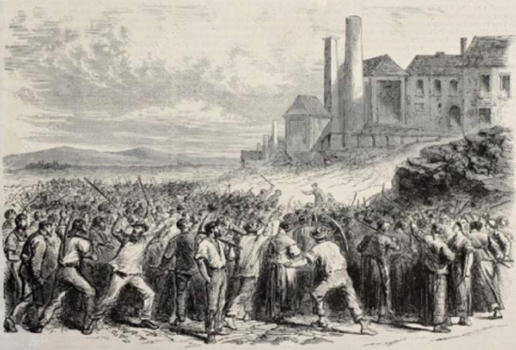
Particle Pollution and CDC
Scientific innovations in 1800s:
  less farming, more cities
  factories, larger populations
  chemicals and fossil fuels (particle pollution)
Mid-20th century:
  air pollution = severe heart and lung problems
Scientists begin studying air pollution and health
  emission of lead and steel in air
  call for government intervention
Notes:
Particle Pollution and the Centers for Disease Control and Prevention (CDC)
Humans have caused air pollution since they discovered fire two million years ago. However, before the Industrial Revolution, the impact of this pollution was not enough to cause public health crises. In the 1800s, scientific innovations allowed societies to move away from farming and into the bustling cities we know today. Thanks to the creation of factories, new communities were developed with populations much larger than ever before. The use of chemicals and fossil fuels skyrocketed, filling the air with a dangerous mix of particulate matter/particle pollution that increased over time.
By the mid-20th century, scientists and health officials in the United States began to take notice of the toll air pollution had on communities near factories. Residents in these industrialized cities were experiencing severe problems with their hearts and lungs, leading to death in some cases. Scientists began investigating the connection between air pollution and health. They found that in communities where people were exposed to high levels of air pollution, a disproportionate number of residents experienced health problems. Much of this pollution came from the emission of small bits of metal, like lead and steel, into the air. Scientists and other concerned citizens began calling for government interventions to reduce the amount of pollution put in the air.

Slide 6
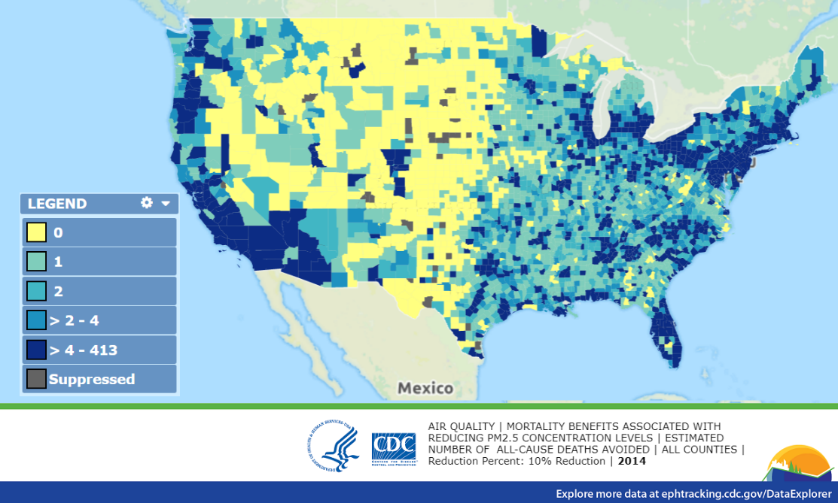
Particle Pollution and CDC
1970: US Environmental Protection Agency (EPA) created
  1: monitor effects humans have on environment
  2: help develop policies to protect citizens and environment
EPA teams up with CDC to protect against dangerous pollutants
CDC creates tracking programs
  educate public: particle pollution and public health
Notes:
In 1970, the federal government answered the call by creating the United States Environmental Protection Agency (EPA). This agency’s job is to monitor the effects humans have on the environment and to advise the government on policies to protect both citizens and the environment. The EPA teamed up with other government agencies and units, including CDC, to provide the federal government with comprehensive plans for protection against dangerous air pollutants.
For its part, CDC created tracking and monitoring programs that keep the public up to date on the levels of particle pollution within communities and the effect those levels have on public health. Together, the organizations work with state and local level health officials to design air pollution prevention plans for communities across the United States.

Slide 7
Think About It
How long have humans contributed to particle pollution?
What effect did the Industrial Revolution have on particle pollution?
How does CDC support efforts to reduce particle pollution?

Slide 8

From the Expert
https://youtu.be/9BVydjpKRH8
Notes:
CDC has supported the efforts of communities to reduce their amounts of air pollution through the creation of CDC's Environmental Public Health Tracking Network. See how the Massachusetts Tracking Program worked with local health officials to protect air quality in Norwood with the arrival of a new asphalt plant. https://youtu.be/9BVydjpKRH8

Slide 9
Think About It
What role did the community members of Norwood, Massachusetts play in tracking the air quality of their community?
What was CDC’s response to air quality concerns in Norwood?
What role do citizen scientists play in monitoring air quality?

Slide 10
Give it a Try
Call to Action!
1. Conduct an Air Particle Observation
2. Build a Filter
3. Share Your Findings
Why do you think participation is important?
Notes:
Why Participate? A Message from CDC
The quality of air in a community plays a large role in the health of that community. Air pollution can make it harder for people with asthma and other respiratory (breathing) diseases to breathe. Air pollution also can be harmful to heart health and may make it more likely that some people will have a heart attack or stroke. Learn the facts about air pollution and how you can keep your community healthy. By sharing air quality observations, members of a community can help inform environmental policies in their areas to keep all its residents safe.
More information about air quality can be found at: https://www.cdc.gov/air/air_health.htm
More information about tracking air pollutants can be found at: https://ephtracking.cdc.gov/showAirData.action

Slide 11
Design an Air Particle Observation and Air Filter
Define
Define the problem
Research
Do background research
Specify
Specify requirements
Brainstorm
Choose and develop solutions
Build
Build a prototype
Test and redesign
Test
Share
Communicate results
Notes:
Design an Air Particle Observation and Air Filter
The engineering design process allows engineers to develop and test solutions to problems. You can use the process to help determine the best way to filter particles from the air. You will take two steps in this process: first you will observe the particles, then you will design a way to trap them.

Slide 12
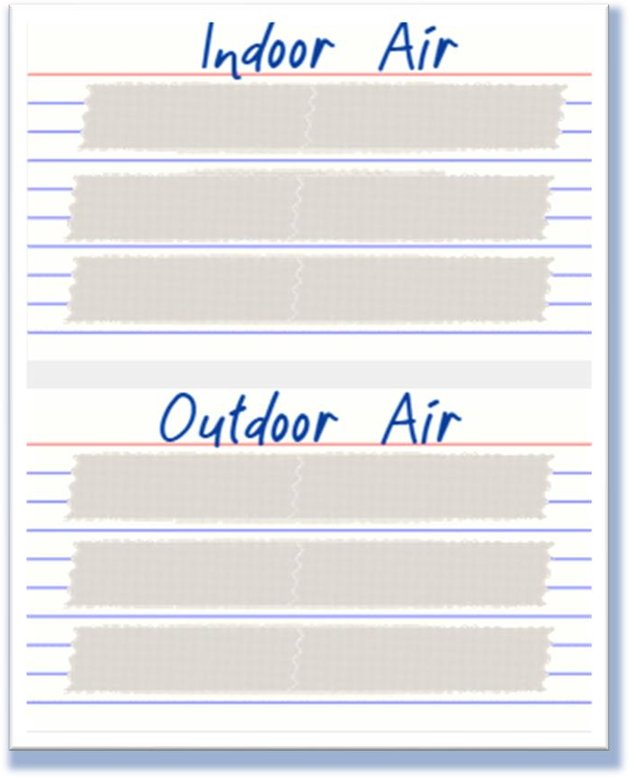
Give it a Try
1. Conduct an Air Particle Observation
Prepare the observation cards
Place the observation cards
Collect observation data
Notes:
Conduct an Air Particle Investigation
Tools of the Trade
To conduct your particle observations, you will need:
3x5” index cards x 2
2 feet double-sided tape
2-oz weights (can be rocks) x 2
magnifying glass
camera
Instructions
Prepare the Observation Cards
1. Cut the double-sided tape into 4” strips.
2. Place 3 tape strips on each index card, one below the next.
3. Label the index cards “Indoor Air” and “Outdoor Air.”
Place the Observation Cards
Note: These observations are best done when there is no rain in the forecast for several days.
4. Place the card labeled “Indoor Air” on a flat surface in your home that will not be disturbed, like a windowsill or table. Make sure it is in a room that receives good air flow, like a living room.
5. Place the card labeled “Outdoor Air” on a flat surface outside of your home that will not be disturbed, like a lawn chair or patio table. Make sure it is in an area that is also away from animals.
Collect Observation Data
6. Take a picture of each card once a day for 7 days. Try to take the picture at the same time each day if possible.
7. After taking the picture, examine each card with a magnifying glass to get a close look at the particles the cards collected. Record a description of the particles you observe (size, shape, color).
8. Organize the photos and the descriptions in the data table on the next page.

Slide 13
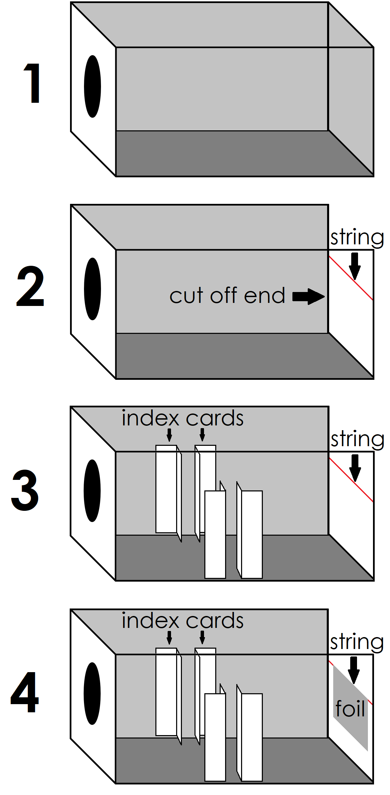
Give it a Try
2. Build a Filter
Prepare the house
Build the filter prototype
Test the filter prototype
Notes:
Build a Filter
Your filter will need to be housed inside a shoe box connected to an air source. In this case, the air source will be a hair dryer. For the shoebox design, you will need:
roll of tape
string – 1 foot
shoebox
3x5” index cards - 4
protractor
3x5” piece of foil
ruler
ground pepper
56 quart or larger clear box
clear plastic wrap
hair dryer
teaspoon measuring spoon
Your filter will be made from your own design. Gather the recommended materials below to create your design.
tissue paper
tulle or netting
fine mesh
craft sticks
coffee filters
paper towels or napkins
tissue
pipe cleaners
cloth squares
Remember that since it is your design, you may think of other materials that could work as a good filter. You can use those as well!
Prepare the Filter House
On one of the short sides of the shoebox, trace the end of the hairdryer and cut out the circle. This is where you will insert the hair dryer.
Cut the second short side of the box completely off so that the end is open. Tape the string across the opening horizontally, cutting off any excess.
Fold the index cards in half lengthwise. Tape the index cards in the inside middle of the shoe box 1 inch apart, as shown in the picture. The cards will hold your filter in place.
Fold the foil in half crosswise and hang it over the string. The movement of the foil will show how much air is traveling through your filter.
Test your device by placing the hairdryer in the hole and turning the dryer on low. Use a protractor to measure the angle created between the table and the foil as the foil blows. This measurement should be somewhere between 0 and 90 degrees. The angle represents air flow at 100%.
Build the Prototype
To build your air filter, you will first need to build a frame. Remember, the frame will need to fit inside the shoebox. Use your ruler to measure the height and width of the shoebox. Your filter will need to fit inside these measurements.
Once you have built your frame, you will need to cover it with material(s) that let(s) air through while blocking particles of pepper.
Some tips:
Many filters have multiple layers to catch particles. However, more layers mean less air flowing through the filter.
Aim to get at least 50% of the air through your filter. This means the angle between the table and the foil should be at least half as big as the first measurement. (For example, if the angle at 100% airflow is 90 degrees, then the airflow for your filter needs to be larger than 45 degrees.)
Aim to block at least 50% of the pepper using your filter.
Once you have determined what your frame and filter layers will look like, draw a diagram with the filter parts labeled.
Test the Prototype
Place the large clear box on its side and place the shoebox, foil side first, inside the box.
Place your filter in the space created by the index cards.
Pour 2 teaspoons of pepper in the space between the filter and the hair dryer.
Turn the hairdryer on low and run it until all the pepper has gotten to the filter.
While the hairdryer is on, use the protractor to measure the angle created by the foil.
Turn the hair dryer off and measure the amount of pepper in the filter.
Repeat the test two additional times and record your results in the table below.

Slide 14
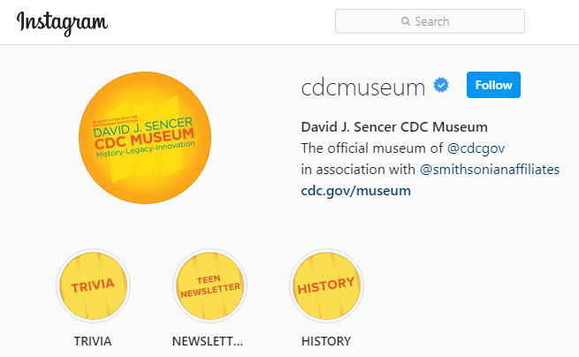
Give it a Try
3. Share Your Findings
Instagram @cdcmuseum
Notes:
Share Your Findings
The David J. Sencer CDC Museum uses award-winning exhibits and innovative programming to educate visitors about the value of public health and presents the rich heritage and vast accomplishments of CDC. Your demonstration could be a valuable contribution! Share your demonstration with the CDC Museum on Instagram using @CDCMuseum.
CDC has a social media presence dedicated to its work with the environment. You can aid CDC with these efforts by sharing your air particle data and pictures of your most successful trial. With a guardian’s permission, log onto Twitter and share your prototype using @CDCEnvironment. Follow @CDCEnvironment on Twitter for info, tips, and news about ways your environment and your health are connected!

Slide 15

Questions?

