Slide 1
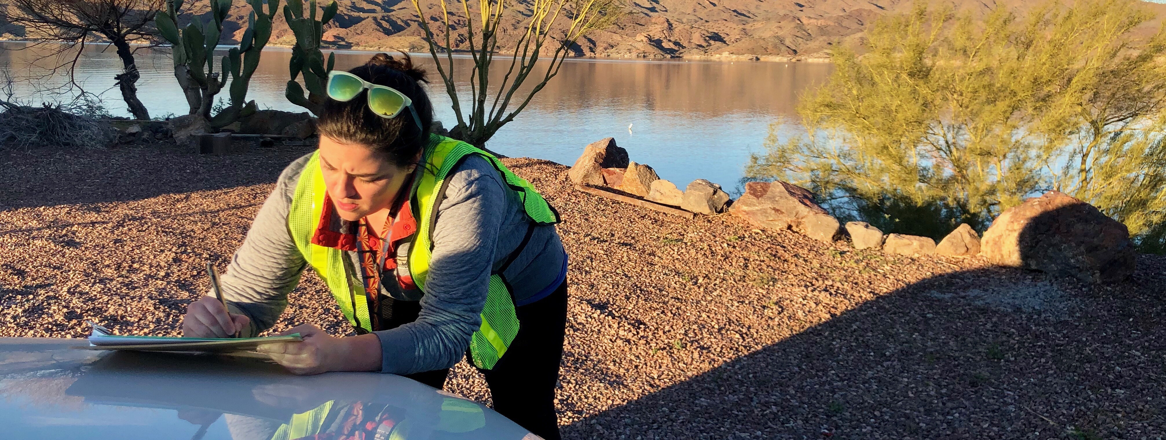

EPIDEMIC INTELLIGENCE SERVICE
CDC’s Disease Detective Training Program

Slide 2
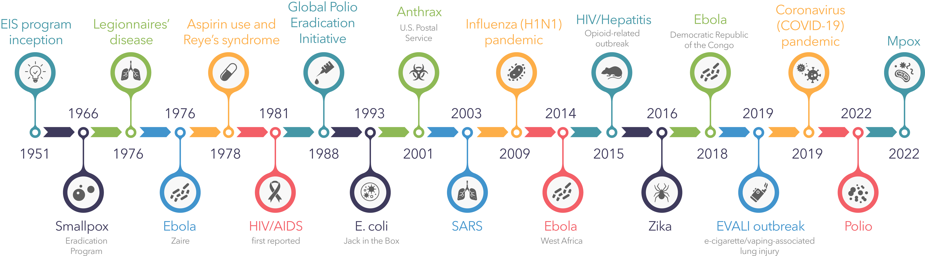
WE WERE THERE
Notes:
Think of a major public health event or emergency. CDC and EIS were there.

Slide 3
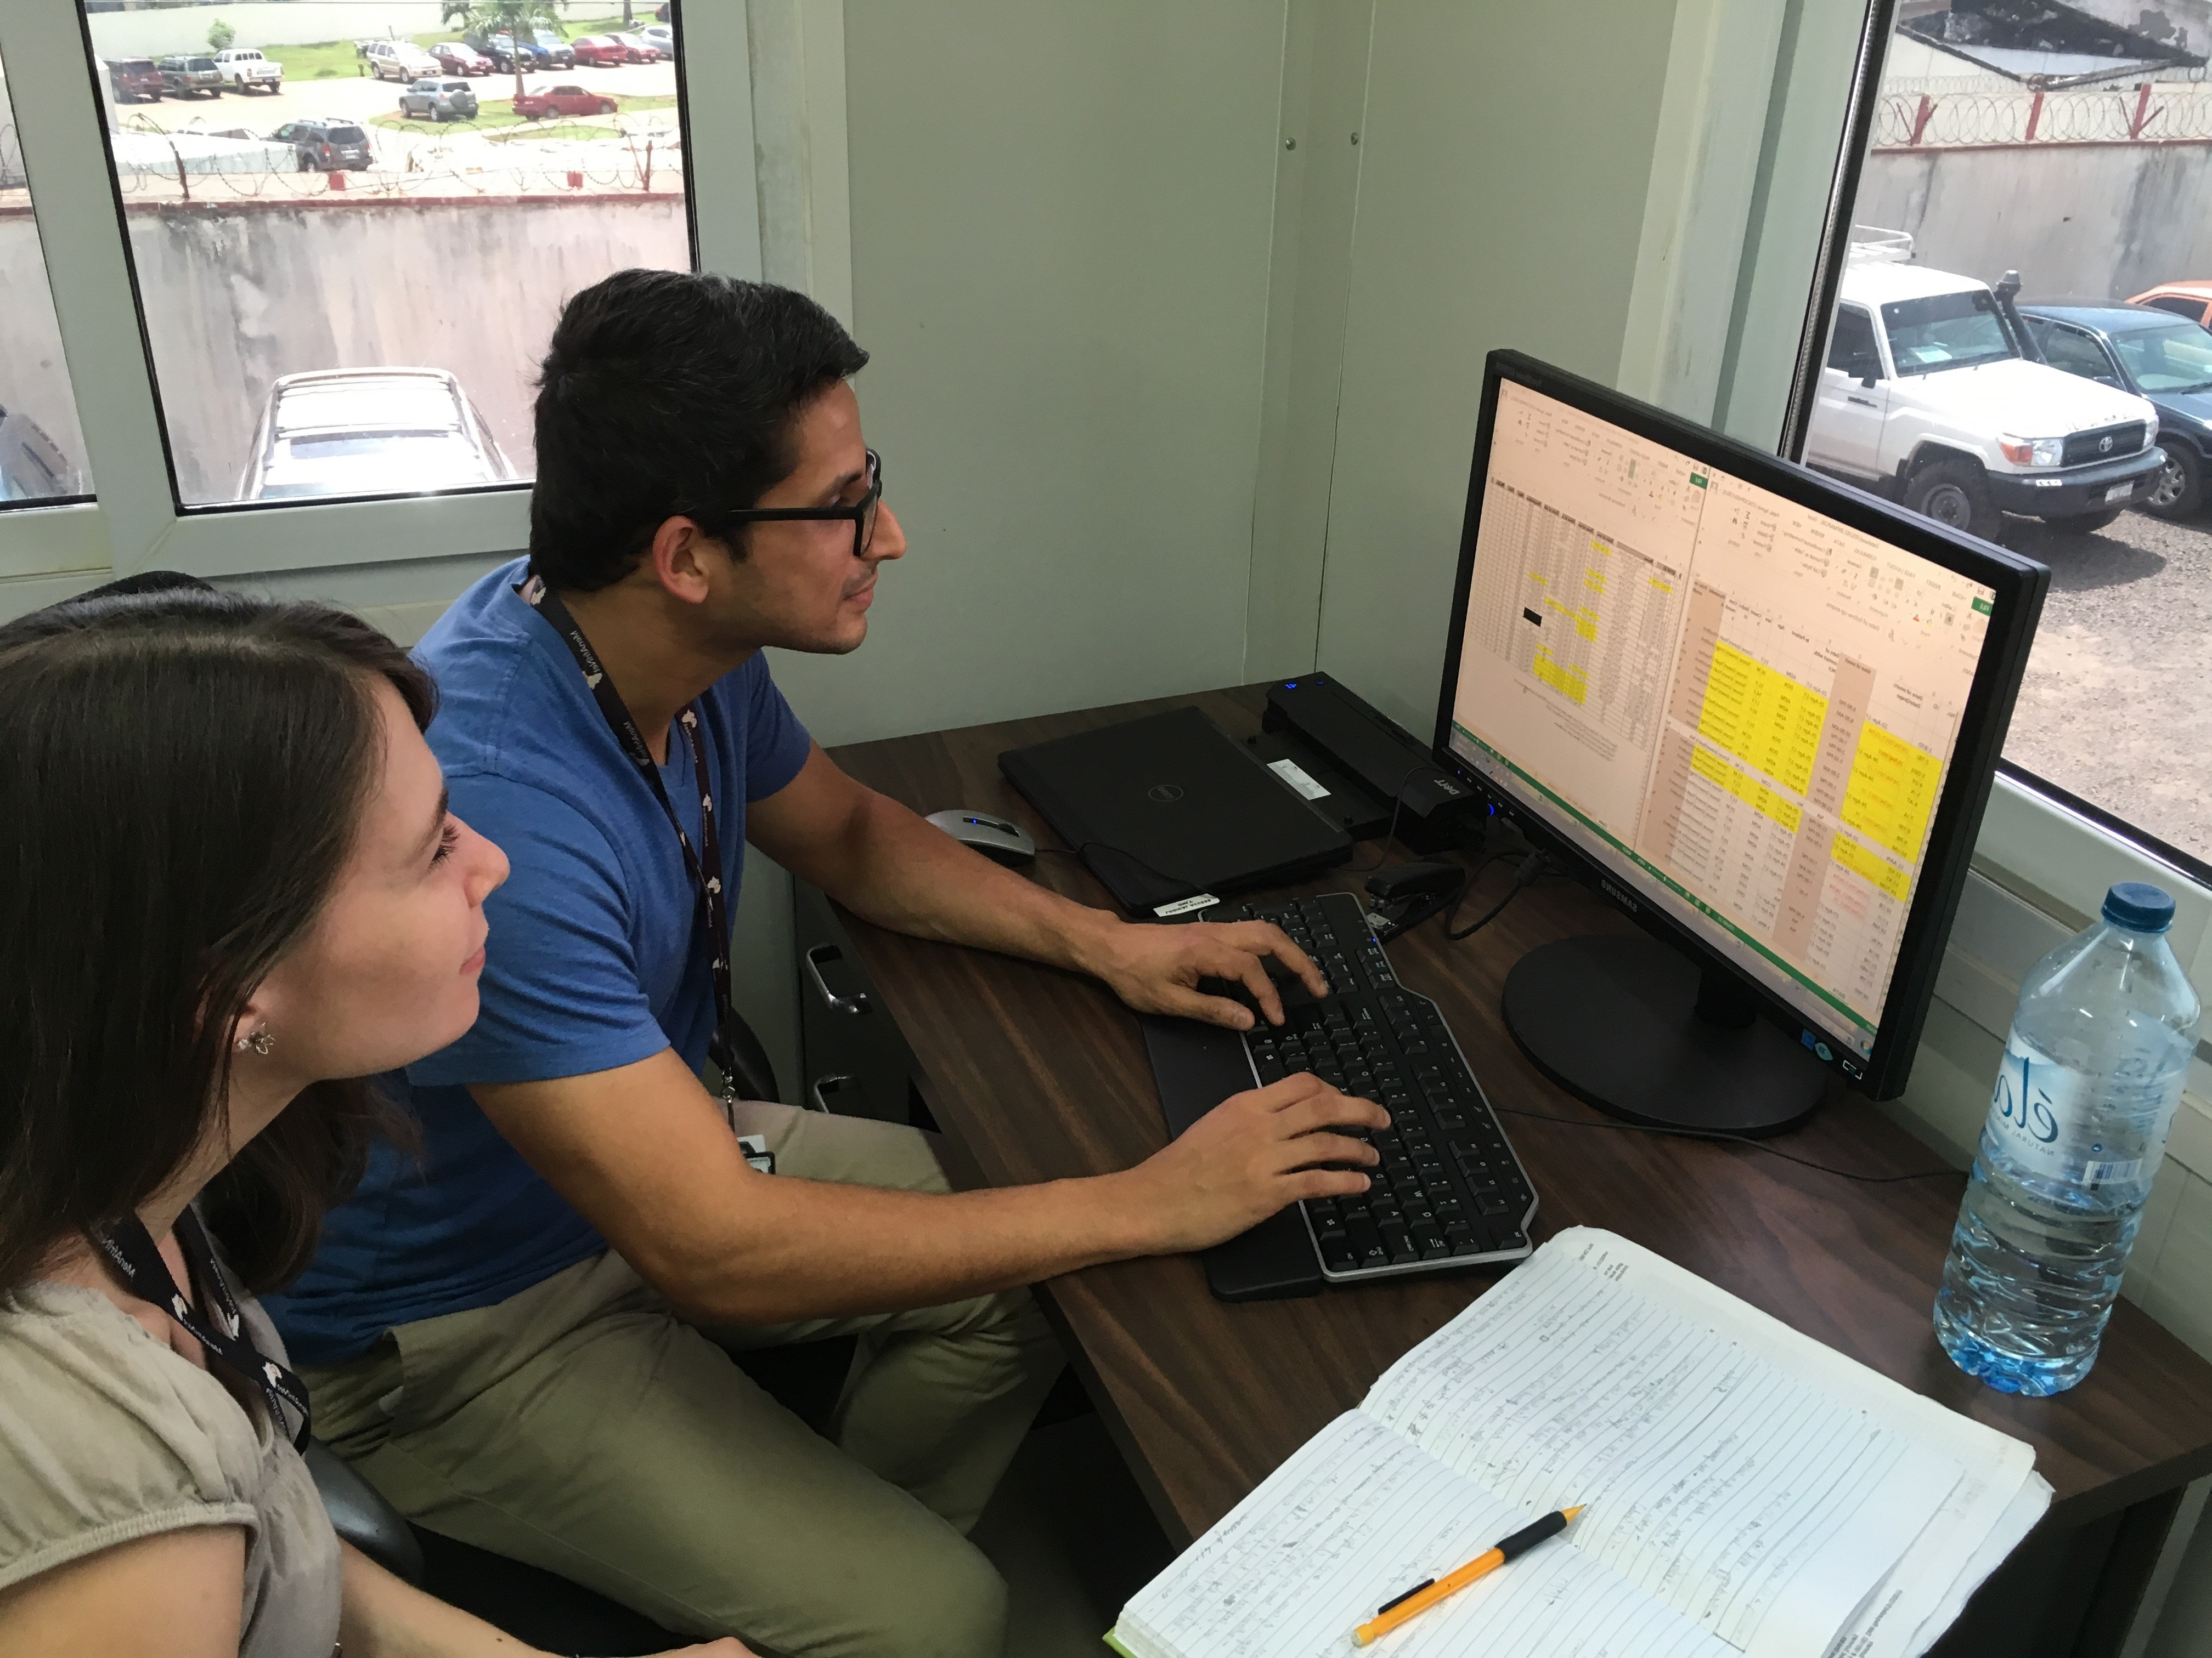
ON THE FRONT LINES
ON THE FRONT LINES

Slide 4
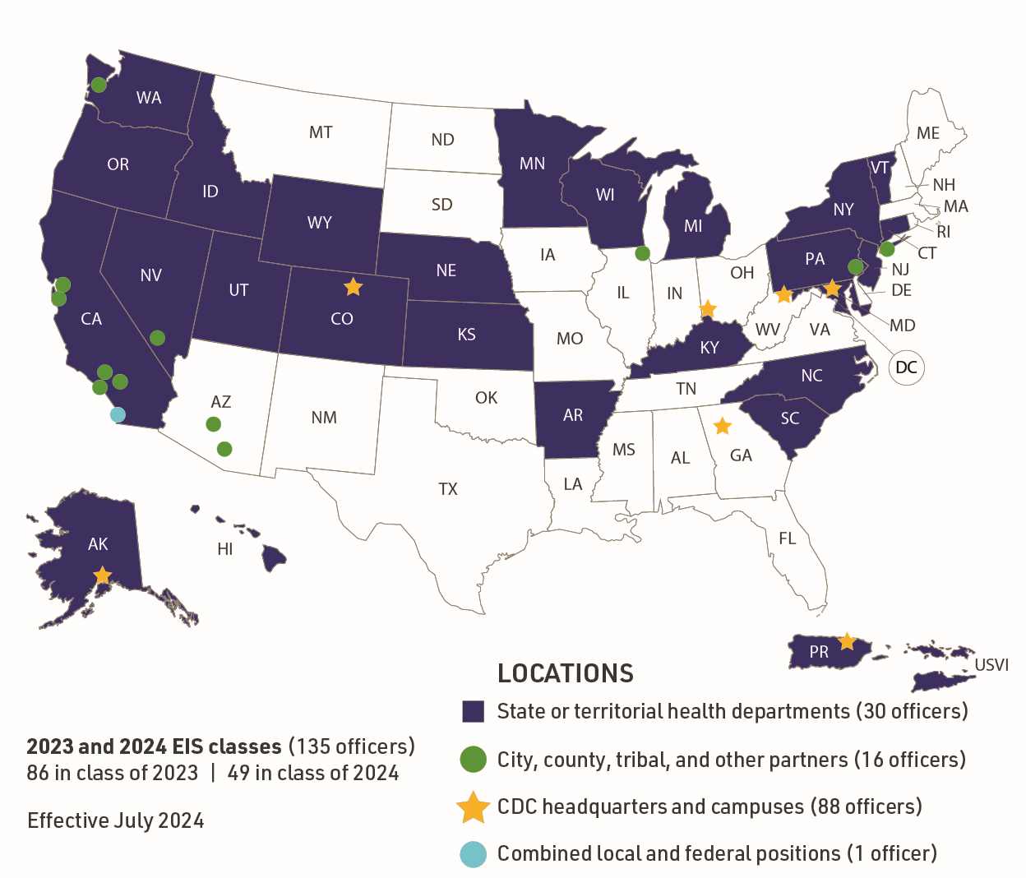
2021 & 2022 EIS Classes
2023 & 2024 EIS Classes
86 in class of 2023 | 49 in class of 2024
Notes:
This map reflects the assigned locations for EIS officers in the classes of 2023 and 2024 across the United States, including CDC headquarters in Atlanta, our field stations in Alaska; Fort Collins, Colorado; the District of Columbia; and the U.S. Virgin Islands. (Assignments are made for EIS officers’ two-year fellowship and do not reflect deployments for Epi-Aids or other emergency response efforts.)
EIS officers placed in the field are embedded in state, tribal, local, and territorial health departments where they work side by side with local public health staff.

Slide 5

EIS OFFICERS ARE
EIS
OFFICERS
ARE . . .
Notes:
CDC’s disease detectives who come from a variety of disciplines with an interest in field experience and a passion for service.
Allied healthcare professionals
Doctoral level scientists (e.g., epidemiologists, microbiologists, psychologists)
Nurses
Physicians
Veterinarians
Pictured: Keisha Lindsay Nurse, PhD, MA (EIS ‘22) presents a TED-style talk about the impact of homicide within Black communities. His is assigned to work in the Los Angeles County Public Health Department.
Her education:
Post-doctoral fellowship: New York University, Communicative Sciences and Disorders
PhD: Howard University, Communication Sciences and Disorders
MA: Queens College, Speech-Language Pathology
BS: New York University, Speech-Language Pathology and Audiology/Education

Slide 6
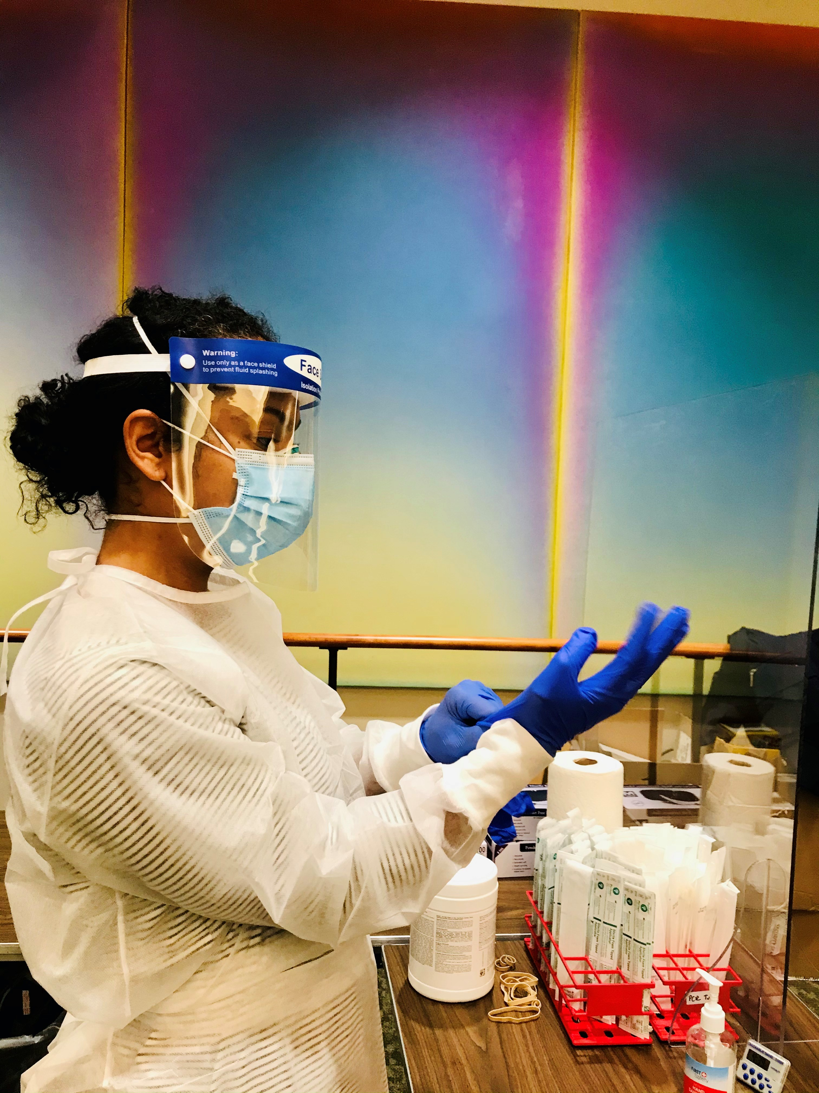
WHY EIS?
Notes:
The EIS program is the world’s longest-running field epidemiology training program.
EIS officers are employed by CDC where they are supervised and mentored by epidemiologists and other scientists recognized as subject matter experts in their respective fields.
In this photo, EIS officer Miriam Van Dyke (EIS 2020) helps collect swab samples for a validation study of a rapid antigen test for COVID-19.

Slide 7
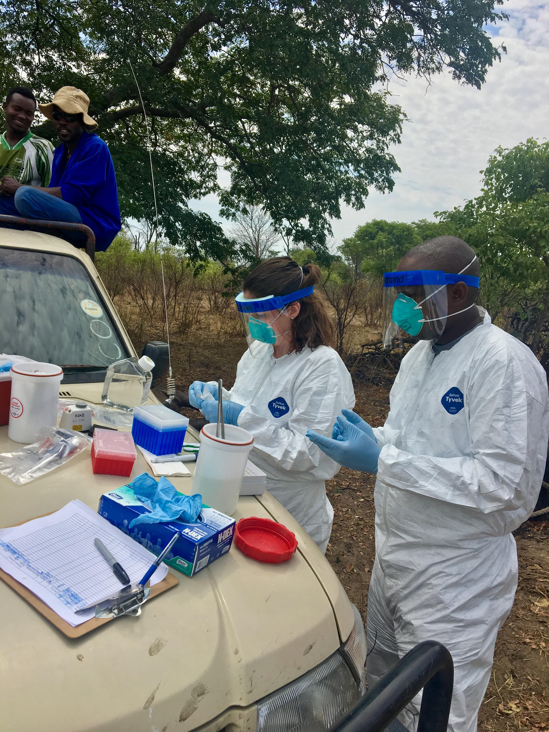
THERE’S NOTHING LIKE IT
Notes:
EIS provides officers with:
2 years on-the-job learning and field work
You are guided by CDC experts and EIS alumni
Unparalleled opportunities
Work as part of interdisciplinary teams to detect and respond to new and ongoing public health threats.
Like Kelsey Sumner (EIS Class of 2021) pictured here in Mwanza, Tanzania during a poliovirus response in June 2022.
As an EIS officer, you’ll…
Have opportunities to work at CDC and state/local health departments
Be part of interdisciplinary teams
Contribute as part of a service and learning program

Slide 8
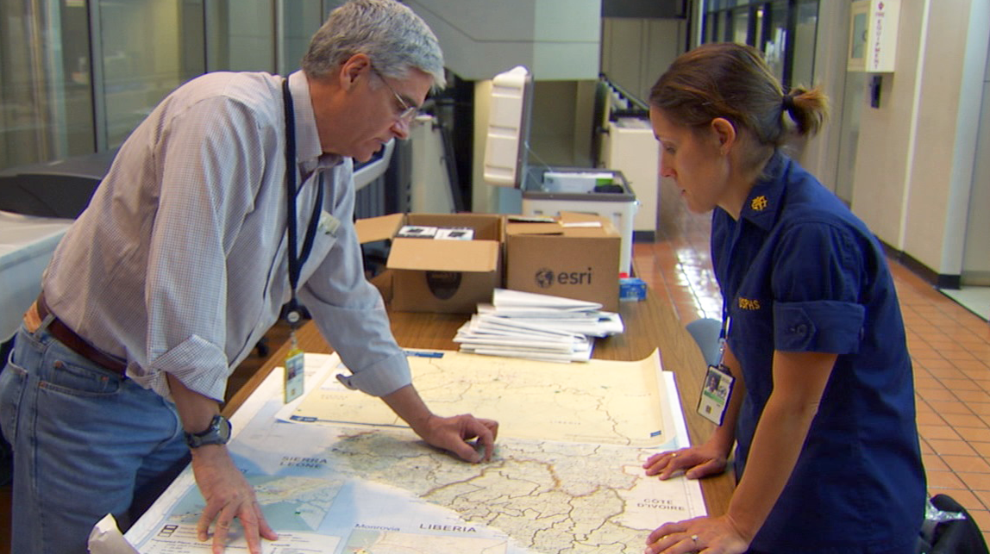
WHERE COULD EIS TAKE YOU?
Notes:
EIS is a gateway to a strong foundation and a successful career in public health.

Slide 9

More than 95%
97%
of recent EIS graduates continue
in public health-related positions

Slide 10
More than 95%
Recent EIS alumni stay with CDC and
State, Tribal, Local, and Territorial Health Departments
82%
work in U.S. government (126/153)
Notes:
Among recent alumni (from the classes of 2020, 2018, and 2016) who are employed, 82% work in the U.S. government. 61% work at CDC, 13% work at domestic STLT agencies, and 8% work at other federal agencies. Among those that work at domestic STLT agencies, 10 work at the city or county level, 9 work at the state level, and 1 works for a tribal government equivalent organization/coalition (zero reported being employed in a U.S. territorial and freely associated state government agency).
Data Source: 2023 Alumni Survey
Response rate: 77% (153/200)
The Alumni Survey is an annual survey sent to EIS alumni 1-, 3-, and 5-years post graduation. These time points were chosen, in collaboration with DWD Matrix Evaluation Team representatives, to monitor alumni career progression over time.

Slide 11
More than 95%
Recent EIS alumni stay with CDC and
State, Tribal, Local, and Territorial Health Departments
82%
work in U.S. government (126/153)
61%
work at CDC
(94/153)
Notes:
Among recent alumni (from the classes of 2020, 2018, and 2016) who are employed, 82% work in the U.S. government. 61% work at CDC, 13% work at domestic STLT agencies, and 8% work at other federal agencies. Among those that work at domestic STLT agencies, 10 work at the city or county level, 9 work at the state level, and 1 works for a tribal government equivalent organization/coalition (zero reported being employed in a U.S. territorial and freely associated state government agency).
Data Source: 2023 Alumni Survey
Response rate: 77% (153/200)
The Alumni Survey is an annual survey sent to EIS alumni 1-, 3-, and 5-years post graduation. These time points were chosen, in collaboration with DWD Matrix Evaluation Team representatives, to monitor alumni career progression over time.

Slide 12
More than 95%
Recent EIS alumni stay with CDC and
State, Tribal, Local, and Territorial Health Departments
82%
work in U.S. government (126/153)
61%
work at CDC
(94/153)
13%
work in domestic State, Territorial, Tribal, Local
(20/153)
Notes:
Among recent alumni (from the classes of 2020, 2018, and 2016) who are employed, 82% work in the U.S. government. 61% work at CDC, 13% work at domestic STLT agencies, and 8% work at other federal agencies. Among those that work at domestic STLT agencies, 10 work at the city or county level, 9 work at the state level, and 1 works for a tribal government equivalent organization/coalition (zero reported being employed in a U.S. territorial and freely associated state government agency).
Data Source: 2023 Alumni Survey
Response rate: 77% (153/200)
The Alumni Survey is an annual survey sent to EIS alumni 1-, 3-, and 5-years post graduation. These time points were chosen, in collaboration with DWD Matrix Evaluation Team representatives, to monitor alumni career progression over time.

Slide 13
More than 95%
Recent EIS alumni stay with CDC and
State, Tribal, Local, and Territorial Health Departments
82%
work in U.S. government (126/153)
61%
work at CDC
(94/153)
13%
work in domestic State, Territorial, Tribal, Local
(20/153)
8%
work at other
federal agencies
(12/153)
Notes:
Among recent alumni (from the classes of 2020, 2018, and 2016) who are employed, 82% work in the U.S. government. 61% work at CDC, 13% work at domestic STLT agencies, and 8% work at other federal agencies. Among those that work at domestic STLT agencies, 10 work at the city or county level, 9 work at the state level, and 1 works for a tribal government equivalent organization/coalition (zero reported being employed in a U.S. territorial and freely associated state government agency).
Data Source: 2023 Alumni Survey
Response rate: 77% (153/200)
The Alumni Survey is an annual survey sent to EIS alumni 1-, 3-, and 5-years post graduation. These time points were chosen, in collaboration with DWD Matrix Evaluation Team representatives, to monitor alumni career progression over time.

Slide 14


EIS Alumni Assume Key Leadership Roles
EIS alumni assume key leadership roles in
State, Tribal, Local, and Territorial Health Departments
34%
Of State Epidemiologists

Slide 15
EIS Alumni Assume Key Leadership Roles
EIS alumni assume key leadership roles in
State, Tribal, Local, and Territorial Health Departments
34%
Of State Epidemiologists
45%
Of State Public Health Veterinarians

Slide 16
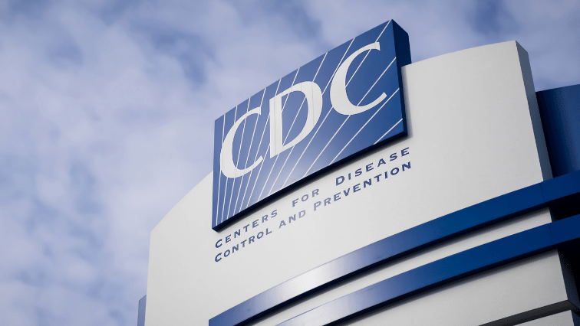
4 of the last 11
4 of the last 12
CDC Directors are EIS alumni

Slide 17
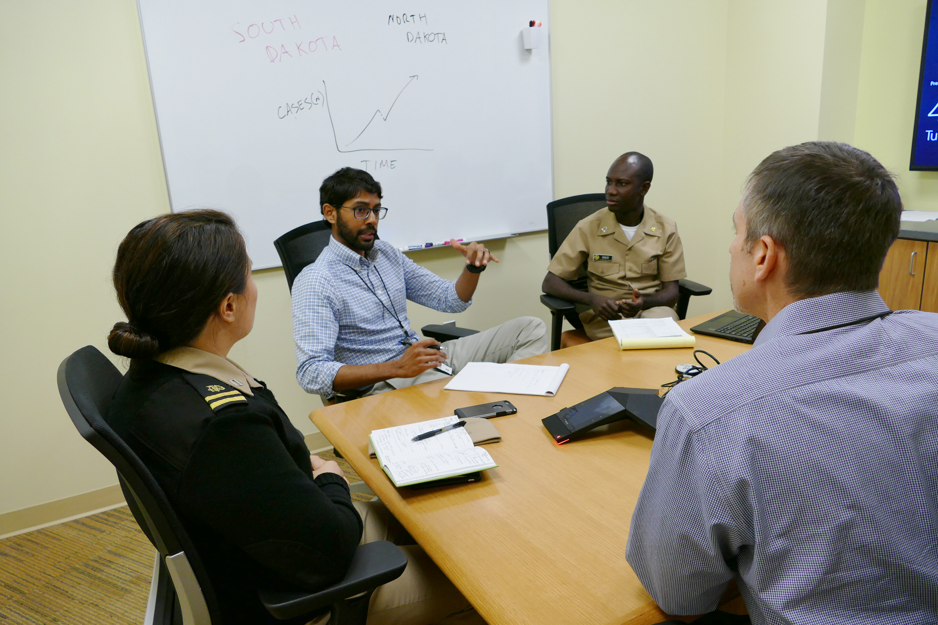
Ready to make a difference?
Notes:
Are you ready to join EIS and make a difference?
Go to our website and check eligibility
Apply in the spring
To hear about the experiences of an EIS officer, check out their stories on the EIS website.

Slide 18
How to Apply
EIS class of 2026
Tentative Application Period: March - June 2025
Notes:
Applications for the EIS Class of 2026 will open on March 3, 2025 9 AM ET to June 5, 2025 5 PM ET. No late applications will be accepted. In most cases you need a doctoral level degree or a clinical license. MPH is not sufficient.

Slide 19
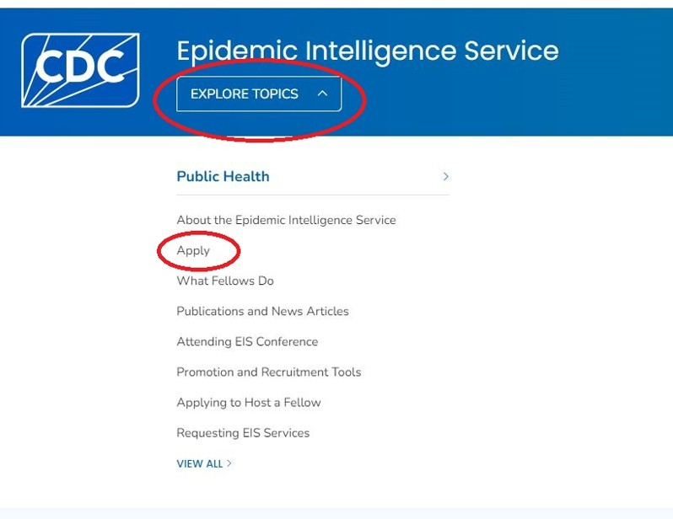
EIS Website
www.cdc.gov/eis

Slide 20
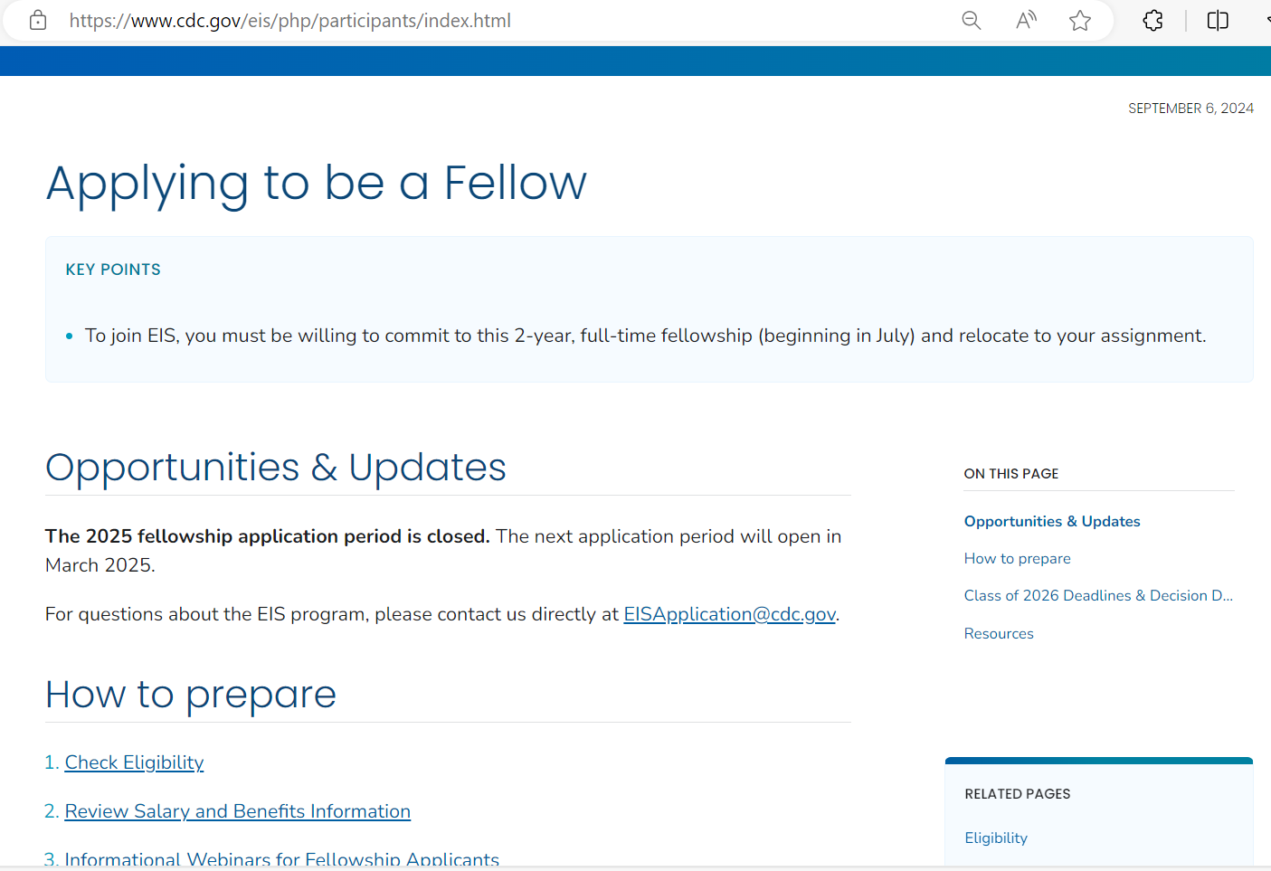
Applying to be a Fellow

Slide 21
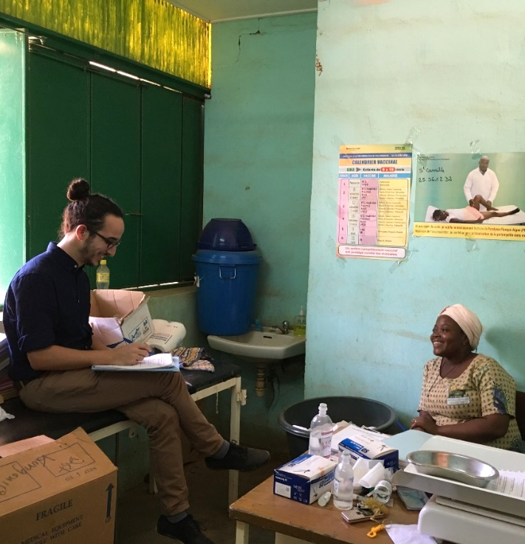
Learn More
LEARN
MORE
www.cdc.gov/eis
www.cdc.gov/fellowships
Notes:
Pictured here is Dr. Amen Ben Hamida (EIS ‘17) from CDC's Emergency Response and Recovery Branch (ERRB) traveled to Burkina Faso on an International Epi-Aid to strengthen severe acute respiratory infection (SARI) sentinel surveillance ahead of the influenza season. Here, Dr. Ben Hamida interviews a Burkinabe health care worker to better understand how local staff use a standardized case definition to decide whether a case is "SARI" or "not SARI."
To learn more about EIS and become a Disease Detective like Amen, check our website and you can email us at the address provided.
Thank you for your time.

